Slide 1
Presentation to the North QLD Law Association
Alignment, Alienation and Estrangement
Children who Resist Contact with a Parent Post Separation
Erylin Rees
Director
Court Children’s Services Qld|SA|NT
27 May 2022

Slide 2
Introduction
Part 1
Understanding alignment and rejection
Part 2
Assessing alignment and rejection
Part 3
Therapeutic interventions with alignment and rejection

Slide 3
Parental Alignment and Rejection
The concept of children’s minds being “poisoned” dates back 100 years
Term of PAS coined by Gardner in 1985.
PAS described common patterns of behaviour of aligned parent to promote rejection of other parent leading to the child refusing visits and rejecting a parent
Notes:
Campaign of denigration
Weak, frivolous, or absurd rationalisations for the deprecation
Lack of ambivalence
The “independent thinker” phenomenon
Reflexive support of the alienating parent in the parental conflict
Absence of guilt over cruelty to and/or exploitation of the alienated parent
Presence of borrowed scenarios
Spread of the animosity to the friends and/or extended family of the alienated parent

Slide 4
Reformulation
PAS is a simplistic approach
Few, if any, cases ‘pure’ alienation – Irrational rejection of a parent by child due to campaign of denigration.
Differentiation of ‘child alienation’ and ‘realistic estrangement’
Naïve , active and obsessive ‘alienating’ parents
Even children who have experienced abuse can have attachment to and desire to see the abusive parent .
Witnessing family violence can turn the child against the abuser or against the victim

Slide 5
Dynamic factors
Children resisting time with a parent is dependent on a number of factors including
  each parent,
  extended family,
  siblings,
  aligned professionals
  importantly the child’s experiences

Slide 6
Reformulation of parental alignment and rejection
Kelly and Johnson (2001) “The alienated child” (refined Johnston and Sullivan 2020)
A child who expresses strong negative feelings and beliefs about a parent that do not reflect the child’s prior experience of that parent.
The alienated child demonstrates contemptuous and aggressive behaviours towards the rejected parent that are developmentally inappropriate.
The alienated child’s beliefs can be irrational or exaggerated, and are significantly disproportionate to their actual experience.
Does not include children who have experienced child abuse or family violence perpetrated by the parent they are rejecting.

Slide 7
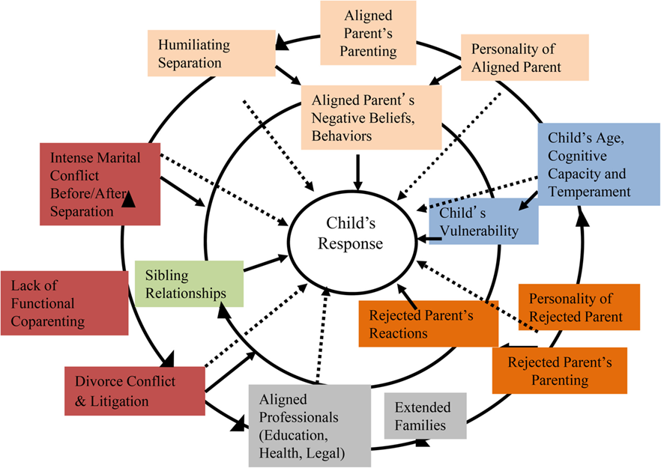
Johnston and Sullivan/ Parental Alienation: In Search of Common Ground For a More Differentiated Theory
Family Court Review, Volume: 58, Issue: 2, Pages: 270-292, First published: 28 April 2020

Slide 8
Dynamic and facilitating factors
Child factors
Parent conflict before and after the separation;
Sibling relationships;
Parent factors
Adversarial process/litigation;
Aligned professionals and extended family; and
Coparenting hostility
Notes:
age, cognitive capacity, temperament, vulnerability, special needs and resilience;
(parenting style and capacity, negative beliefs and behaviors, mental health, and personality, including responsiveness and willingness to change);

Slide 9
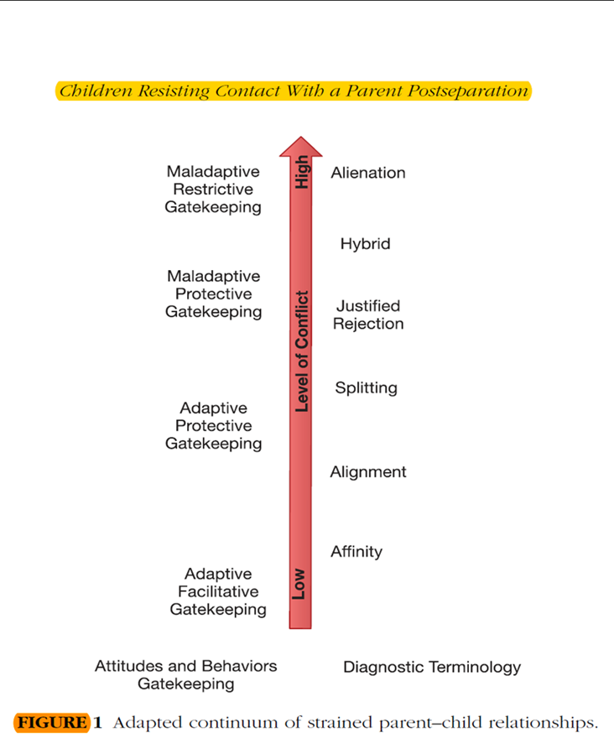
Adapted continuum of strained parent-child relationships
Polack and Saini 2015

Slide 10
Non – Aligned children / Affinity to one Parent
Positive relationships with both parents and child able to see some negatives about each
Differences in the child’s attachments and relationships with each parent, dependent on personalities and family roles.
Affinity towards a parent is flexible and can change over time with child’s expected development and changes in family. (e.g. younger children often prefer primary caregiver, middle childhood affinity for same gender while adolescence prefer least restrictive)

Slide 11
Aligned children
Children can be aligned with one parent for a range of different reasons relating to parenting style, gender, age, personality and interests.
Mild to moderate alignment with one parent is not uncommon in functional families and can vary depending on parenting roles, children’s ages and other variable factors
Siblings may each have different alignments
Aligned children do not completely reject the nonpreferred parent but are ambivalent about time
May be the result of one parent insensitivity and poor parenting skills, absence sense of moral indignation at separation

Slide 12
High conflict splitting
In high conflict separations children can be triangulated into the conflict and need to “pick a side” as an emotional survival mechanism. Children aged 9-11 are particularly vulnerable to this.
Younger children can split their experiences with both parents and appear to each parent to be rejecting of the other parent
Adolescence tend to be reflective of both sides

Slide 13
Rejecting children
Children can reject a parent due to their direct experience of mistreatment, assault or abuse of themselves or someone else by that parent.
This can include emotional abuse and be related to separated associated conflict or violence
The parent’s willingness, or lack thereof, to acknowledge their violence or mistreatment and it’s effect on the victim(s) can also be a significant factor in the child’s rejection.
A parent’s negative, critical or rejecting responses to a child’s alignment to the other parent can contribute to rejection of that parent.
Conditional love can lead to alignment and rejection: e.g. ‘I love you if you only love me’.

Slide 14
Realistically estranged children
Realistic estrangement is a justified, protective, and adaptive response to experience of trauma
Rejection of one parent due to child’s experience of the actions of that parent
Emotional distress experienced is congruent to their actual experience
May include emotional or physical trauma
Child may have some emotional ambivalence about the rejected parent, but unequivocal about no contact.
Favoured parent’s behavior may reinforce child’s position
Risk of re-traumatisation if forced contact

Slide 15
Alienated children
Child’s resistance primarily result of alienating parent’s conduct.
Prior to the separation the children had a “good enough” relationship with the parent
Near or complete rejection of one parent by the child – with little or no ambivalence about the rejected parent or the loss of a relationship with them.
Tend to use same language or complaints as the aligned parent.
Fusion or enmeshment in the thinking of the child and the parent they are aligned with.
Vague, false or exaggerated claims against rejected parent.
Tendency to become over involved in adult matters and disputes and have strong views on adult issues such as financial matters.
Act as a spy for aligned parent if visiting rejected parent
Most obvious and entrenched in older children: 8 – 16 years
Younger children can still be aligned but are less likely to maintain a strong rejection when they spend time with the rejected parent.
Rejection of the parent tends to increase with less time spent with that parent.

Slide 16
Parental Alienating Behaviours
Johnston and Sullivan (2020) have defined PAB as:
‘an ongoing pattern of observable negative attitudes, beliefs and behaviors of one parent (or agent) that denigrate, demean, vilify, malign, ridicule, or dismiss the child’s other parent’
Notes:
portraying the other parent as dangerous;
exaggerating and exploiting the other parent’s behavior, negative attributes and challenges;
undermining;
parentifying the child;
oversharing legal and other inappropriate information with children;
co-opting children as messengers, spies and confidants;
conspiring with children to withhold information, keep secrets and mislead the other parent;
serreptiously contacting the children when they are with the other parent;
withholding parenting time and being inflexible around scheduling;
withholding love and affection from the child if they do not share and act on the parent’s views;
disparaging the other parent’s family members;
co-opting neighbours, therapists, school personnel and others in an effort to garner support and turn them against the other parent; and
believing it is their right, supporting or permitting a child or adolescent to make a life altering decision to never see a parent again

Slide 17
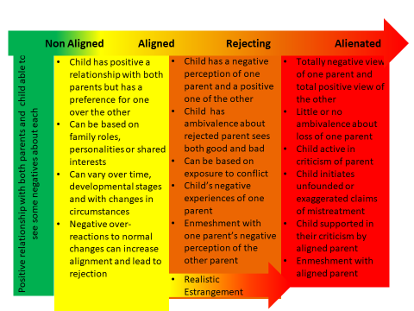
Post separation child-parent rel’ship continuum
.

Slide 18
Aligned Parent
Naïve
Passive about the child’s relationship with other parent
Critical of other parent, including to child
Accepts time with other parent where it is not problematic
Unaware of the influence they have on the child’s views/ feelings
Exposes child to their perspectives on parent conflict.
Active
knowingly attempts to influence the child to reject other parent
Has own motives based in their experience of or attitudes to the relationship/separation
Is aware their actions are seen as wrong and attempts to conceal their actions and motives
Escalates conflict
Obsessive
Denigration of other parent – open and directly to the children
Rarely has insight or self control
Determination to destroy child’s relationship with other parent and exclude them from their own and the child’s life
May be a perpetrator of family violence/child abuse – various types and degrees
May have personality disorder or psychiatric illness

Slide 19
Rejected Parent
Positive
Maintains a positive stance in relation to both the children and the other parent.
Wants to minimise conflict and maintain their relationship with the children.
Often confused and saddened by rejection.
Engages well with the children when with them, working through resistance in positive ways.
Reactive
Reacts angrily to rejection, both to children and other parent.
Escalates conflict.
Critical of other parent – sometimes to children.
Can be positive with children if they are not difficult or resistant.
Abusive
Denigration of other parent – open and directly to the children.
Angry and blaming.
Perpetrator of family violence/child abuse – various types and degrees.
May be causing realistic estrangement

Slide 20
Impact on children
Extensive research shows children of separated parents show better outcomes, emotionally, socially and academically when they maintain a relationship with both parents
Relationship problems
Lack of empirical research on long term impact of strained relationships between children and parents
Depends on severity, intensity of alienation and vulnerability of child
Age of the child

Slide 21
Assessment

Slide 22
Risks
Bias; Polarised and only focus on favoured or rejected parent
Not screening for fv, child abuse/neglect, substance abuse, mental illness
Only focus on child/ information from child’s therapist

Slide 23
Abuse allegations
Need to be assessed by Child Protection Authorities
Danger of system abuse to child of multiple interviews
Bias (occurred or is fabricated)

Slide 24
Assessment of Parents
Parents; attitude, beliefs, behaviours
Capacity to support relationship
History of family relationships
Capacity to be child focussed
Capacity of rejected parent to be a caregiver
Allegations of fv, child abuse;
Impact of ongoing court proceedings

Slide 25
Assessment children
Child; temperament, resilience, overall functioning
Experience of abuse or neglect, direct/indirect
Understanding of separation and conflict
Experience of the rejected parent
How the child has formed their views, have these views changed over time of not spending time with the rejected parent
Willingness to engage with parent, (how observations relate to interview responses)
How would child react if Ordered to spend time with a rejected parent
Impact of ongoing court proceedings

Slide 26
Interventions
Forensic assessment goal to provide information for Court processes, relies on neutral stance.
Therapeutic work relies on a therapeutic alliance involving building trust, providing a safe environment to explore and be vulnerable to expose self and try new behaviours.
When boundaries are crossed people will not be as open to the impact of therapy
Therapy can be effective after Orders change situation

Slide 27
Interventions

Slide 28
Development of resistance to contact is complex and multi-determined.
It is important court processes do not contribute
Need to be move beyond polarised responses
Multiple interventions including psychoeducation, CBT, behavioural skills training, family therapy depending on individual assessment of family

Slide 29
Progression of interventions
  Information to parents
  Therapy
  Focussed Intervention/ Reunification
  Change of caregiver (risks)
  Court Orders
  Consequences

Slide 30
When rejection is mild
Therapeutic input; with child to develop strengths, resilience and healthier attachments
with rejected parent : to develop empathy for the child’s emotions and needs and understanding of the children’s perspective
with favoured parent: to appreciate advantages for children to have a relationship with both parents
Education for parents, eg POP programmes and parenting capacity programmes
Supervised third party handover
Gradual increase in time

Slide 31
When rejection of a parent is moderate
Have assessment of individual family situation child’s previous relationships and current views
Reunification therapy
Clear orders
Counselling for parents to develop parallel rather than cooperative parenting practices
Supervised time
Orders for extended time with rejected parent

Slide 32
When rejection of a parent is absolute
Looking for the least detrimental solution short and long term
Assessment of risk to stay with favoured parent.
Clear and specific Orders (involuntary participants in treatment)
Can rejected parent care for the child
No research on change of residence success
Weigh up competing risks eg; Consider how child will react/ running away/ self harm
If rejected parent is to walk away assistance with ways to keep the “door open” for future contact
Favoured parent to keep rejected parent informed of child’s progress

Slide 33
Factors for success
Early intervention
Younger age of the child
Realistic expectations/ connections not nec contact
Capacity of parents to communicate
Co-parenting dynamics
Ability of parent to have good experiences with the child
Absence of abuse
Clear court orders to the protect the child’s relationship with both parents.

Slide 34
Case Example
Oscar’s parents separated when he was 6 years old
Prior to the separation the mother was the primary caregiver while the father was a FIFO worker spending 4 weeks away and 2 weeks at home
Rel’ship before sep is described differently by parents with the mo describing the fa as being controlling and the fa describing verbal conflict
At sep Oscar continued to live with mo and spend time with his father when he was in town
Oscar became increasingly reluctant to spend time and by the age of 8 refused to spend time

Slide 35
Mo says Oscar experienced fa being abusive to her and that he had physically disciplined Oscar
Fa says time was fine before he repartnered.
Fa also says while Oscar initially protested at sep from mo he would settle once in his care
Mediation was attempted with no success
A counsellor has interviewed Oscar and his mo and is concerned Oscar might have experienced more abuse at his fa’s hands

Slide 36
Child Factors
Oscar is a boy who has learning difficulties and struggles with his peer group at school
He has missed a significant amount of time at school
He identified that he is close to his mo who provides for his needs

Slide 37
Aligned mother
Described the fa as being absent in first years and only having a rel with Oscar because she supported it
Grief at the end of the marital rel
Fear that the fa would let down Oscar in the future
Powerless to force Oscar to go against his will to his fa

Slide 38
Rejected father
Agreed Oscar has a good rel with his mo and that she has met the majority of his needs
Thought the mo was refusing to allow Oscar to have a rel with him due his new rel and mo and her family are denigrating him to Oscar
Agreed the marriage had been conflictual although mutualised the conflict

Slide 39
Issues to explore
How can Oscar’s individual characteristics/ vulnerabilities be explored? What might be looking for?
What further information would be useful to know from outside agencies?
What weight should be placed on the counsellor’s opinion?
What parental factors need to be taken into account?
What could assist Oscar and his parents in this situation?

Slide 40
Challenges
Can alienating parents be good enough parents?
At what age is it “too late”?
Early intervention is most likely to succeed, but is more likely to be based on incomplete assessment.
The use of court processes increases pre existing negative feelings of children towards a rejected parent.
Is the emotional and relationship damage associated with court action worse for the child than the long term harm of the alienation?

Slide 41
Questions

