Slide 1

Advocacy and Vulnerable Witnesses: tips, traps and techniques
Joshua Treviño QC

Slide 2
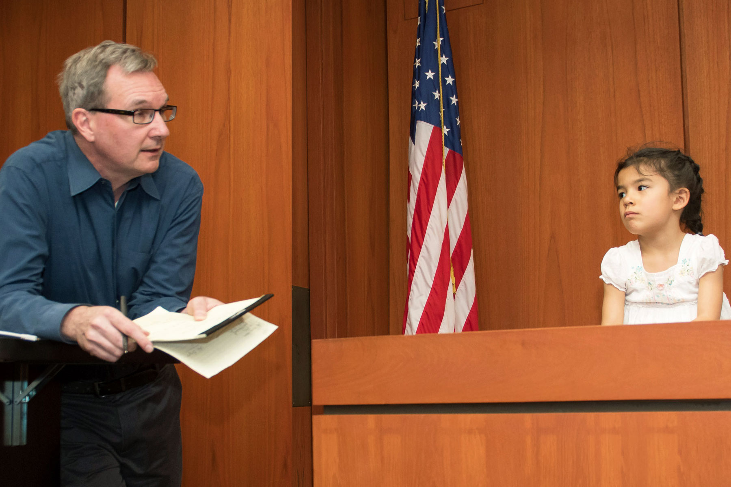

Slide 3
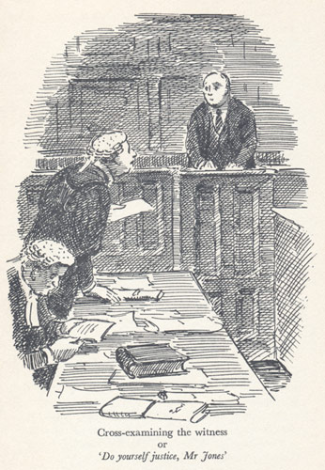
“Not even the abuses, the mishandlings, and the puerilities which are so often found associated with cross-examination have availed to nullify its value. It may be that in more than one sense it takes the place in our system which torture occupied in the mediaeval system of the civilians. Nevertheless, it is beyond any doubt the greatest legal engine ever invented for the discovery of truth. However difficult it may be for the layman, the scientist, or the foreign jurist to appreciate this its wonderful power, there has probably never been a moment’s doubt upon this point in the mind of a lawyer with experience. “You can do anything,” said Wendell Phillips, “with a bayonet – except sit upon it”. A lawyer can do anything with a cross-examination – if he is skilful enough not to impale his own cause upon it.”
John Henry Wigmore, Evidence in Trials at Common Law (Little, Brown and Company, 3rd ed, 1974) vol 5, 32.

Slide 4
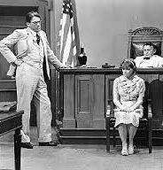
“In short, conventional cross-examination relies heavily on questions and tactics which are developmentally inappropriate, confusing and distressing for child witnesses, and likely to decrease the quality and quantity of their evidence. Indeed, the negative impact of cross-examination-styled questions on children’s accuracy has been demonstrated repeatedly in experimental studies. However, reforming cross-examination presents a particular challenge because conventional practice is supported, first, by widespread ignorance of children’s language development and safe questioning practice and, second, by strong traditions which validate manipulative and suggestive questioning as part of proper advocacy and the right to a fair trial.”
(McGregor, K. 2017, “Child witnesses in the NZ criminal courts: Issues, responses and opportunities”)

Slide 5
Ward (a Pseudonym) v R [2017] VSCA 37:
“10 …[T]he cross-examination of a child complainant … is a task of considerable complexity, requiring great care and sensitivity. Where the purpose of the cross-examination is to undermine the child’s credibility and/or to cast doubt on the child’s account of the accused’s conduct, defence counsel face two related forensic challenges. Both are governed largely by the dictates of fairness to a child witness.
11 The first challenge is to formulate questions which are age-appropriate. This is necessary as a matter of basic fairness to the child witness, so that he or she can understand the questions and respond. But it is equally important in the interests of the accused. Unless the questions are age-appropriate, answers which appear to create inconsistencies in the evidence are unlikely to serve the desired purpose of creating a doubt in the minds of the jury or — on appeal — of persuading this Court that the jury ‘must have had a doubt’ about the evidence.
12 The second challenge is that, so far as practicable in the circumstances, the child witness must be given the opportunity to say whether something they have said, and which the accused disputes, is true. This is the obligation of fairness to which expression is given in the rule in Browne v Dunn. The content of this obligation is, of necessity, different in the case of young children, who will not generally respond with understanding or accuracy to a formal challenge to their evidence, or ‘puttage’ as to the accused’s case. As a result, there is a significant risk that they will accept suggestions made to them by cross-examining counsel without understanding their implications.”

Slide 6


Slide 7
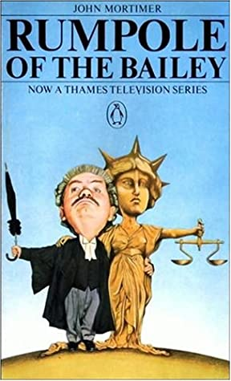

Slide 9


Slide 10
Evidence Act 1977 –
Part 2 – Division 4A –
Evidence of Affected Children
Operational from 5 January 2004

Slide 11
Section 9E - Principles for dealing with a child witness
(1) Because a child tends to be vulnerable in dealings with a person in authority, it is the Parliament’s intention that a child who is a witness in a proceeding should be given the benefit of special measures when giving the child’s evidence.
(2) The following general principles apply when dealing with a child witness in a proceeding—
(a) the child is to be treated with dignity, respect and compassion;
(b) measures should be taken to limit, to the greatest practical extent, the distress or trauma suffered by the child when giving evidence;
(c) the child should not be intimidated in cross-examination;
(d) the proceeding should be resolved as quickly as possible.
(3) In this section —
child means a child under 16 years.

Slide 12
Section 21 – Improper questions
(1) The court may disallow a question put to a witness in cross-examination or inform a witness a question need not be answered, if the court considers the question is an improper question.
(2) In deciding whether a question is an improper question, the court must take into account —
(a) any mental, intellectual or physical impairment the witness has or appears to have; and
(b) any other matter about the witness the court considers relevant, including for example, age, education, level of understanding, cultural background or relationship to any party to the proceeding.
(3) …
(4) In this section —
improper question means a question that uses inappropriate language or is misleading, confusing, annoying, harassing, intimidating, offensive, oppressive or repetive.

Slide 14
Evidence Act 1977
Part 2 – Division 4C - Intermediaries
Operational from 5 July 2021

Slide 15
Section 21AZM - Functions
(1) An intermediary for a witness in a relevant proceeding has the following functions in relation to the witness’s evidence in the proceeding—
(a) to communicate or explain to the witness questions put to the witness, to the extent necessary to enable the witness to understand the questions;
(b) to communicate or explain to a person asking questions of the witness the answers given by the witness in reply, to the extent necessary to enable the person to understand the answers.
(2) An intermediary for a witness in a relevant proceeding also has the functions conferred on the intermediary under subdivision 3 in relation to directions hearings.
(3) In performing a function under this division, an intermediary—
(a) is an officer of the court; and
(b) must act impartially.

Slide 16
Section 21AZJ – Meaning of relevant proceeding
(1) A relevant proceeding is a criminal proceeding—
(a) for a child sexual offence; and
(b) held before a court at a place prescribed by regulation.
(2) For subsection (1)(a), it does not matter whether the criminal proceeding also relates to other offences.
(3) In this section— child sexual offence means an offence of a sexual nature committed in relation to a child, including, for example, an offence against a provision of the Criminal Code, chapter 22 or 32.

Slide 17

Pilot scheme operational in Brisbane and Cairns with review in July 2023.
Intermediary schemes already operating in NSW, Victoria, ACT, SA and Tasmania.

Slide 18
childabuseroyalcommission.gov.au

Slide 19
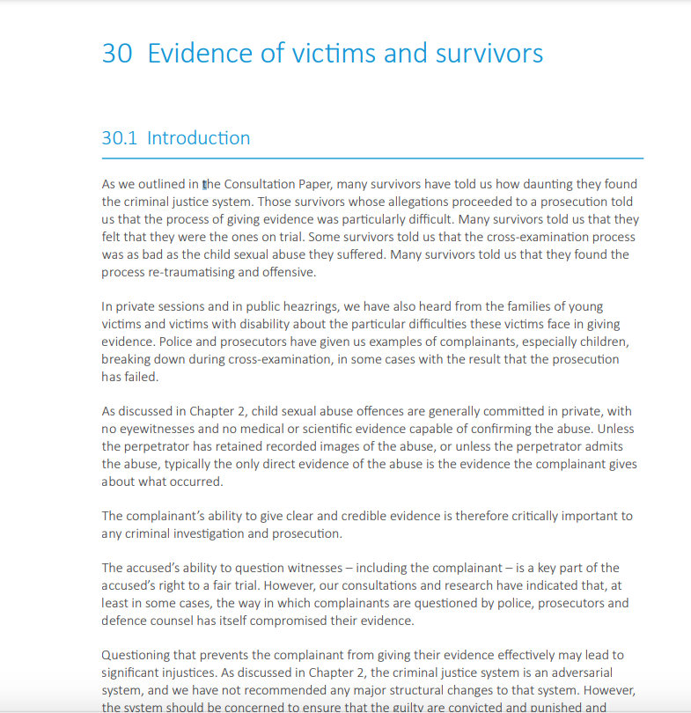

Slide 20
The accused’s ability to question witnesses – including the complainant – is a key part of the accused’s right to a fair trial. However, our consultations and research have indicated that, at least in some cases, the way in which complainants are questioned by police, prosecutors and defence counsel has itself compromised their evidence.
Questioning that prevents the complainant from giving their evidence effectively may lead to significant injustices. As discussed in Chapter 2, the criminal justice system is an adversarial system, and we have not recommended any major structural changes to that system. However, the system should be concerned to ensure that the guilty are convicted and punished and not just that the innocent are acquitted. This requires that the complainant be given a good opportunity to give their ‘best evidence’.
By ‘best evidence’, we mean the most complete and accurate evidence a witness is able to give.
The term ‘best evidence’ has been used in England and Wales and Australia to describe the goal of ensuring children and vulnerable witnesses are able to give a complete and accurate account as a witness in criminal proceedings.

Slide 21
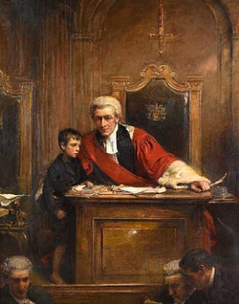
Ward (a Pseudonym) v The Queen [2017] VSCA 37 at [96] – [192]

Slide 22
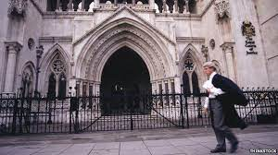
The Advocate’s Gateway
Took Kit 1, 2, 6 and 16
www.theadvocatesgateway.org

Slide 23
Second Reading Speech 27/11/2019
“Importantly, the bill also incorporates further amendments to provide the legislative basis to support a pilot program for intermediaries. The Palaszcuk government is giving a voice to vulnerable victims of child sexual abuse through the provision of funding to support establishment of a pilot Queensland intermediary scheme.
The Criminal justice report recommended intermediary schemes be established to mitigate the difficulties that witnesses, including survivors and victims, in child sexual abuse matters may experience in participating in the criminal justice process. At the investigation stage of a child sexual abuse matter, police may request an intermediary through the Queensland Intermediary Scheme’s matching service to support a witness to give their most complete and accurate evidence. Under the provisions in the bill, courts will be able to appoint qualified intermediaries for prosecution witnesses who are under 16 years, or have an impairment of the mind, or have difficulty communicating, or fall within another class of persons prescribed under regulation.
The bill provides for pre-trial hearings to enable the court to give directions about communication issues-which the royal commission referred to as ‘ground rules’ hearings. The intermediary, who is an independent impartial officer of the court, ensures the witness understands the questions being put to them and is given the opportunity to give their best evidence.
Not only will the use of intermediaries ensure that the best evidence is obtained from the witness for the police and courts to assess the child abuse case properly; the communication support provided by the intermediary will also reduce the stress experienced by these vulnerable witnesses in criminal justice proceedings. These proceedings can b e daunting and intimidating for any witness but particularly for a child, someone with an impairment of the mind or someone who has difficulty communicating.”

Slide 24
(1) The court must, on making the order under which the intermediary is appointed, give a direction that a hearing under this subdivision (a directions hearing) be held in relation to the giving of evidence by the witness in the relevant proceeding.
(2) Subsection (1) does not prevent the court, with the consent of the parties to the relevant proceeding, holding the directions hearing immediately after making the order mentioned in subsection (1).
(3) Also, at any stage of the relevant proceeding, the court may, on its own initiative or on the application of a party to the proceeding, give a direction that a further directions hearing be held in relation to the giving of evidence by the witness in the proceeding.
(4) In giving a direction under subsection (1) or (3) for the holding of a directions hearing, the court may, if it considers it appropriate, direct that—
(a) the intermediary prepare a written report for the court that states—
(i) the communication needs of the witness; and
(ii) the intermediary’s recommendations about the most effective way to communicate with the witness; or
(b) a stated person attend the hearing.
(5) The intermediary must comply with a direction given under subsection (4)(a).
Section 21AZM - Directions for holding directions hearings

Slide 25
Section 21AZQ Attendance at directions hearing
The following persons must attend a directions hearing held in the relevant proceeding—
(a) the prosecutor or a person representing the prosecutor;
(b) the legal practitioner representing the defendant or, if the defendant is unrepresented, the defendant;
(c) the intermediary;
(d) a person directed to attend the directions hearing under section 21AZP(4)(b).
(2) The witness may, but is not required to, attend the directions hearing.
(3) Subsections (1) and (2) apply subject to any direction of the court.

Slide 26
21AZR - Functions of intermediary at directions hearing
(1) The intermediary must, at a directions hearing held in the relevant proceeding—
(a) inform the court of the communication needs of the witness; and
(b) recommend to the court the most effective way to communicate with the witness.
(2) The information and recommendations may be given or made in any way the court considers appropriate, including, for example—
(a) in a report prepared in compliance with a direction given under section 21AZP(4)(a); or
(b) in a report prepared by the intermediary before the intermediary was appointed for the witness.

Slide 27
Section 21AZS - Court may give directions
(1) The court may, at a directions hearing held in the relevant proceeding, give the directions about the giving of evidence by the witness that the court considers appropriate for the fair and efficient conduct of the proceeding.
(2) Without limiting subsection (1), a direction may be given about 1 or more of the following matters—
(a) the manner of questioning the witness;
(b) the duration of questioning the witness;
(c) the questions that may, or may not, be put to the witness;
(d) if there is more than 1 defendant—the allocation among the defendants of the topics about which the witness may be questioned;
(e) the use of models, plans, body maps or similar aids to—
(i) help communicate a question to be put to the witness; or
(ii) help the witness communicate an answer to a question put to the witness;
(f) the use of an audio visual link or another communication facility—
(i) to enable the witness and the intermediary to communicate with each other; or
(ii) for another purpose, including, for example, to enable the court, the prosecutor and the legal practitioner representing the defendant to communicate with the intermediary.
(3) In deciding whether to give a direction under this section, the court may have regard to the information given, and recommendations made, by the intermediary under section 21AZR.
(4) Subsections (1) and (2) do not limit the Criminal Code, section 590AA or the Justices Act 1886, section 83A.

Slide 28
Section 21AZS - Court may give directions
(1) The court may, at a directions hearing held in the relevant proceeding, give the directions about the giving of evidence by the witness that the court considers appropriate for the fair and efficient conduct of the proceeding.
(2) Without limiting subsection (1), a direction may be given about 1 or more of the following matters—
(a) the manner of questioning the witness;
(b) the duration of questioning the witness;
(c) the questions that may, or may not, be put to the witness;
(d) if there is more than 1 defendant—the allocation among the defendants of the topics about which the witness may be questioned;
(e) the use of models, plans, body maps or similar aids to—
(i) help communicate a question to be put to the witness; or
(ii) help the witness communicate an answer to a question put to the witness;
(f) the use of an audio visual link or another communication facility—
(i) to enable the witness and the intermediary to communicate with each other; or
(ii) for another purpose, including, for example, to enable the court, the prosecutor and the legal practitioner representing the defendant to communicate with the intermediary.
(3) In deciding whether to give a direction under this section, the court may have regard to the information given, and recommendations made, by the intermediary under section 21AZR.
(4) Subsections (1) and (2) do not limit the Criminal Code, section 590AA or the Justices Act 1886, section 83A.

Slide 29
The manner of questioning
Phrasing questions positively rather than negatively;
Using active rather than passive voice;
Separating questions on separate topics;
Use the child’s words to describe people, actions and objects;
Using signposting;
Discuss events in a logical sequence;
Include only one query in each question;
Avoid questions that may be taken too literally.
Avoid “Do you remember ?” questions.

Slide 30
Questions to Avoid
A risk of misunderstanding or unreliable compliance with:
Tag questions;
  “John didn’t touch you, did he?”
Questions requiring a yes/no response;
Questions in the form of statements (assertions);
  “And this correspondence started with you?”
Forced questions ( closed choice);
  “Did Bill or Jane open the door?”

Slide 31
Section 21AZS Court may give directions
(1) The court may, at a directions hearing held in the relevant proceeding, give the directions about the giving of evidence by the witness that the court considers appropriate for the fair and efficient conduct of the proceeding.
(2) Without limiting subsection (1), a direction may be given about 1 or more of the following matters—
(a) the manner of questioning the witness;
(b) the duration of questioning the witness;
(c) the questions that may, or may not, be put to the witness;
(d) if there is more than 1 defendant—the allocation among the defendants of the topics about which the witness may be questioned;
(e) the use of models, plans, body maps or similar aids to—
(i) help communicate a question to be put to the witness; or
(ii) help the witness communicate an answer to a question put to the witness;
(f) the use of an audio visual link or another communication facility—
(i) to enable the witness and the intermediary to communicate with each other; or
(ii) for another purpose, including, for example, to enable the court, the prosecutor and the legal practitioner representing the defendant to communicate with the intermediary.
(3) In deciding whether to give a direction under this section, the court may have regard to the information given, and recommendations made, by the intermediary under section 21AZR.
(4) Subsections (1) and (2) do not limit the Criminal Code, section 590AA or the Justices Act 1886, section 83A.

Slide 32
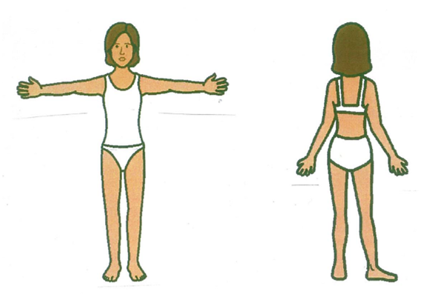
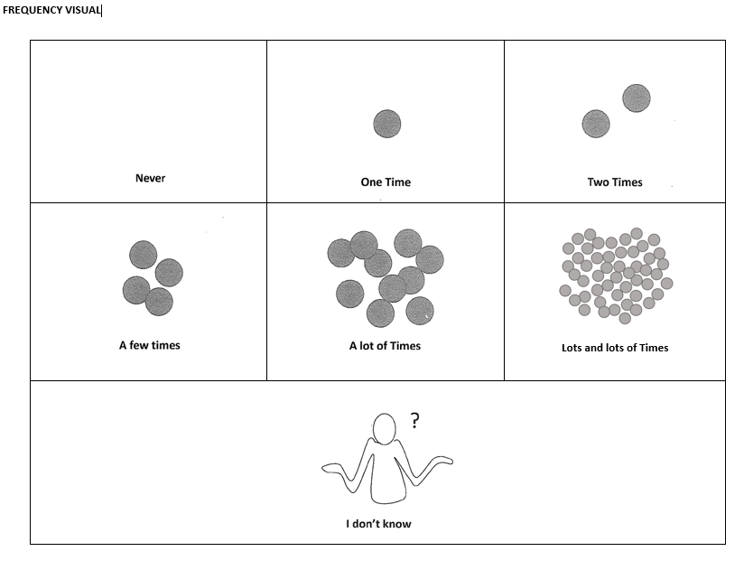
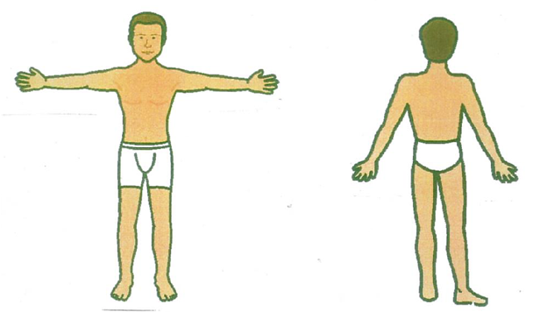

Slide 33
Section 21AZS Court may give directions
(1) The court may, at a directions hearing held in the relevant proceeding, give the directions about the giving of evidence by the witness that the court considers appropriate for the fair and efficient conduct of the proceeding.
(2) Without limiting subsection (1), a direction may be given about 1 or more of the following matters—
(a) the manner of questioning the witness;
(b) the duration of questioning the witness;
(c) the questions that may, or may not, be put to the witness;
(d) if there is more than 1 defendant—the allocation among the defendants of the topics about which the witness may be questioned;
(e) the use of models, plans, body maps or similar aids to—
(i) help communicate a question to be put to the witness; or
(ii) help the witness communicate an answer to a question put to the witness;
(f) the use of an audio visual link or another communication facility—
(i) to enable the witness and the intermediary to communicate with each other; or
(ii) for another purpose, including, for example, to enable the court, the prosecutor and the legal practitioner representing the defendant to communicate with the intermediary.
(3) In deciding whether to give a direction under this section, the court may have regard to the information given, and recommendations made, by the intermediary under section 21AZR.
(4) Subsections (1) and (2) do not limit the Criminal Code, section 590AA or the Justices Act 1886, section 83A.

Slide 34
At [121] of Ward:
‘It is assumed that an adult witness has the cognition, and the independence of will, to reject questions which contain a suggestion or assertion of the existence (or non-existence) of a particular fact. Such assumptions cannot be made in the case of a child witness. As already noted, a child’s vulnerability and the likelihood that they will assent to suggestive questions increase the risk that the child will give answers that are contradictory. As Bowden, Henning and Planter observed:
The rule in Browne v Dunn requires all relevant propositions that will later be relied on to be put to a witness. However, it is established that children and persons with intellectual disabilities are likely to become confused and either change their version of events or acquiesce in a contradictory account when challenged. Challenging a vulnerable witness’s testimony in accordance with Browne v Dunn and suggesting an alternative version of facts may not advance the pursuit of truth.’
Notes:
Bowden, Phoebe; Henning, Terese; Plater, David ‘Balancing fairness to victims, society and defendants in the cross-examination of Vulnerable Witnesses: An impossible triangulation?’ [2014] MelbULawRw 1; (2014) 37(3) Melbourne University Law Review 539 (citations omitted).

Slide 35
Browne v Dunn
Suggested form of questioning -
- “I’m going to say something to you X, now tell me if it is true, or not true. X was not there, true or not true?”
- “Is it true that….?”
- “X did not XXX, true or not true?”
- “X did not XXX, agree or disagree?”
To avoid: “X did not XXX, yes or no?” (Avoid NEGATIVE phrases with yes/no - is it not confusing that they are not - yes/no???)
To avoid: “Isn’t it true that…” (negative question)
To avoid: “you never saw him, did you?” (tag question)

Slide 36
At [125] – [126] of Ward:
“Although it is ordinarily a matter for counsel how they choose to cross-examine, fairness dictates that counsel should only ask questions in a form that is appropriate to the age of the child. As to compliance with the rule in Browne v Dunn, if counsel does not give the child a fair opportunity to respond to the attack that is to be made on their evidence, counsel runs the risk that their opponent, or the judge, will take the view that there has been a breach of the rule. Moreover, if they do not give the child the opportunity to state whether they maintain their initial account, the tribunal’s ability to assess the merits of the issue is thereby diminished. As a result, counsel will not have satisfied their forensic purpose, which is to elicit evidence which may cause the tribunal to doubt the child’s primary allegations.
Of course, to ask the child whether their allegation is true, or whether the event they have described actually happened, may result in the child confirming the allegation. But that is a risk which always inheres in the discharge of the rule with every witness, whether adult or child. In the case of an adult, however, leading questions, and direct ‘puttage’, are permitted because the law presumes that the adult witness is able to understand that their account is challenged and can respond accurately to such a form of question.”

Slide 37
Example of Intermediary Recommendations:
Questioning Recommendation | Advice for Questioner | Rationale
1. For the complainant to have a short break at least every 50 minutes, with the possibility of additional breaks if necessary. | The intermediary can provide advice about the precise length of break required. | The complainant may require breaks to avoid fatigue, and in the event she begins to display signs of stress or anxiety when communicating at court.
2. Signposting topics and question forms during questioning. | Say, ‘[BM], now I am going to talk to you about…’ Alert the complainant to propositional questions before they are asked and the required responses (agree or disagree) to be used to affirm or disaffirm information. | This will assist the complainant to remain focused on the topic of questioning and transition to new topics of questioning and question forms.

Slide 38
3. Parties should state their name prior to the commencement of their questioning. | For example, say ‘[BM], it is Ms/ Mr X talking now’. | The complainant will be clear about who is speaking with her.
4. Avoid use of figurative language and idioms. | Do not use terms such as, ‘hit it off’ or ‘ring a bell’. | The complainant may resort to literal understanding.
5. Ask one question containing one idea at a time, avoiding multi-part questions and preamble. | For example, ask, ‘what time did you get to school on Wednesday?’ rather than, ‘when you went to school on Wednesday, what time did you get there and who was there when you arrived?’. | The complainant may experience difficulty processing complicated or lengthy questions in a court context.
6. Ask questions at a slow speaking pace and pause between questions. | Ask questions at a slow pace to allow the complainant time to process the information and ensure a clear pause is taken between questions. | The complainant requires extra time to process spoken language, especially when under stress.

Slide 39
7. Avoid use of ‘tag’ questions. | Instead of saying, ‘you left the room, didn’t you?’, say ‘did you leave the room?’. | Tag questions are linguistically complex, can cause confusion and increase the possibility of unintentional inaccurate responses.
8. To put an argument, use a short, simple statement followed by the question, ‘do you agree or disagree?’ | For example, say, ‘you went to the zoo yesterday. Do you agree or disagree?’ | The complainant is able to provide a response when an argument is presented in a short statement followed by a question which requires her to affirm or disaffirm her statement.
9. For the complainant to be able to utilise ‘agree’ and ‘disagree’ visual communication aids when answering propositional questions. | The intermediary can arrange for ‘agree’ and ‘disagree’ cards to be available for the complainant. | The complainant can point and refer to these aids as required, which may assist her provision of verbal responses.

Slide 40

R v QX (No 6) [2021] ACTSC 248 - Orders:
  The complainant should have a short break during the pre-trial hearing at least every 50 minutes, with the possibility of additional breaks if necessary.
  Counsel are to signpost topics to the complainant.
  Counsel should state their name prior to the commencement of their questioning.
  Counsel are to avoid use of figurative language and idioms.
  Counsel are to ask questions at a slow speaking pace and pause between questions.
  Counsel are to avoid the use of ‘tag’ questions.
  To put an argument, counsel are to use a short, simple statement followed by the question, ‘do you agree or disagree?’
  If references to clock time are required during questioning, counsel are to use digital time and include ‘AM’ or ‘PM’.
  Counsel are to use references to the complainant’s routine or events of significance, if required.

Slide 41

  Counsel must first identify a person by name to the complainant but are then able to use pronouns to refer to the relevant person as ‘he’ or ‘she’.
  Counsel are to use the complainant’s own vocabulary for body parts during questioning and clarify her meaning of words for body parts where required.
  The complainant is to be given a copy of the transcript of each of her eight evidence in chief interviews.
  Drawing and writing materials should be available for the complainant during provision of her evidence.
  The Judge presiding over the pre-trial hearing and counsel may remind the complainant of communication rules if necessary. That is, verbalising responses rather than nodding, pointing, or gesturing.
  The complainant is to have access to a distractor item during questioning.
  The intermediary, Ms Sarah Cocco, is to sit near the complainant at all times during her provision of evidence so as to assist and be visible to the court.
  The intermediary is to raise their hand and say, ‘Your Honour’ to indicate that a communication need or issue has arisen for the complainant.
  It is recommended that the complainant participate in a pre-hearing visit to court to practice using video-link facilities and ask questions she may have with regard to court processes.
  A therapy dog from the ACT Canine Court Companion Program be present at court on the days the complainant is required for questioning, if available.

Slide 42
R v QX (No 6) [2021] ACTSC 248 para 50:
“It has often been stated that cross-examination is the engine of truth. Nevertheless, the engine of truth can be fine-tuned. The engine of truth may be brought into the 21st century without any compromise as to its effectiveness. This is true for both the questioning by counsel for the prosecution and questioning by counsel for the accused.”

Slide 43
“Rumpole, you must move with the times”
“If I don’t like the way the times are moving, I shall refuse to accompany them.”
- John Mortimer, The Anti Social Behaviour Of Horace Rumpole

Slide 44

‘Advocates must adapt to the witness, not the other way around’
R v Ludemba; R v P [2014] EWCH 2064 at [45].

