Slide 1

Lex Medicus
Trauma and psychological impact
DR LEAH STUCKINGS
BA (Hons) DClinPsych GradCertEd MAPS FCCLP
CLINICAL PSYCHOLOGIST
PIRS-trained
lexmedicus.com.au
info@lexmedicus.com.au
1300 633 453

Slide 2
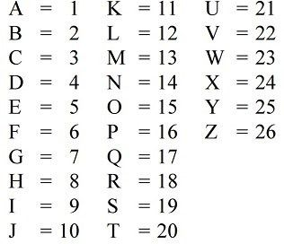

BRAIN BREAK!!
1. Stand up – rub your tummy; pat your head. ….Swap hands.
2. Add up your name: (E.g. L=12; E=5; A=1; H=8 equals 26)

Slide 3
TRAUMA
WHAT DOES TRAUMA LOOK LIKE?
HOW CAN YOU TELL WHEN SOMEONE HAS BEEN TRAUMATISED?
SIGNS/MANNERISMS/COMMENTS MADE
* * *
ALL MENTAL ILLNESS IS THE RESULT OF TRAUMA (&/OR ‘DISORGANISED ATTACHMENT’) – BIG OR SMALL – SHORT-LIVED OR LENGTHY & ENDURING
HOWEVER NOT ALL PEOPLE WHO HAVE EXPERIENCED TRAUMA END UP WITH MENTAL ILLNESS
INCREASED LIKELIHOOD OF MENTAL ILLNESS WHEN NUMBER OF TRAUMAS IN CHILDHOOD INCREASES

Slide 4
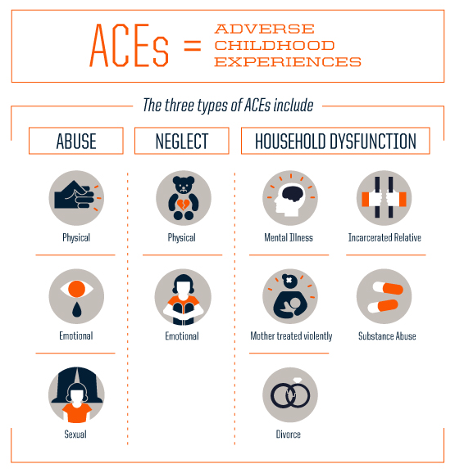
Adverse Childhood Experiences (ACEs)
1970s – Dunedin study began – nature vs nurture
Research by Felitti and colleagues (1998):

Slide 5
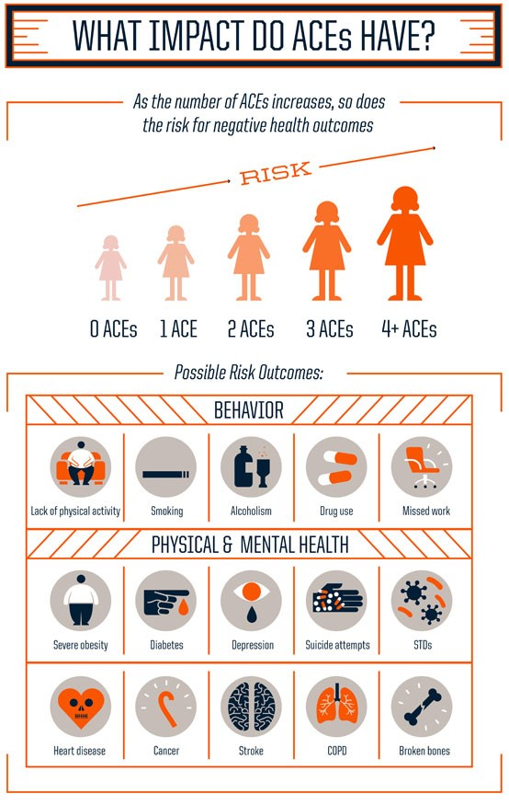

Slide 6
No. of ACEs increases risk behaviours and disease
Graded relationship – four or more ACEs:
  4 to 12 fold increase in substance abuse, and mental illness
  Exposure to 4+ ACEs is associated with 33 times the likelihood of learning or behavioural problems compared to those with fewer ACEs
  Gene expression – epigenetics demonstrates how a gene can lay dormant unless ACEs occur. E.g. schizophrenia; Diabetes

Slide 7
HOW THIS OCCURS - EPIGENETICS
An individual may carry a gene for a chronic illness or mental illness – if ACEs/trauma occurs it may be “switched on”. If there are no ACEs (or very few), or no gene for that illness, then the illness may never arise in the individual.
Poor lifestyle choices (e.g. smoking, drug use, unhealthy eating, unprotected sex) will increase the gene expression.
Therefore, ACEs increase poor lifestyle choices, and ACEs AND lifestyle choices increase the gene expression.

Slide 8
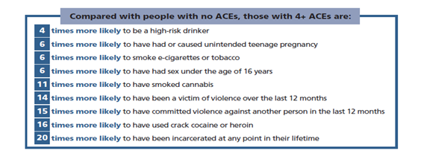

Slide 9
ACEs in adolescents
Higher ACEs (ie. Childhood traumas) increase:
  school non-completion
  Unemployment
  Poverty
  School expulsion - ‘school to prison pipeline’

Slide 10
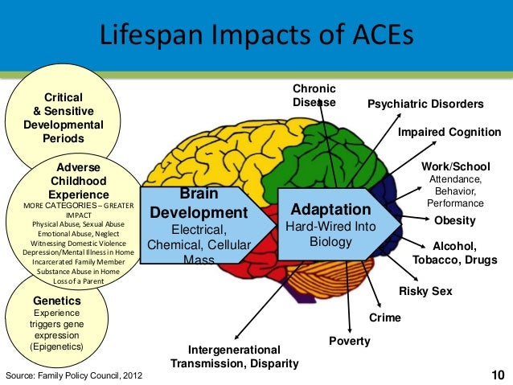

Slide 11
ACEs (& Disorganised Attachment) and mental illness in adulthood
Complex Posttraumatic stress disorder (PTSD)
Schizophrenia
Bipolar affective disorder
Depression
Anxiety
ADHD
Substance misuse
Personality Disorders
Others (psychosomatic; eating disorders; gender dysphoria)

Slide 12
Early Trauma and Criminality
Exposure to stress in childhood disrupts healthy brain development – conduct issues; risk taking behaviours
Disorganised Attachment in childhood is a predictor of delinquency (School to prison pipeline)
Link between childhood trauma/ACEs and adulthood criminality and victimization
Link between ACEs and ‘criminogenic’ risk factors (ie. Substance abuse, poor educational attainment, mental illness)
Again, a graded relationship
‘Cycle of violence’
NO CAUSALITY PROVEN – ONLY CORRELATIONAL EVIDENCE

Slide 13
Welsh ACEs Study 2015
×14 | times more likely to be a victim of violence in the last 12 months
×15 | times more likely to be a perpetrator of violence in the last 12 months
×20 | times more likely to have been incarcerated in their lives

Slide 14
Childhood institutional abuse -Royal Commission
1990’s inquiries – Stolen Generation and Forgotten Australians
These inquiries found that victims of forced separation and of institutional abuse are impacted in very similar ways as found in numerous ACEs studies. Along with distrust of agencies/services.
  INTER-GENERATIONAL TRAUMA
  Legacy of the Royal Commission
  Reduce risk of abuse
  Protect children
  Limit psychiatric and medical disability

Slide 15
Psychiatric Impairment Rating Scale (PIRS)
How to calculate the PIRS on historic claims
Unscrambling an egg – disentangling the effects of abuse/neglect from other conditions
Was there a previous Diagnosed condition? (by a Psychiatrist/Clinical Psychologist)

Slide 16
PIRS
CALCULATING PRE-EXISTING INJURY – BUT WHAT ABOUT POST-INJURY EXPERIENCES ALSO??:
GEPI 1.51 says “indicate the degree of impairment due to the previous injury, pre-existing condition or abnormality. This is known as the deductible portion and should be deducted from the degree of permanent impairment determined by the assessor”.
GEPI 11.11 “pre-existing impairment is calculated using the same method for calculating current impairment level. Use all available information. If the percentage pre-existing impairment cannot be assessed, 10% of the estimated level of the condition now being assessed is to be deducted”.
Estimate the PIRS pre-injury…an adult with recent injury v’s an adult with an early injury plus potentially recent injuries
Rule: 10% if cannot estimate pre-injury functioning (if any pre-existing condition)

Slide 17
E.g. of a PI institutional abuse claim
Male in his 30s; incarcerated
Sexually abused on two occasions within school setting aged approx. 10yo
pre-existing ADHD; learning disorder; family break-up (ACE)
post-injury experience 20’s - head injury from assault; chronic long term drug use – effected memory of events
Drug addiction; crime & imprisonment (assault, weapons, drugs); loss of jobs; unstable relationships.
Nil family history of mental illness (incl biological sibling)
Dx: PTSD; Dysthymia; Polysubstance dependence; ADHD; Vulnerable personality traits

Slide 18
E.g. of a PI institutional abuse claim (contd)
Is the abuse the Claimant suffered a causative factor in his behaviour? If so, please provide your reasons;
the abuse resulted in a number of psychological issues.
likely contributed significantly to his ensuing problematic drug addiction, anxiety and anger.
contributed to Cluster B personality traits which have further contributed to interpersonal problems and criminal behaviour.
In turn, his educational and occupational histories have been affected.

Slide 19
E.g. of a PI institutional abuse claim (contd)
The Claimant’s ability to complete any type of work, or obtain any type of employment:
a long history of behavioural, drug and anger issues since the abuse. This has resulted in him having rarely worked and being imprisoned for numerous offences since his teen years.
poor literacy and educational attainment, making him less qualified for jobs.
interpersonal issues impact upon his ability to obtain and maintain work.

Slide 20
Summary
Adverse Childhood Experiences (childhood trauma) increase risk of mental illness, poor lifestyle choices, criminality, and physical disease.
>4 ACE’s increases this risk significantly.
The Royal Commission has enabled victims to be heard, gain compensation and support, and improved institutional practices. And in turn, protection of future generations of children.
Calculating the PIRS for historic childhood abuse matters.

Slide 21

Questions

Slide 22
YouTube – how to reduce ACEs
Adverse Childhood Experiences (ACEs) – YouTube

Slide 23
References
Altovelli, 2003,Institutional processes for dealing with allegations of child sexual abuse.
Australian Human Right Commission, 1997.
Australian Royal Commission into Institutional Responses to Child Sexual Abuse, 2017.
Blakemoore et al., 2017, The impacts of institutional child sexual abuse: A rapid review of the evidence.
Commonwealth of Australia, 2001, Lost innocents report.
Bell, H., Limberg, D., & Robinson, E. (2013). Recognising trauma in the classroom: A practical guide for educators. Childhood Education, 89 (3), 139-145.
Boullier, M. & Blair, M. (2018). Adverse childhood experiences. Paediatrics and Child Health, 28, (3), 132-137.
Boyce, W., Levitt, P., Martinez, F., McEwen, B., & Shonkoff, J. (2021). Genes, environments, and time: The biology of adversity and resilience. Paediatrics, 147, (2), 1-14.
Chafouleas, S., Koriakin, T., & Overstreet, S. (2018). Addressing childhood trauma in school settings: A framework for evidence-based practice. School Mental Health, 11, 40-53.
Cronholm, P., Forke, C., Wade, R., Bair-Merritt, M., Davis, M., Harkins-Schwarz, M., Pachter, L., & Fein, J. (2015). Adverse childhood experiences: Expanding the concept of adversity. American Journal of Preventative Medicine, 49, (3), 354-361.
Hatty, 1991, Of nightmares and sexual monsters: Struggles around child abuse in Australia.

Slide 24
Ref contd
Felita, V., Anda, R., Nordenberg, D., Williamson, D., Spitz, A., Edwards, V., Koss, M., & Marks, J. (1998). Relationship of childhood abuse and household dysfunction to many of the leading causes of death in adults. American Journal of Preventative Medicine, 14, (4), 245-258.
Fondren, K., Lawson, M., Speidel, R., McDonnell, C., & Valentino, K. (2020). Buffering the effects of childhood trauma within the school setting: A systematic review of trauma-informed and trauma-responsive interventions among trauma-affected youth. Children and Youth Services Review, 109, 1-18.
Howard, J. (2013). Distressed or Deliberately Defiant? Australia: Australian Academic Press.
Howard, (2021). National Guidelines for Trauma-Aware Education. Austalia: QUT.
Hunt, T., Slack, K., & Berger, L. (2017). Adverse childhood experiences and behavioural problems in middle childhood. Child Abuse and Neglect, 67, 391-402.
Jaycox, L., Cohen, J., Mannarino, A., Walker, D., Langley, A., Gegenheimer, K., Scott, M., & Schonlau, M. (2010). Addressing childhood trauma in school settings: A framework for evidence-based practice. School Mental Health, 11, 40-53.
Kaufman and Erroga, 2016, Risk profiles for institutional child sexual abuse.
McPhillips et al., 2019, Understanding trauma as a system of psycho-social harm: Contributions from the Australian royal commission into child sex abuse
Maniglio, 2009, The impact of child sexual abuse on health: A systematic review of reviews.
Metzler, M., Merrick, M., Klevens, J., Ports, K., & Ford, D. (2017). Adverse childhood experiences and life opportunities: Shifting the narrative. Children and Youth Services Review, 72, 141-149.
Morton, B., & Berardi, A. (2017). Trauma-informed school programming: Applications for mental health professionals and educator partnerships. Journal of Child and Adolescent , 11, 487-493.
Norman, R., Munkhtsetseg, B., De, R., Aelxander, B., & Scott, J. (2012). The long-term health consequences of child physical abuse, emotional abuse, and neglect: A systematic review and meta-analysis. PLOS Medicine, 9, (11), 1-31.
Racine, N., Eirich, R., Dimitropoulos, G., Hartwick, C., & Madigan, S. (2020). Development of trauma symptoms following adversity in childhood: The moderating role of protective factors. Child Abuse and Neglect, 101, 1-11.

Slide 25
Ref contd
Metzler, M., Merrick, M., Klevens, J., Ports, K., & Ford, D. (2017). Adverse childhood experiences and life opportunities: Shifting the narrative. Children and Youth Services Review, 72, 141-149.
Morton, B., & Berardi, A. (2017). Trauma-informed school programming: Applications for mental health professionals and educator partnerships. Journal of Child and Adolescent , 11, 487-493.
Norman, R., Munkhtsetseg, B., De, R., Aelxander, B., & Scott, J. (2012). The long-term health consequences of child physical abuse, emotional abuse, and neglect: A systematic review and meta-analysis. PLOS Medicine, 9, (11), 1-31.
Racine, N., Eirich, R., Dimitropoulos, G., Hartwick, C., & Madigan, S. (2020). Development of trauma symptoms following adversity in childhood: The moderating role of protective factors. Child Abuse and Neglect, 101, 1-11.

Slide 26
Lex Medicus
THANK
YOU!
Bridging the gap between Medicine & the Law.
lexmedicus.com.au
info@lexmedicus.com.au
1300 633 453

