Slide 1
Health and Safety Prosecution in Queensland: the changed landscape after three years of independent prosecution
North Queensland Law Association Annual Conference
The Ville, Townsville, 27 May 2022
Aaron Guilfoyle, Special Counsel

Slide 2
Introduction
02

Slide 3
Pre-Dreamworld landscape:
Model WHS Act 2011

Slide 4
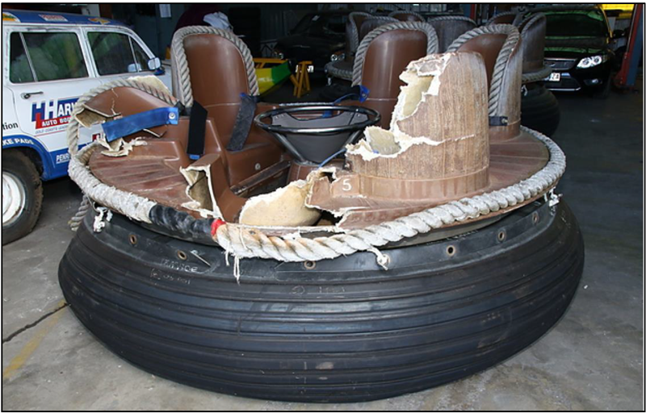
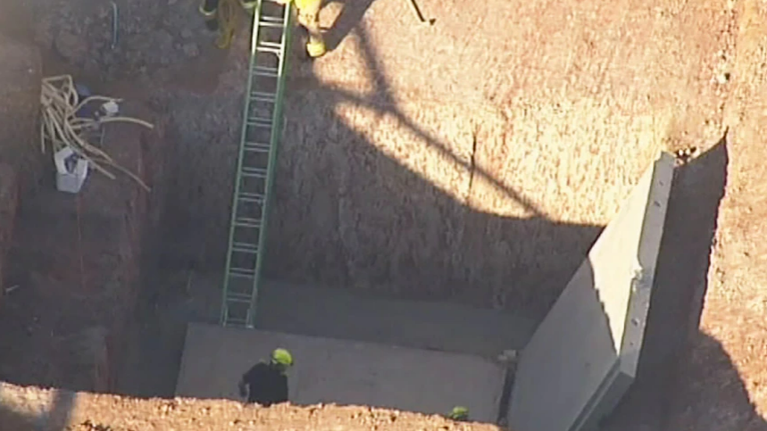
October 2016:
Dreamworld and Eagle Farm Racecourse
5

Slide 5
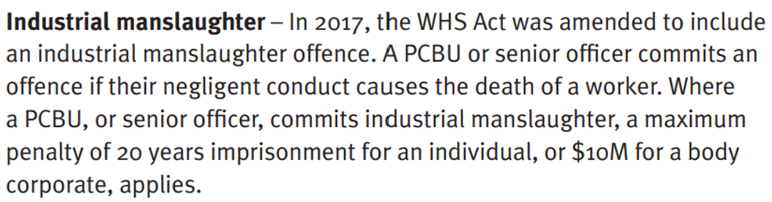
Industrial Manslaughter
7

Slide 6
Three Years of Independent Prosecution

Slide 7
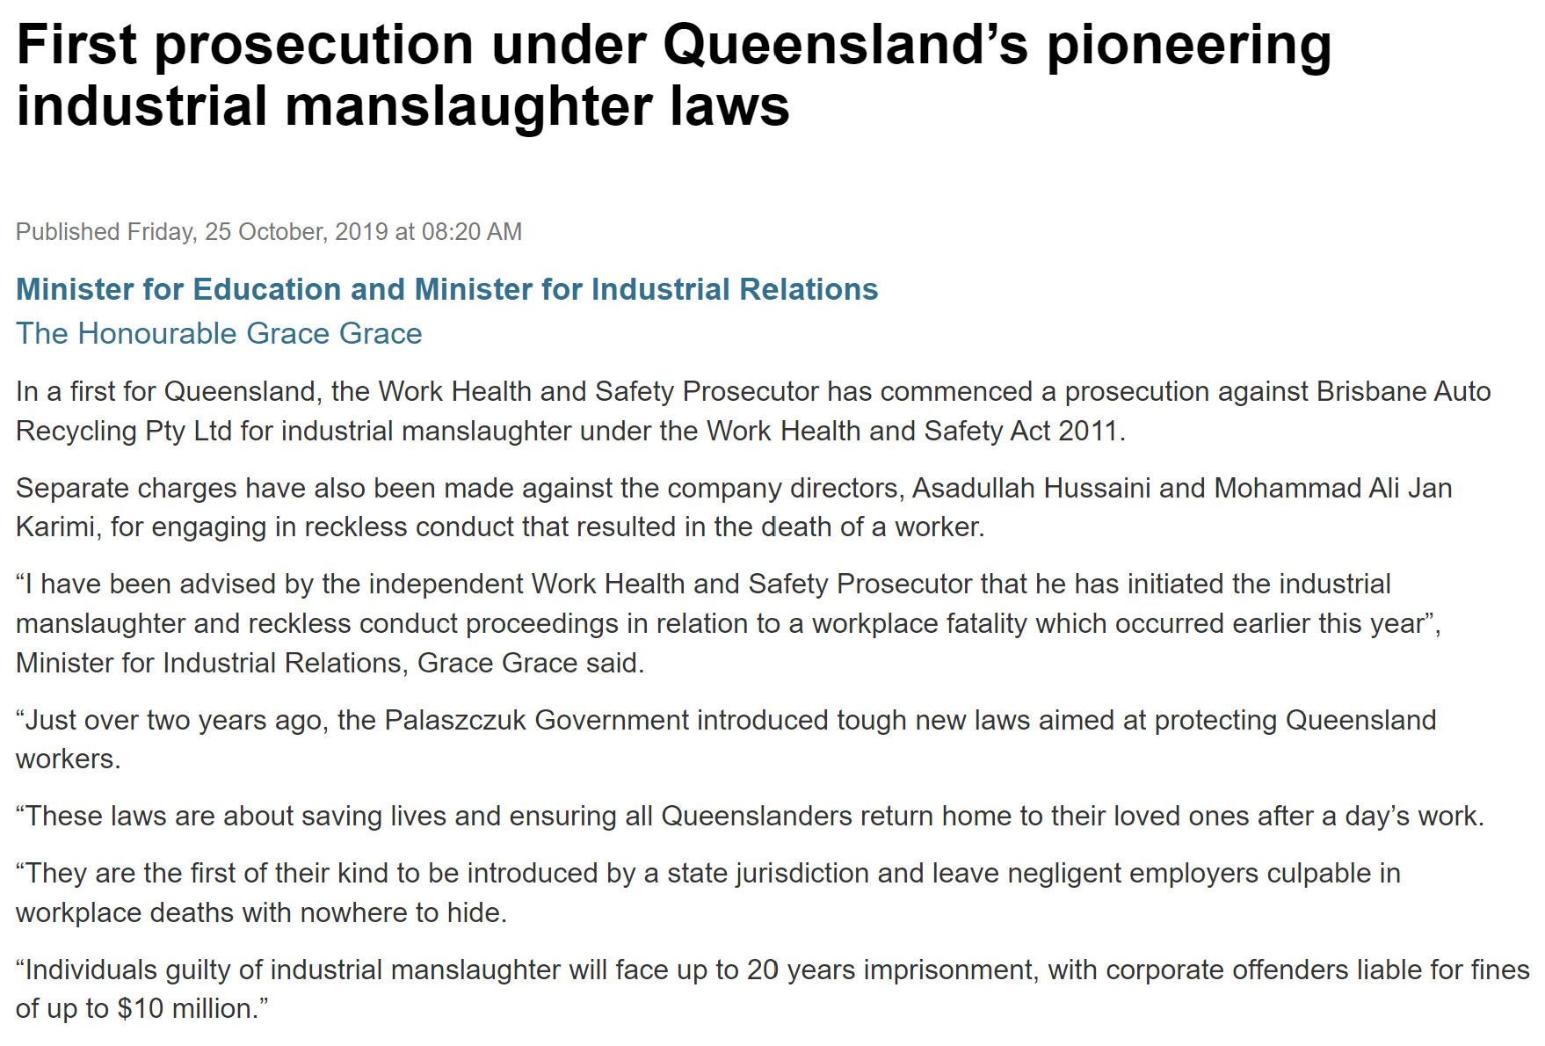
Industrial Manslaughter
R v Brisbane Auto Recycling and Ors [2020] QDC 113
6

Slide 8
Notable decisions
R v Jeffrey Owen: Industrial Manslaughter (Unreported, Gympie District Court, 25 March 2022)
R v Cordwell Resources Pty Ltd and Brian Cordwell: Reckless Conduct (Unreported, Maroochydore District Court, 8 October 2021)
R v Illawara Enterprises (Qld) Pty Ltd and Michael Walsh: Reckless Conduct (Unreported, Brisbane District Court, 8 April 2022)
Guilfoyle v Ardent Leisure Ltd [2020] QMC 13: Category 2
Cummins v Guilfoyle [2021] QDC 248: Intimidate Inspector
Guilfoyle v Enco Precast Pty Ltd: Obstruct Inspector (Unreported, Brisbane Magistrates Court, 22 July 2021)
6

Slide 9
Office of the Work Health and Safety Prosecutor:
Achievements
24

Slide 10
The changed WHS prosecution landscape
24

Slide 11
THANK YOU

