Slide 1


Refresher of Conflict Analysis,
Tools and Practices
Claire Holland
James Cook University
Conflict Management and Resolution Program

Slide 2
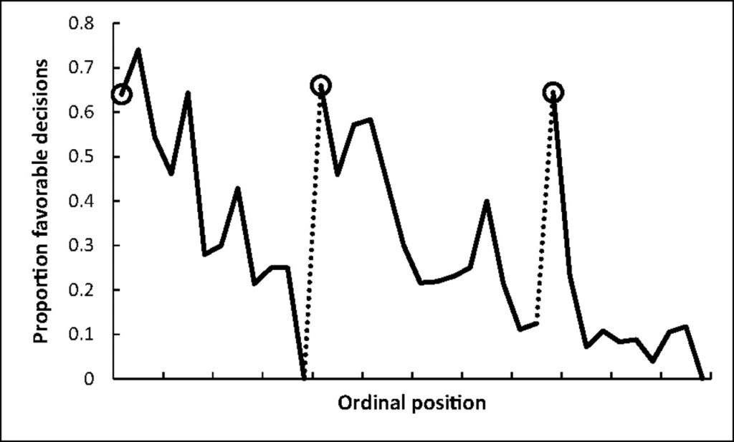
Danziger, S., Levav, J., & Avnaim-Pesso, L. (2011). Extraneous factors in judicial decisions. Proceedings of the National Academy of Sciences, 108(17), 6889-6892.

Slide 3
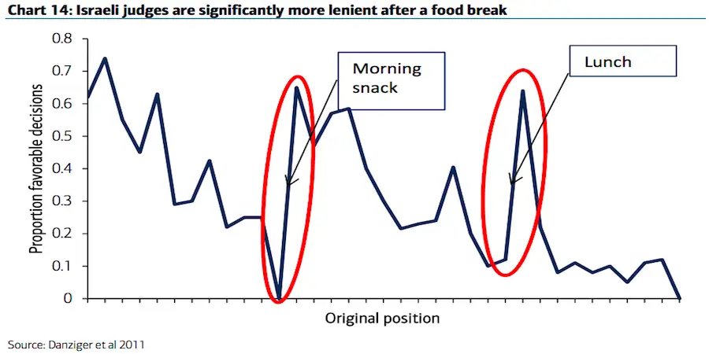
Danziger, S., Levav, J., & Avnaim-Pesso, L. (2011). Extraneous factors in judicial decisions. Proceedings of the National Academy of Sciences, 108(17), 6889-6892.

Slide 4
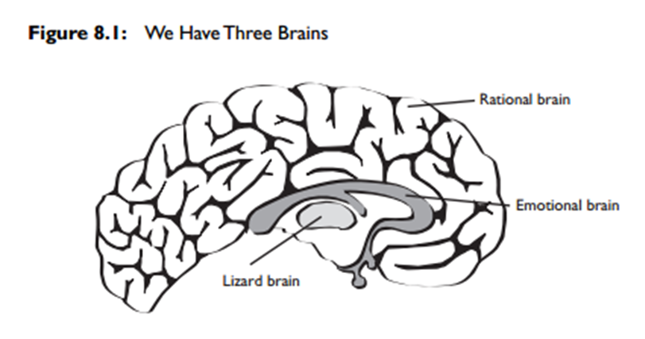
The brain and conflict
Rational Brain
Higher brain functions (logic and reasoning)
Emotional Brain
Intuition and instinct (fight, flight or freeze; storytelling; context; memory
Amygdala
Manages information flow between rational and emotional brain centres
Lizard Brain
Biological survival functions (breathing and sleeping)
Alexander, N., Howieson, J. & Fox, K. (2015). Negotiation: Strategy Style Skills, 3rd Ed, LexisNexis
Notes:
Stuck Amygdala
“it may take only 33 milliseconds for our amygdala to become stuck”
“it takes about 20 minutes [to get it unstuck]”

Slide 5
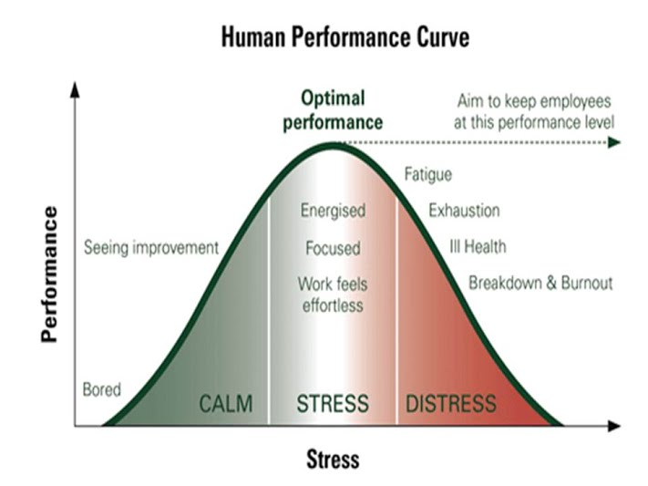
https://sites.google.com/site/hookappsychology4a/theories-of-motivation-by-aliya-tucker/iv-arousal-theory

Slide 6
Edge of Chaos
https://sites.google.com/site/hookappsychology4a/theories-of-motivation-by-aliya-tucker/iv-arousal-theory

Slide 7
Conflict Analysis
Analysis
Development of strategy

Slide 8
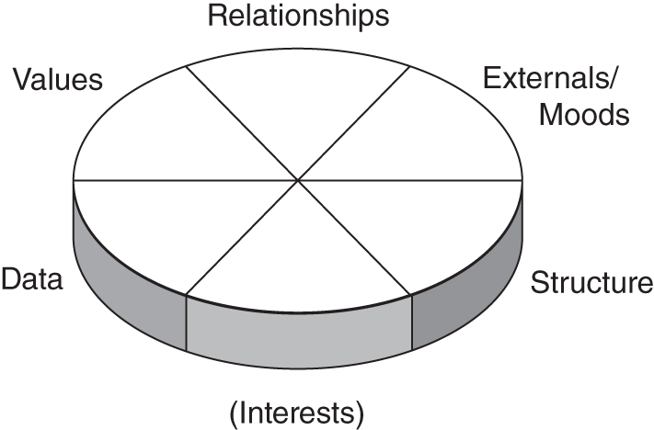
Moore’s Circle of Conflict
Moore, C. W. (2014). The mediation process: Practical strategies for resolving conflict. John Wiley & Sons.

Slide 9
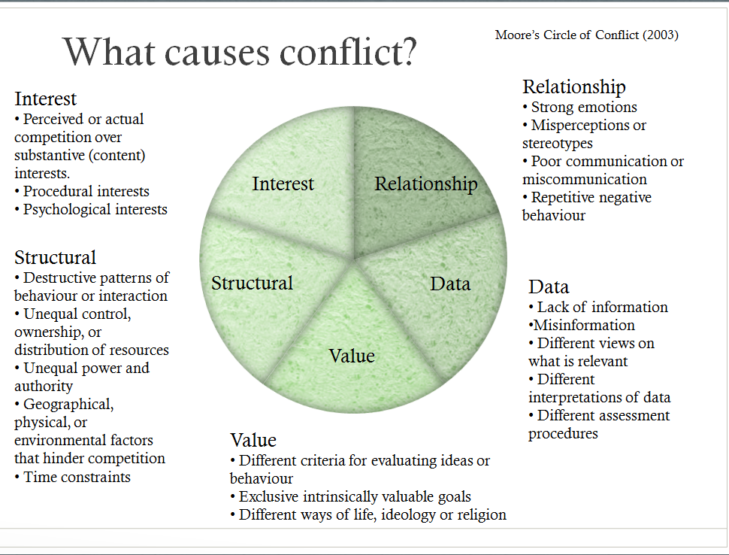
Moore’s Circle of Conflict
Moore, C. W. (2014). The mediation process: Practical strategies for resolving conflict. John Wiley & Sons.

Slide 10

The Conflict Iceberg
WHAT YOU SEE →
Behaviour
Physical health
Expectations
Bias
Language
Values
Culture
Mental health
Environment
Schooling
WHAT YOU DON’T NECESSARILY SEE →
Politics
Thinking and feeling
Religion
Faith
Spirituality
Education

Slide 11
Worldview
Ontology | What is real or true?
Logic | How is ‘the real’ organised?
Axiology | What is important?
Epistemology | How do we know about ‘what is’?
Ethics | How should we act?

Slide 12
Other people’s behaviour
Our behaviour
Our worldview
Our ‘under the iceberg’

Slide 13
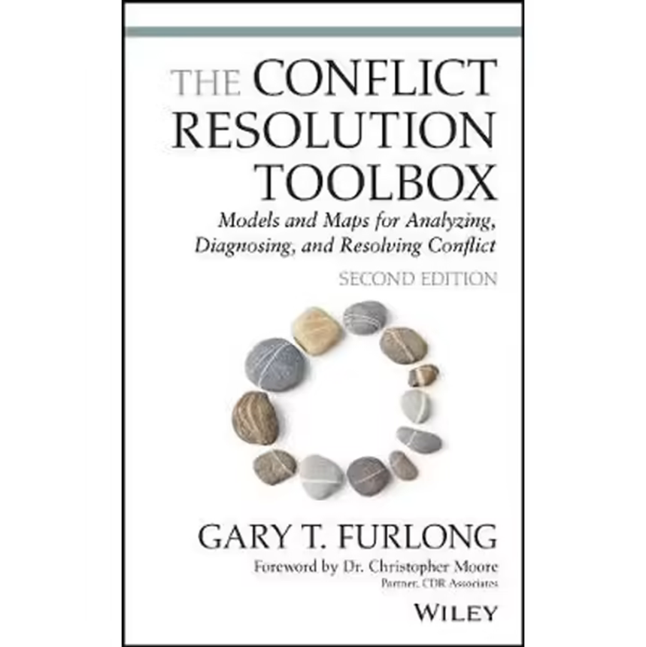
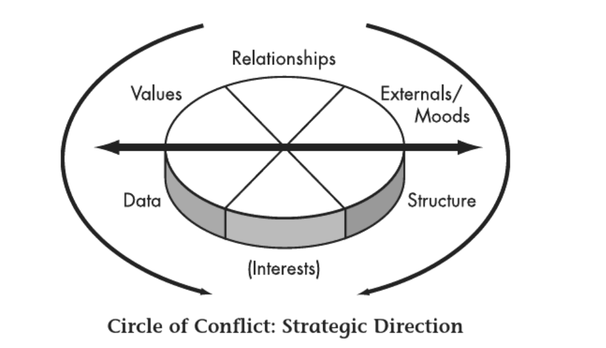
Moore’s Circle of Conflict
Furlong, G. T. (2020). The conflict resolution toolbox: Models and maps for analyzing, diagnosing, and resolving conflict. John Wiley & Sons

Slide 14

Possible Relationship Interventions
Control expression of emotions through procedure, ground rules, caucuses, and so forth
Promote expression of emotions by legitimizing feelings and providing a process
Clarify perceptions and build positive perceptions
Improve quality and quantity of communication
Block negative repetitive behaviour by changing structure
Encourage positive problem-solving attitudes.
Interest
Relationship
Data
Value
Structural
Notes:
Mediation, conflict coaching or another process?

Slide 15
Possible Value-Related Interventions
Avoid defining problem in terms of value
Allow parties to agree and to disagree
Create spheres of influence in which one set of values dominates
Search for superordinate goals that all parties share.
Interest
Relationship
Data
Value
Structural
Notes:
Mediation, facilitation, family DR or conflict coaching

Slide 16
Possible Data Intervention
Reach agreement on what data are important
Agree on process to collect data
Develop common criteria to assess data
Use third-party experts to gain outside opinion or break deadlocks
Interest
Relationship
Data
Value
Structural
Notes:
Facilitation, conciliation or arbitration

Slide 17
Possible Structural Interventions
Clearly define and change roles
Replace destructive behaviour patterns
Reallocate ownership or control of resources
Establish a fair and mutually acceptable decision-making process
Change negotiation process from positional to interest-based bargaining
Modify means of influence used by parties (less coercion, more persuasion)
Change physical and environmental relationship of parties (closeness and distance)
Modify external pressures on parties
Change time constraints (more or less time)
Interest
Relationship
Data
Value
Structural
Notes:
Facilitation, negotiation, etc.
This circle is good to keep in mind and as we learn more about a process we can link them to these causes of conflict and get a clearer understanding of appropriate processes that could address these common causes of conflict.

Slide 18
Possible Interest-Based Interventions
Focus on interests, not positions
Look for objective standards and criteria to guide solution development
Develop integrative solutions that address needs of all parties
Search for ways to expand options or resources
Develop trade-offs to satisfy interest of different strengths.
Interest
Relationship
Data
Value
Structural
Notes:
If it’s a possible interest based conflict, appropriate interventions may include…
Our understanding of different processes will help us to select an intervention that could meet these ideas of solutions.
As we go through the different processes in this subject we will consider what processes that could assist this may be negotiation, mediation or facilitation.

Slide 19
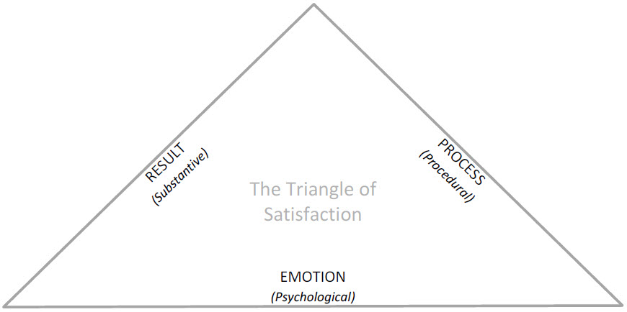
The Triangle of Satisfaction
Furlong, G. T. (2020). The conflict resolution toolbox: Models and maps for analyzing, diagnosing, and resolving conflict. John Wiley & Sons

Slide 20
Dispute resolution spectrum
Informal
Flexible
Voluntary
Confidential
Consensual
Negotiation
Mediation
Advisory
Determinative
Litigation
Facilitative
Conciliation
Arbitration
Restorative Justice Conferencing
Parties determine outcome
Third party determines outcome
Formal
Inflexible
Mandatory
Public

Slide 21

Characteristics of Enduring Conflicts
Have deep roots
Involve values and identity issues
Rooted in Distrust
Embedded in structures
Systemic and complex
Destructive interactions
Involve fundamental power issues
Persistent
[Mayer 2009]

Slide 22
Six ways to stay with conflict
Long-term frame
Facing conflict avoidance
Conflict narratives
Communication
Power and escalation
Agreements
Sustainable approach

Slide 23
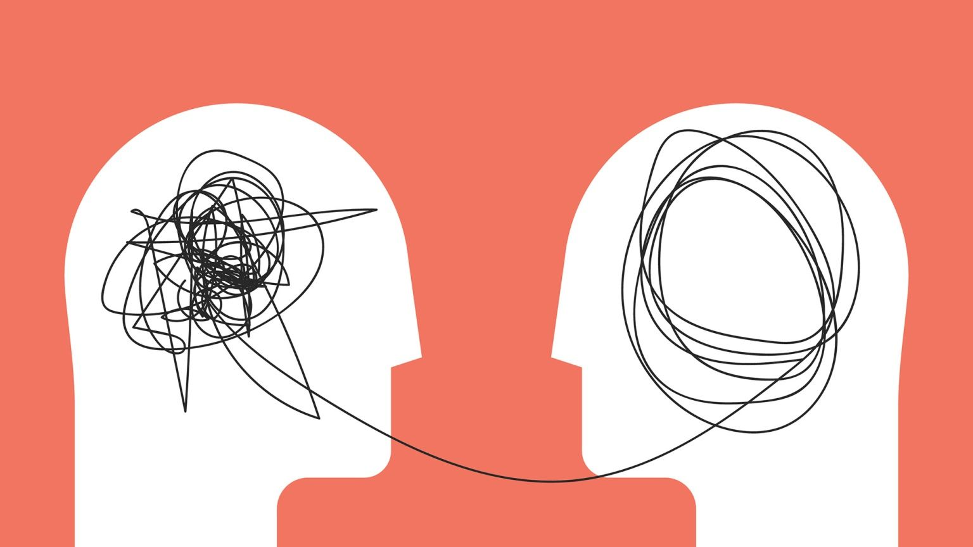
Conflict Narratives

Slide 24
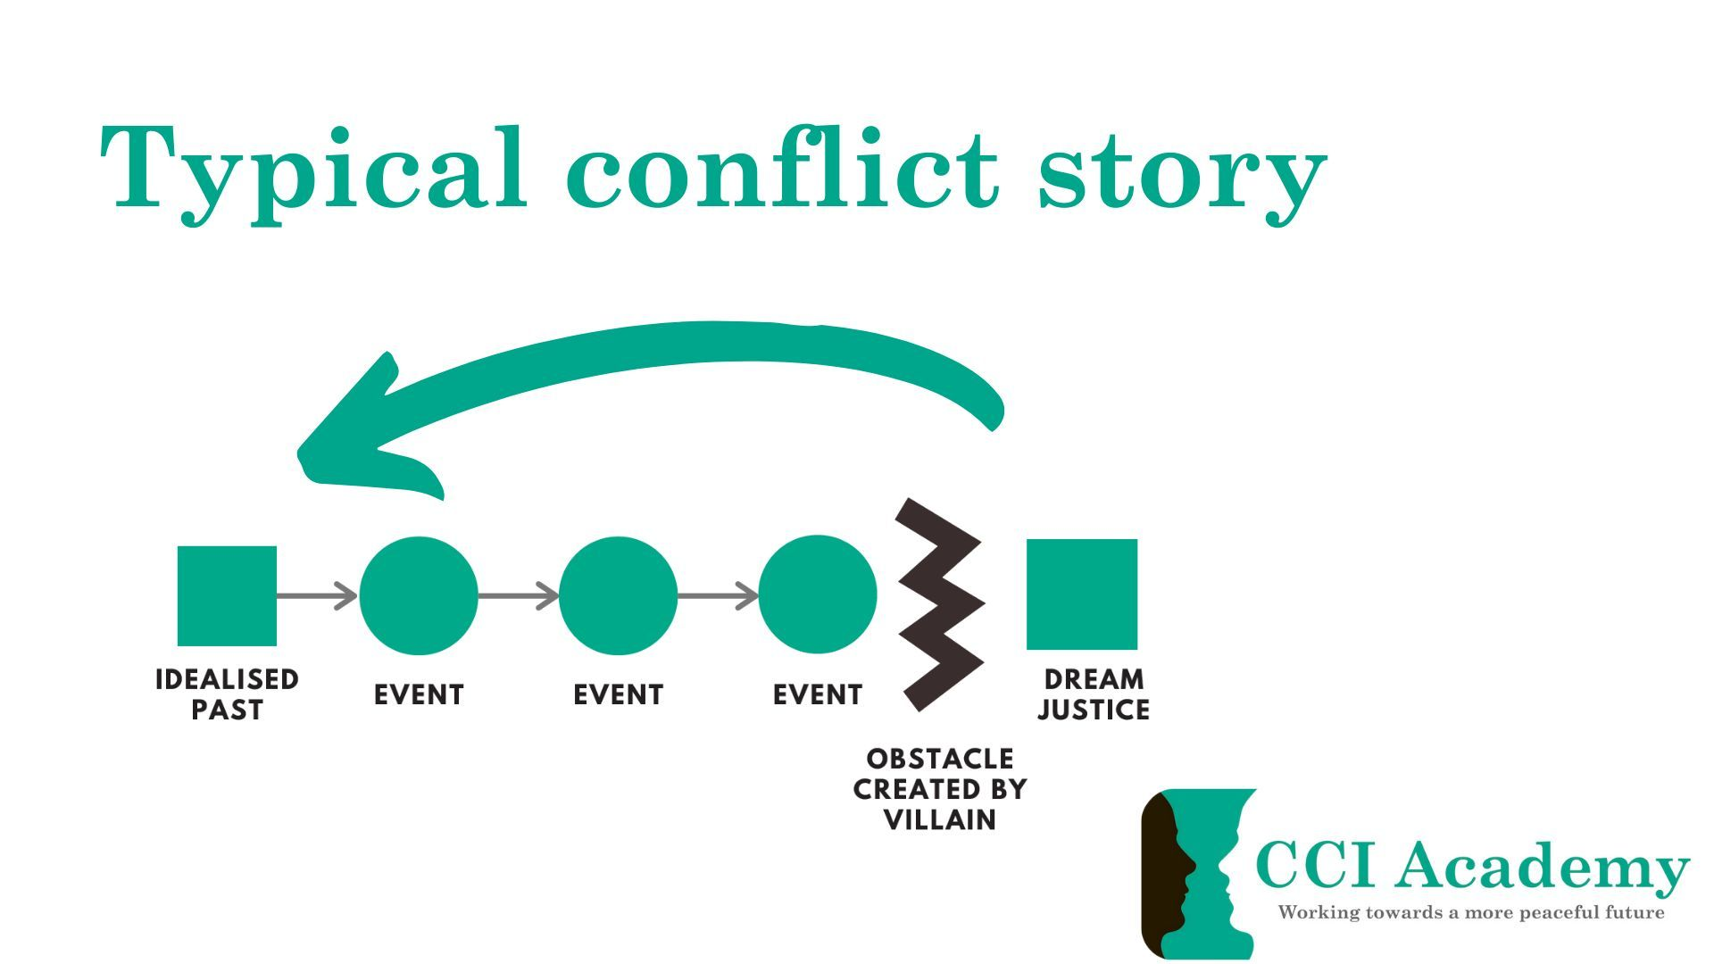

Slide 25
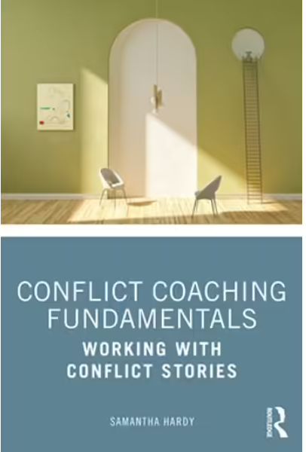
Dream Justice
Idealised past
Overly simplistic version of events
Past can never be fully restored
Events that have taken place can not be undone
Memory of the suffering remains

Slide 26
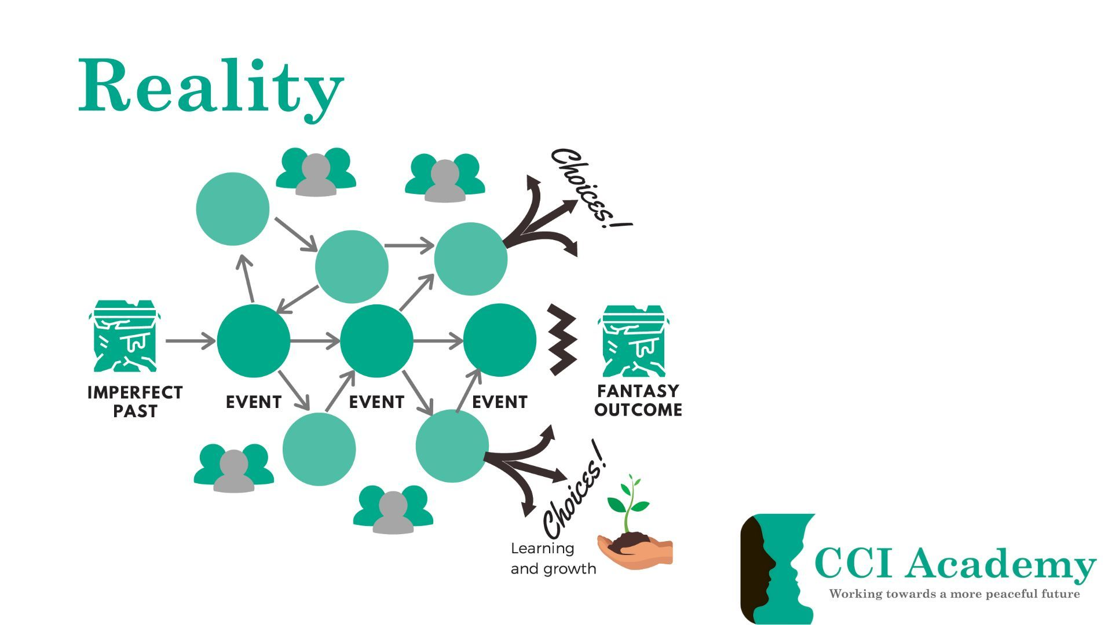

Slide 27
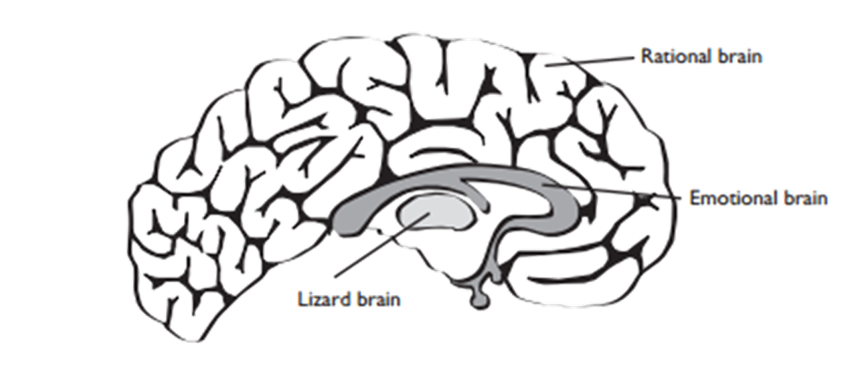



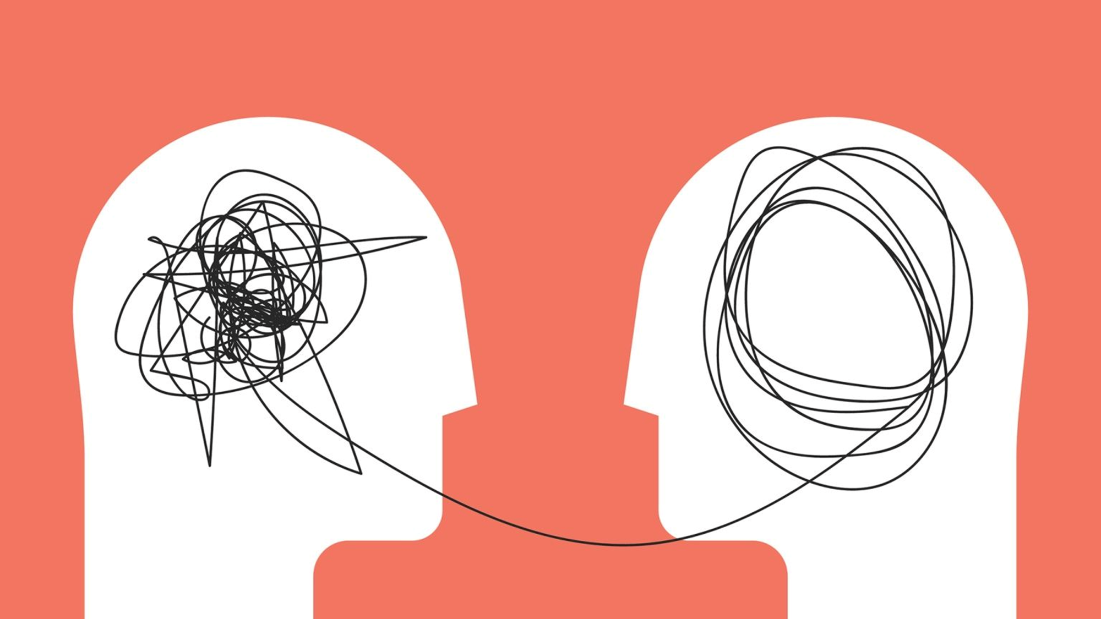
Conflict Resolution
VS
Conflict Management

Slide 28
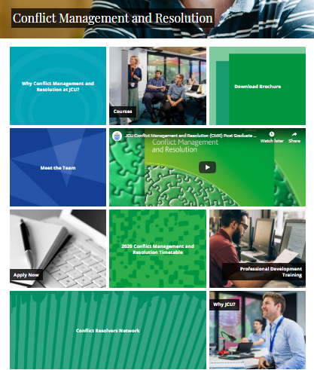
www.jcu.edu.au/conflictresolution
Claire Holland
Director
Conflict Management and Resolution Program
Claire.Holland@jcu.edu.au

