Slide 1
Reporting Misconduct
Cate Heyworth-smith kc
Chambers 33

Slide 2
NOT MY ZOO.
NOT MY MONKEYS.

Slide 3
Different Jurisdictions
Queensland
Singapore
United States
Victoria
England

Slide 4
QUEENSLAND
Barristers’ Conduct Rule 2011
12 A barrister must not engage in conduct which is:
(a) dishonest or otherwise discreditable to a barrister;
(b) prejudicial to the administration of justice; or
(c) likely to diminish public confidence in the legal profession or the administration of justice or otherwise bring the legal profession into disrepute.

Slide 5
Queensland (Contd)
Australian Solicitors Conduct Rules
3. Paramount duty to the court and the administration of justice
3.1 A solicitor’s duty to the court and the administration of justice is paramount and prevails to the extent of inconsistency with any other duty.
5. Dishonest and disreputable conduct
5.1 A solicitor must not engage in conduct, in the course of practice or otherwise, which demonstrates that the solicitor is not a fit and proper person to practise law, or which is likely to a material degree to:
5.1.1 be prejudicial to, or diminish the public confidence in, the administration of justice; or
5.1.2 bring the profession into disrepute

Slide 6
Queensland (Contd)
Australian Solicitors Conduct Rules
32. Unfounded allegations
32.1 A solicitor must not make an allegation against another Australian legal practitioner of unsatisfactory professional conduct or professional misconduct unless the allegation is made bona fide and the solicitor believes on reasonable grounds that available material by which the allegation could be supported provides a proper basis for it.

Slide 7
SINGAPORE
sec. 70D of the Legal Profession Act (Sing)
sec. 39(1)) of the Corruption, Drug Trafficking and Other Serious Crimes (Confiscation of Benefits) Act

Slide 8
UNITED STATES
Model Rules of Professional Conduct 1983
In Re Himmel 533 N.E.2d 790 (Ill. 1988)
In Re Riehlmann 891 So.2d 1239 (2005)

Slide 9
In Re Riehlmann 2005
a lawyer's duty to report professional misconduct is triggered when, under the circumstances, a reasonable lawyer would have "a firm opinion that the conduct in question more likely than not occurred.”
requisite knowledge under Rule 8.3(a) is “more than a mere suspicion, but less than absolute or moral certainty.”
the obligation to report is to report “promptly”.

Slide 10
In Re Riehlmann 2005
“The only aggravating factor present in this case is the respondent's substantial experience in the practice of law. As for mitigating factors, we adopt those recognized by the disciplinary board, placing particular emphasis on the absence of any dishonest or selfish motive on respondent's part. Notwithstanding these factors, however, the respondent's failure to report Mr. Deegan's bad acts necessitates that some sanction be imposed. The Respondent's knowledge of Mr. Deegan's conduct was sufficient to impose on him an obligation to promptly report Mr. Deegan to the ODC. Having failed in that obligation, the respondent is himself subject to punishment. Under all of the circumstances presented, we conclude that a public reprimand is the appropriate sanction.”

Slide 11
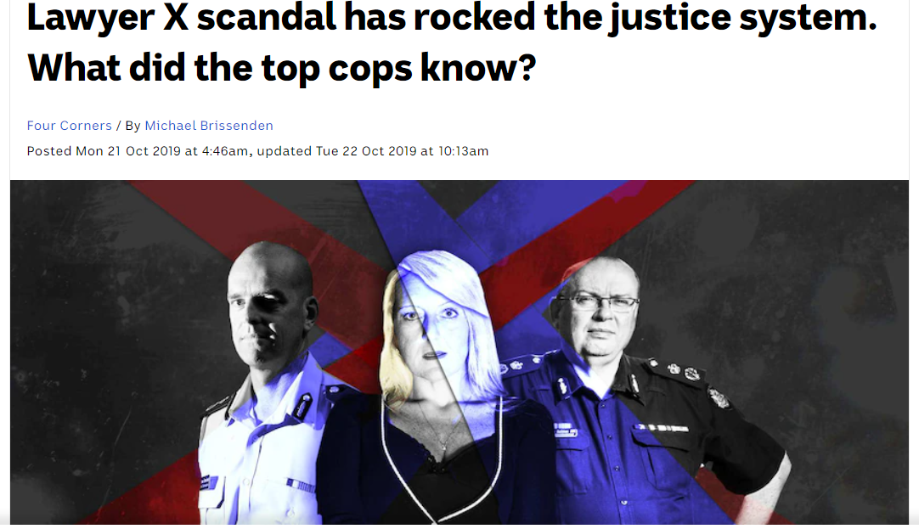
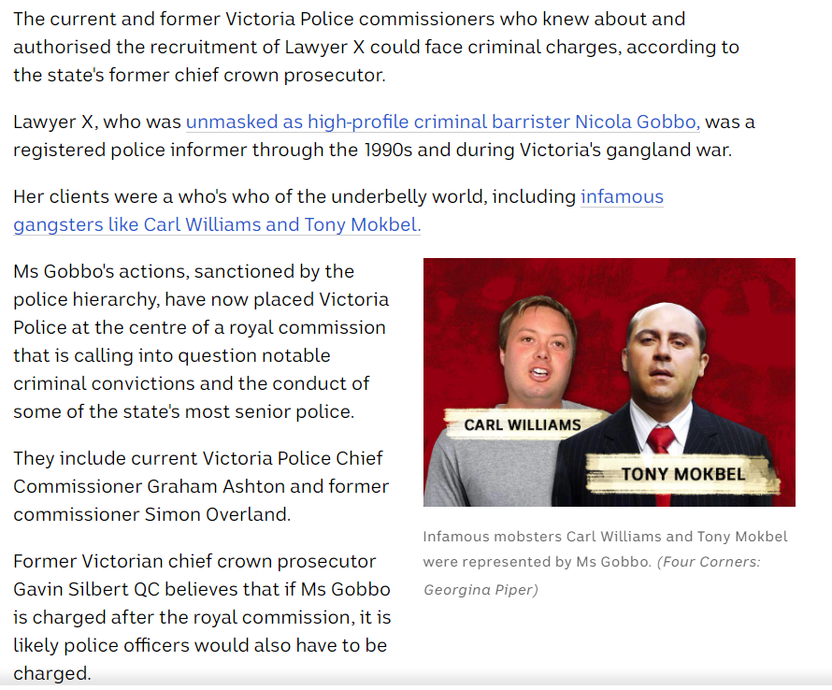
VICTORIA

Slide 12
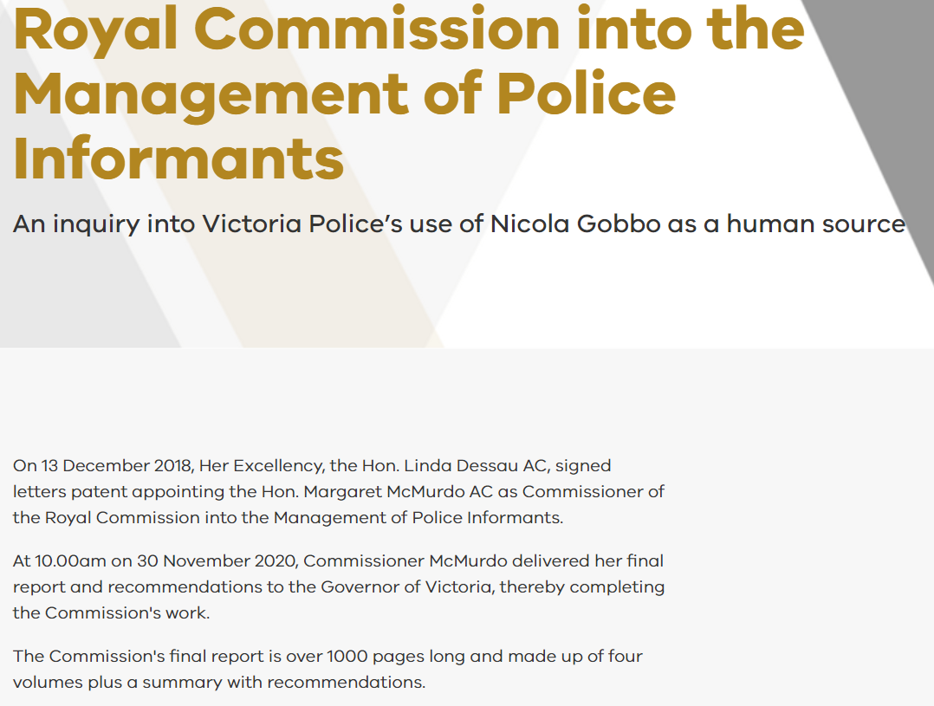
Victoria (Contd)

Slide 13
Victoria (Contd)
RECOMMENDATION 86
That the Victorian Government, within 12 months, pursues through the Council of Attorneys-General and the Legal Services Council, an amendment to the Legal Profession Uniform Law introducing a mandatory requirement for lawyers to report the suspected misconduct of other lawyers. The Victorian Government should ensure the Victorian Legal Services Board and Commissioner is appropriately resourced to implement this recommendation.
If the amendment incorporating a mandatory reporting obligation has not been agreed within 12 months, the Victorian Government should, within a further 12 months, introduce a mandatory reporting requirement for Victorian lawyers to report the suspected misconduct of other lawyers.

Slide 14
Victoria (Contd)
RECOMMENDATION 88
That the Victorian Legal Services Commissioner, within 12 months, revokes the Instrument of Delegation conferred on the Victorian Bar for receiving and handling complaints regarding barristers and resumes that function.

Slide 15
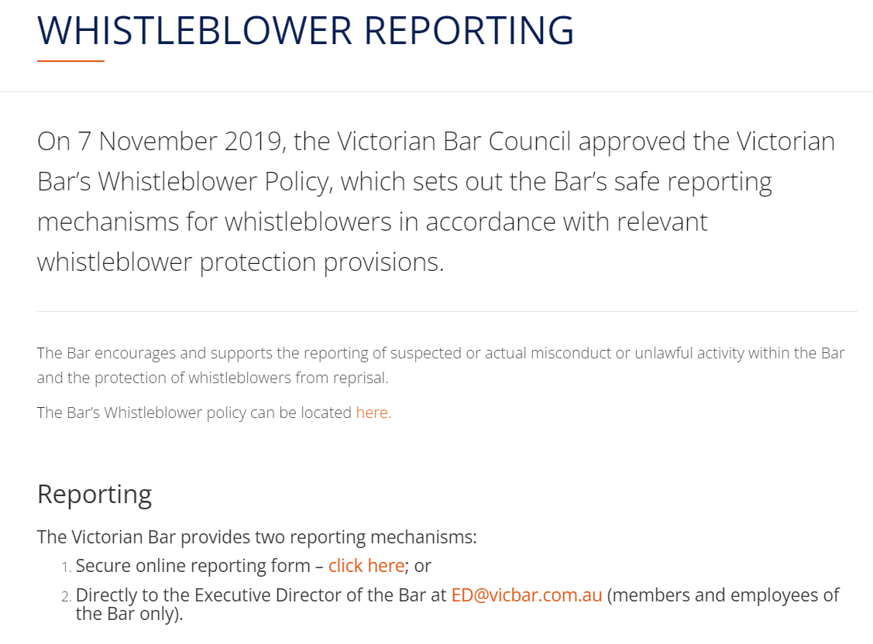
Victoria (Contd)

Slide 16
ENGLAND
Bar Standards Board Handbook for Barristers
C66 Subject to your duty to keep the affairs of each client confidential and subject also to rules rC67 and rC68, you must report to the Bar Standards Board if you have reasonable grounds to believe that there has been serious misconduct by a barrister [or other relevant entity].

Slide 17
England (Contd)
Exceptions:
  you become aware of the facts giving rise to the belief that there has been serious misconduct from matters that are in the public domain and the circumstances are such that you reasonably consider it likely that the facts will have come to the attention of the Bar Standards Board; or
  you are aware that the person that committed the serious misconduct has already self-reported; or
  the information or documents which led to you becoming aware of that other person’s serious misconduct are subject to legal professional privilege; or
  you become aware of such serious misconduct as a result of your work on a Bar Council advice line.

Slide 18
England (Contd)
What constitutes serious misconduct?
  dishonesty;
  assault or harassment;
  seeking to gain access without consent to instructions or other confidential information relating to the opposing party’s case;
  seeking to gain access without consent to confidential information relating to another member of chambers, member of staff or pupil;
  encouraging a witness to give evidence which is untruthful or misleading;
  knowingly or recklessly misleading, or attempting to mislead, the court or an opponent;
  being drunk or under the influence of drugs in court;
  proceedings are initiated in respect of or against you;
  a breach by a barrister of rC67 above; for example, reporting, or threatening to report, another person as a litigation tactic or otherwise abusively; or merely to please a client or any other person or otherwise for an improper motive;
  conduct that poses a serious risk to the public.

Slide 19
England (Contd)
Walker v Bar Standards Board PC 2011/0219, 19 September 2013
Khan v Bar Standards Board [2018] EWHC 2184 (Admin)
Diggins v Bar Standards Board [2020] EWHC 467 (Admin)
Farquharson v Bar Standards Board [2022] EWHC 1128 (Admin)

