Slide 1
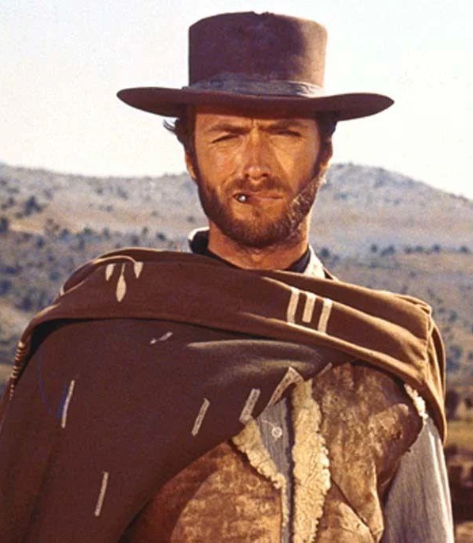
The intersection between Family Law, Domestic Violence and Child Protection:
A comparison of the good, the bad and the ugly**
By Deanna Musumeci

Slide 2


Interplay between the legislation
DOMESTIC AND FAMILY VIOLENCE PROTECTION ACT 2012
FAMILY LAW ACT 1975
CHILD PROTECTION ACT 1999

Slide 3
Family Law Act 1975
Deals with family law matters – children, property, spousal maintenance
Overarching principles
Objectives – parenting
Central Practice Directions

Slide 4
Domestic and Family Violence Protection Act 2012 (Qld)
The main objects for administering the Domestic and Family Violence Protection Act 2012 (Qld) are to:
  Maximise the safety, protection and wellbeing of people (including children) who fear, experience or are exposed to domestic violence; and
  Prevent or reduce domestic violence and exposure of children to domestic violence; and
  Ensure that people who commit domestic violence are held accountable for their actions.

Slide 5
Child Protection Act 1999
The purpose of this Act is to provide for the protection of children.
The main principle for administering this Act is that the safety, wellbeing and best interests of a child, both through childhood and for the rest of the child’s life, are paramount.

Slide 6

Jurisdictional Considerations

Slide 7
Jurisdictional Boundaries
Competing authority
Considerations which are relevant to this determination include parenting arrangements, protection orders and/or child protection intervention
Do I need to understand the separate processes and rules of different courts and tribunals?

Slide 8
Jurisdictional Conflicts
The need to identify potential conflicts or inconsistencies between the legal frameworks of different jurisdictions.
How will these conflicts impact the outcome of the matter or the enforcement of orders?

Slide 9
Consent and Confidentiality
How do the rules and limitations regarding the sharing of confidentiality apply to cross-jurisdiction matters?
The need to consider the sequence of proceedings, the coordination of evidence, and the timing od hearings.
What does the client want??

Slide 10

Case Management and Court Processes

Slide 11
Case Planning
Developing a comprehensive case management plan.
Why it is important to consider the sequence of proceedings, the coordination of evidence, and the timing of hearings.
For example – Child Protection proceedings on foot and wanting to commence FCFCOA proceedings for care arrangements

Slide 12
Expertise and Collaboration
Engaging with professionals
How does this help to present my case effectively in each jurisdiction?

Slide 13

Cultural Sensitivity and Client Support

Slide 14
Cultural and social Considerations
Considering the Cultural and social backgrounds and needs of clients in cross-jurisdictional matters.
Why it is important to understand the impact of cultural/social factors on domestic violence, child protection and family law issues?

Slide 15
Client Support Networks
Lastly, make sure to facilitate connections with support networks to provide comprehensive assistance and support to your client throughout the processes.

Slide 16
Case exampleS OF THE INTERPLAY, AT PLAY!
Isles v Nelissen (first instance decision)

Slide 17
WHICH ACT IS THE GOOD, BAD & UGLY?
CHANGES TO LEGISLATION AS A RESULT OF ‘HEAR HER VOICE’
CHANGES TO FAMILY LAW ACT IMMINENT
CHILD PROTECTION ACT …………………………………………………

