Slide 1
The Joy of Trusts - a delicate question
Executor and trustee removal applications
Some observations and practical tips

Slide 2
“An executor, like a trustee, is in a fiduciary position with the beneficiary and the essential elements of a trust are all present in executorship.
However, although there are great similarities between the two offices, it is not possible to identify the position of an executor with that of a trustee. Their respective powers and duties differ in important respects.
The principal duties of an executor are to get in the assets of the deceased, to pay the legacies given by the will, and to distribute the assets.”
Meagher and Gummow, Jacobs’ Law of Trusts in Australia, (6th ed., 1997), at para. 241

Slide 3
Jurisdiction:
"to hear and determine all testamentary matters and to hear and determine all matters relating to the estate of any deceased person; and has jurisdiction to make all such declarations and to make and enforce all such orders as may be necessary or convenient in every respect”
s6 Succession Act 1981

Slide 4
“In deciding to remove a trustee the court forms a judgment based upon considerations, possibly large in number and varied character, which combine to show that the welfare of the beneficiaries is opposed to his continuing occupant of the office.
Such a judgment must be largely discretionary.
But in a case where enough appears to authorise the Court to act, the delicate question upon whether it should act and proceed to remove a trustee is one upon which the decision of a primary judge is entitled to especial weight.”
Miller v Cameron (1936) CLR 572

Slide 5
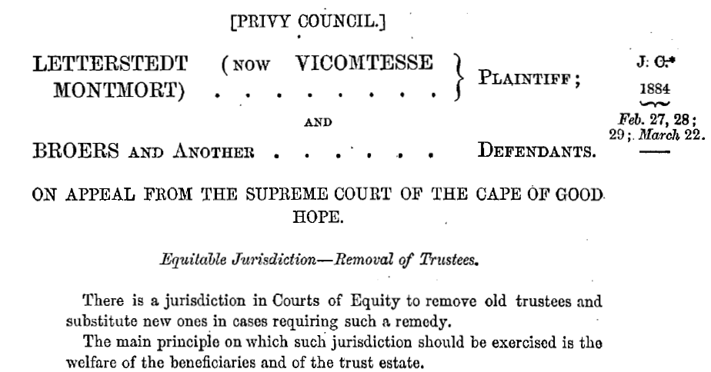

Slide 6
“In case of positive misconduct, Courts of Equity have no difficulty in interposing to remove trustees who have abused their trust; it is not indeed every mistake or neglect of duty, or inaccuracy of conduct of trustees which will induce Courts of Equity to adopt such a course. But the acts or omissions must be such as to endanger the trust property or shew a want of honesty, or want of proper capacity to execute the duties, or want of reasonable fidelity”
Letterstedt v Broers (1884) 9 App Cas 371

Slide 7
“In exercising so delicate a jurisdiction as that of removing trustees, their Lordships do not venture to lay down any general rule beyond the very broad principle … enunciated, that their main guide must be the welfare of the beneficiaries.”
It is quite true that friction or hostility between trustees and the immediate possessor of the trust estate is not of itself a reason for the removal of the trustees. But where the hostility is grounded on the mode in which the trust has been administered, where it has been caused wholly or partially by substantial overcharges against the trust estate, it is certainly not to be disregarded.”

Slide 8
“A Court will not lightly interfere with a testator’s appointment of executors and trustees. Its ultimate concern must be with the due administration of the estate in the interests of creditors and beneficiaries … careful consideration needs to be given to actual and potential conflicts of duty and interest, as well as to the extra expense that might be expected from bringing in an independent third party to administer the estate.”
Williams v Williams [2005] 1 Qd R 105 [45]

Slide 9
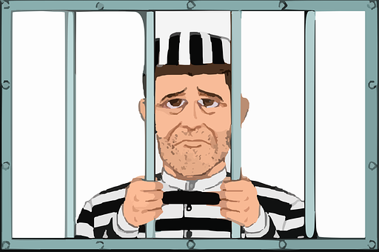

Slide 10
“In deciding to remove a trustee the court forms a judgment based upon considerations, possibly large in number and varied in character, which combine to show that the welfare of the beneficiaries is opposed to his continuing occupation of the office. Such a judgment must be largely discretionary.
A trustee is not to be removed unless circumstances exist which afford ground upon which the jurisdiction may be exercised.”

Slide 11
“It follows that a trustee’s past conduct may be so concerning as to give good reason to intervene but, in considering whether the court should intervene, the issue is whether the future welfare of the beneficiaries is opposed to the trustee continuing”
“the welfare of the children as a consideration in administering the trusts does not fall to be assessed in a vacuum”
JPD V DMS as Trustee [2022] QSC [28]

Slide 12
“… it will be necessary to enquire further to see who was to blame for any dissention since otherwise the cestui che trust will be placed in the falsely powerful position of being able to raise a dispute with their trustee and then apply for their removal”
JPD v DMS as Trustee [2022] QSC 181

Slide 13
“A trustee is an accounting party. It is a fundamental obligation of a trustee to keep and render to the beneficiaries a full and candid record of their stewardship, including all appropriate financial accounts …
That duty to account encompasses a duty to keep records, a duty to report to the beneficiaries and/or the court, and a duty to pay amounts the trustee is obliged to pay to the beneficiaries.”
Byrnes v Kendle (2011) 243 CLR 253 [42]

Slide 14
… where the court’s assistance in enforcing the trustee’s obligation to account is invoked, the court should be concerned with only two questions, they being: first: whether the plaintiffs are, or the plaintiff is one of the cestius che trust; and second: whether the defendant trustee has failed to observe his obligation to account.”
Spellson v George (1987) 11 NSWLR 300 [315-316]

