Slide 1


Tips on Navigating Local Government Issues
Presentation to North Queensland Law Association Conference
20 May 2023
| Preston Law

Slide 2

Introduction
Probity and Procurement
Delegated Decision Making
Native Title
Human Rights
Right to Information
Employment

Slide 3
Probity and Procurement
Medium sized contractual arrangements
  $15,000 or more but less than $200,000
  3 quotes
Large sized contractual arrangements
  $200,000 or more ex GST
  Tenders
Exemptions apply
Risk Areas:
  Departures, and using non-conforming tenders
  Possibility of relying on negotiations following tender award

Slide 4

Delegated Decision Making
Starting Point: A Council Resolution
Section 257 Local Government Act – delegate to CEO (or Mayor)
Section 259 – CEO delegate to other officers (sub-delegations)
BUT NOTE:
  CANNOT delegate powers exercisable by resolution or which require Council to “adopt” something (adopt = resolution)
  “Direct to CEO” powers – no delegation necessary (but s. 259 sub-delegation available)
© Preston Law

Slide 5
Native Title
Compensation is the key area of change
Payable by the Commonwealth or the State, on just terms
Landmark case of Timber Creek, decided in March 2019. First High Court decision on compensation
  Three grounds for compensation – economic loss (calculated up to the freehold value of the land), interest, non-economic (cultural/spiritual) loss
  High Court: non-economic loss is “what the Australian community would regard as appropriate, fair or just” – in this case, $1.3m for 127 hectares
  Award was approximately 4x freehold value of date of extinguishing act

Slide 6
Native Title (cont.)
Limited cases, in part because compensation claims to be finalised after claims are determined. This will be the next big area of change in Native Title Law.
Native Title determined over 280 million hectares of land in Australia
What might be on the agenda?
  A change to the Native Title (Queensland) Act 1993 (Qld) to transfer compensation liability from State to other parties – eg project proponents (as is the case in WA/NSW for resource holders)
  Funding availability
  Passing on risk

Slide 7
human Rights
Qld legislation commenced operation on 1 January 2020
Purpose to consolidate and establish statutory protections
Ensure public functions are exercised in a compatible way
In making decisions, Council must properly consider human rights
Must not be incompatible but Human Rights can be limited
© Preston Law

Slide 8
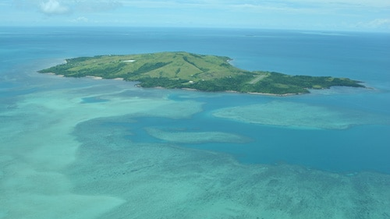
Human Rights (cont.)
Waratah Coal v Youth Verdict – Land Court decision delivered 25 November 2022
  Recommended Minister refuse MLA
  Considered:
    Section 28 HR Act
    UN Declaration on the Rights of Indigenous Peoples
  Climate change in Torres Strait – result in cultural heritage displacement
  No allegation of breach of Aboriginal Cultural Heritage Act

Slide 9
Right to Information
Check resources that are already publicly available first
If a client needs to utilise the access regime under the RTI Act, then:
  Be aware of formalities – application fee, verification of ID, submission of approved form properly completed
  Consider timeframes – 25 business days, plus extensions in certain circumstances and “clock stopping” acts
Appeal rights:
  Internal review, but only if decision maker is not Council’s CEO.
  External review, to the Office of the Information Commissioner.
  20 business days on receipt of decision notice (not necessarily receipt of documents).

Slide 10
Employment
Local Governments subject to Industrial Relations Act 2006 (Qld)
Unfair dismissal/general protections claims heard in the Queensland Industrial Relations Commission
Local Government Regulation 2012 sets out requirements about:
  How CEO of a Council must give a Notice of Grounds for Disciplinary Action
  Specific disciplinary action available
    Typically dismissal or written reprimand/warning (which must contain particular details to be valid)
    Also an option: demotion and deduction from salary of not more than 2 penalty units

Slide 11





Contact Us
Julian Bodenmann| Partner
07 4052 0717
jbodenmann@prestonlaw.com.au
prestonlaw.com.au

