Slide 1

Upskill your legal research with

Slide 2



This session will cover
Who is the Supreme Court Library Queensland?
Using library resources for research
Library services for you

Slide 3
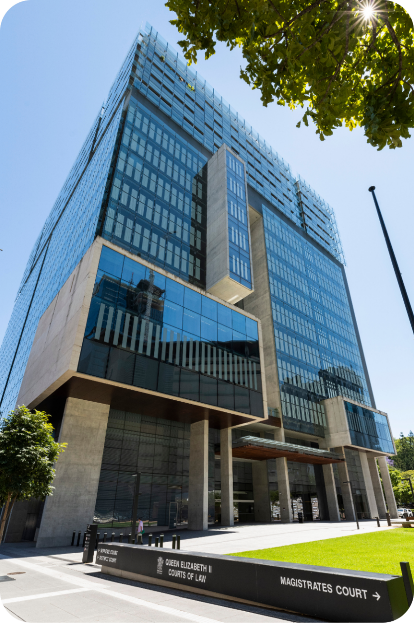

Who are we?
Queensland’s largest law library
We provide legal information, research and training services to Judges, practitioners
  and members of the public.
Over 160 years old!
Have locations all across Queensland

Slide 4



Your free information services
30 minutes of free research a day
10 documents delivered to your inbox a day for free
Free legal research training

Slide 5



Your free library facilities*
Extensive collection
Printing, scanning and photocopying
Wi-Fi
Desktop computers

Slide 6



Your free collections
Queensland Sentencing Information Service (QSIS)*
Unreported decisions on CaseLaw
Virtual Legal Library (VLL)*
*Eligibility conditions apply.

Slide 7
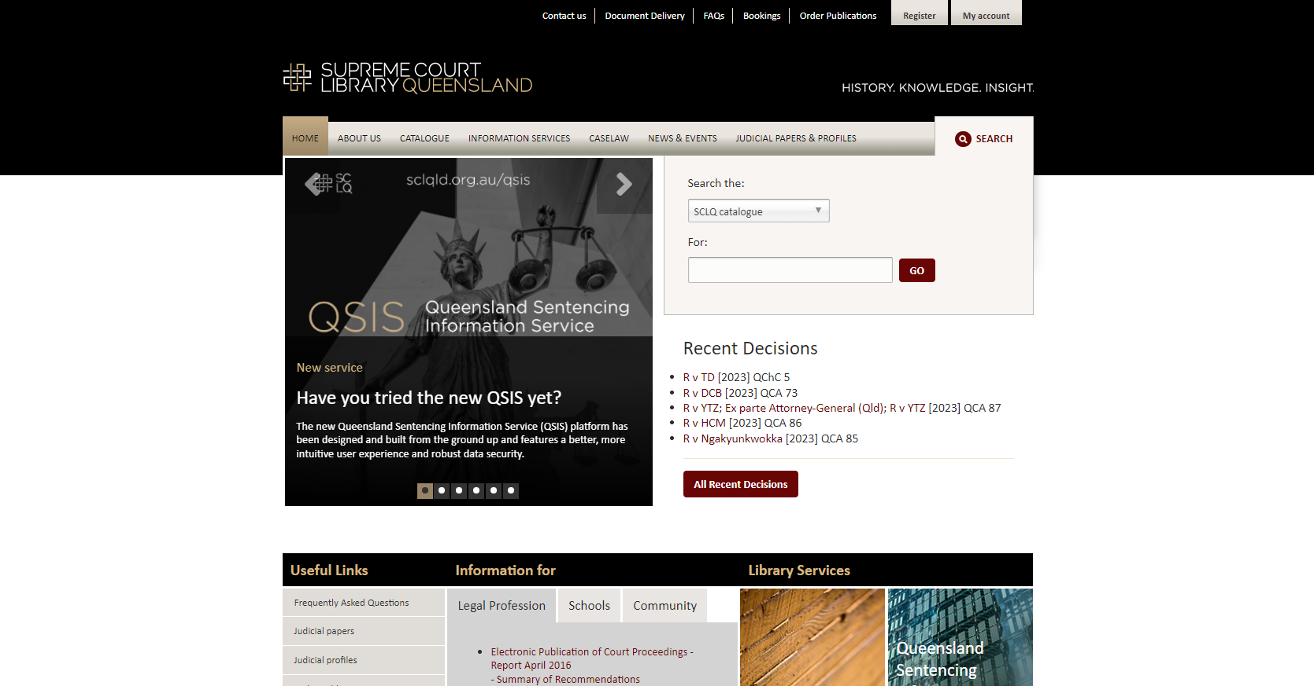
Our website
Notes:
Tour of the library’s website highlight:
Library catalogue: use to search for whether something is held in the library
Document Delivery link – submit a document or research request
My account: log in to VLL
Information services tab: apply for services
CaseLaw: find unreported Queensland decisions

Slide 8
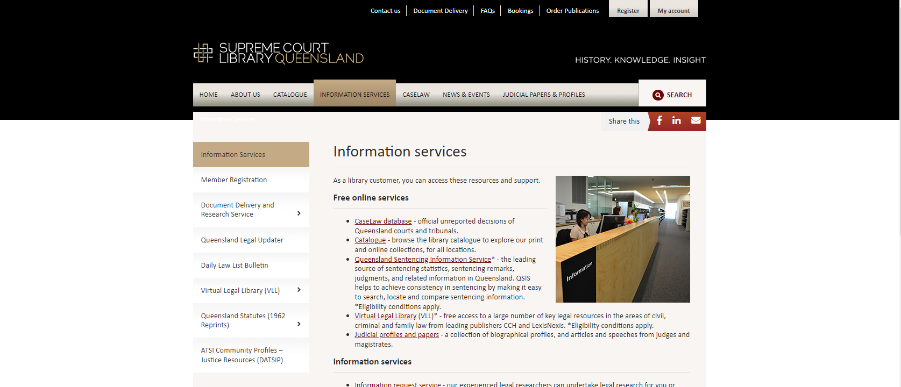
Our website
Notes:
Information services tab:
Register for services under ‘Member registration’
Find more information about document delivery and research service under the relevant tab
Log in to VLL or find more information under the VLL tab

Slide 9
The library catalogue

Slide 10
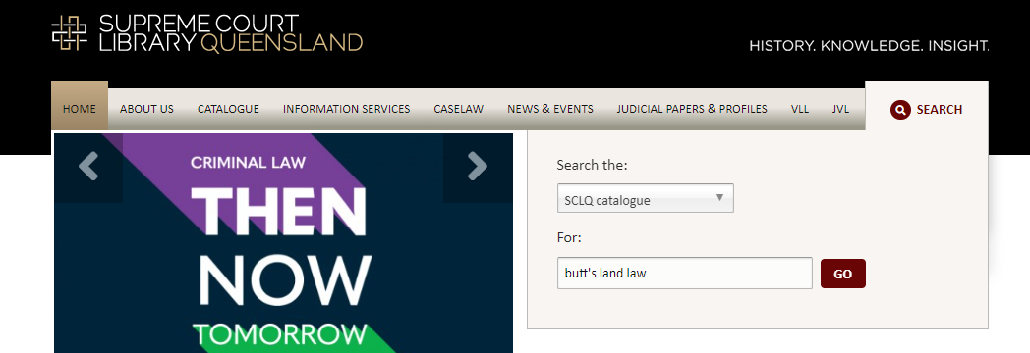
Our website
Notes:
Searching to see if something is available in the library
*Note you will not be able to access it remotely from here and that you will only be able to find books, journals, report series – you will not be able to find individual cases, journal articles etc.

Slide 11
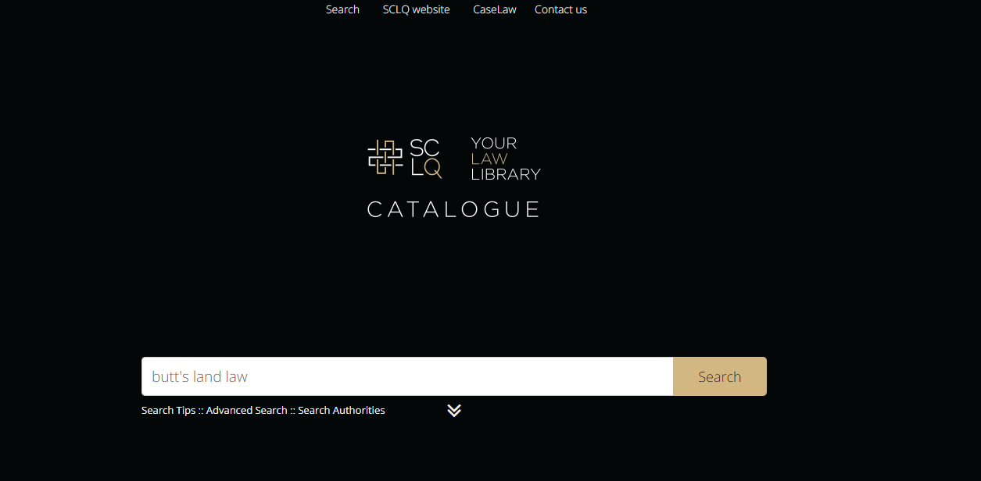
Our website
Notes:
Searching to see if something is available in the library
*Note you will not be able to access it remotely from here

Slide 12
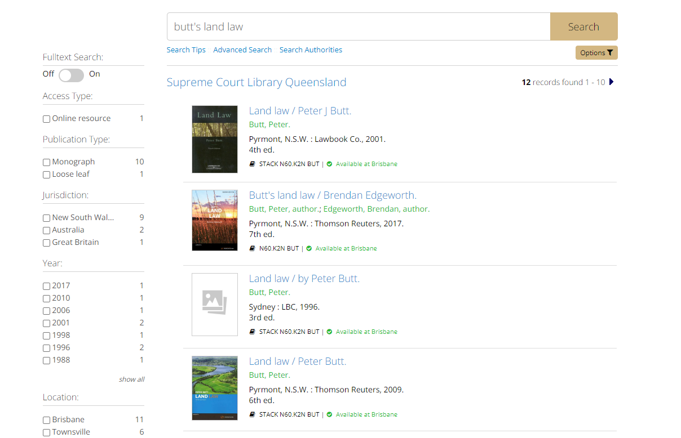
Our website
Notes:
Note where you are able to find it on the shelf

Slide 13
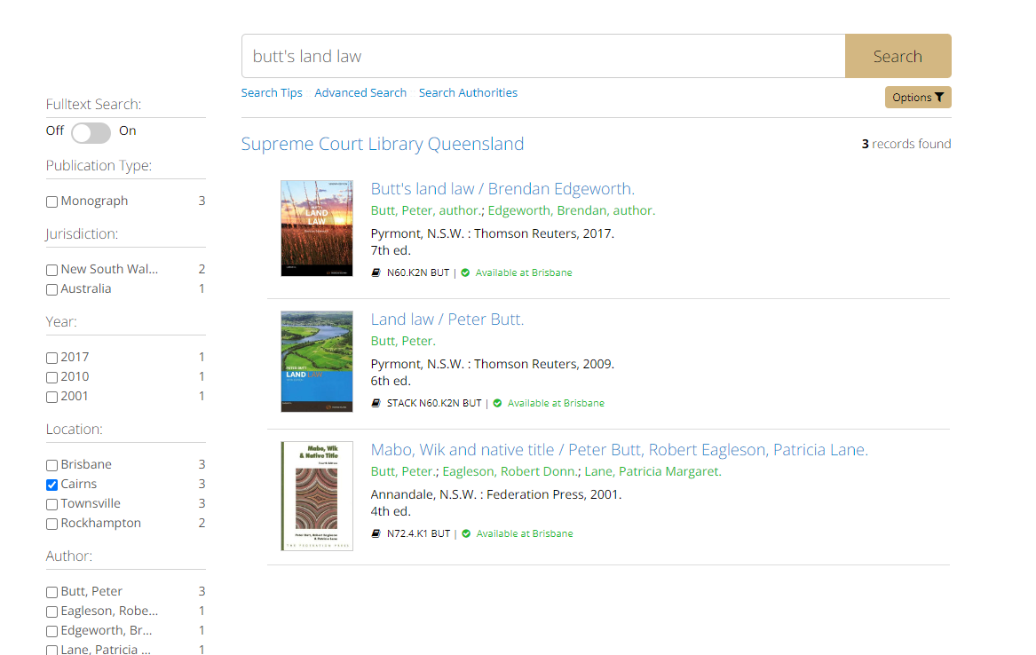
Notes:
Can limit by library to Cairns

Slide 14
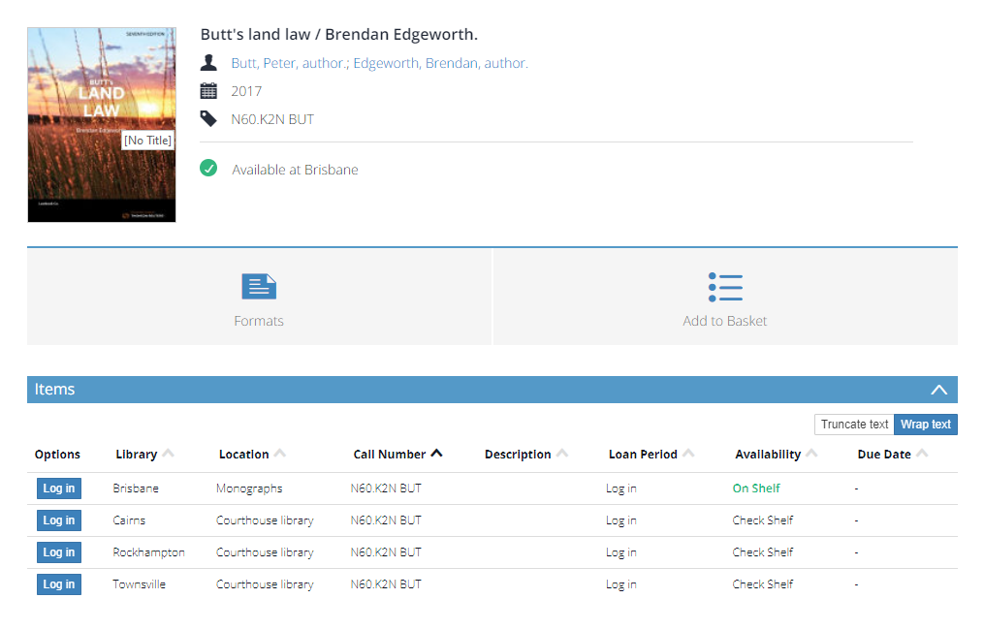
Notes:
If you click on the item record you will be able to confirm that it is available in Cairns and note the call number if you want to find it on the shelf.
Or request a section through document delivery

Slide 15
Virtual Legal Library

Slide 16
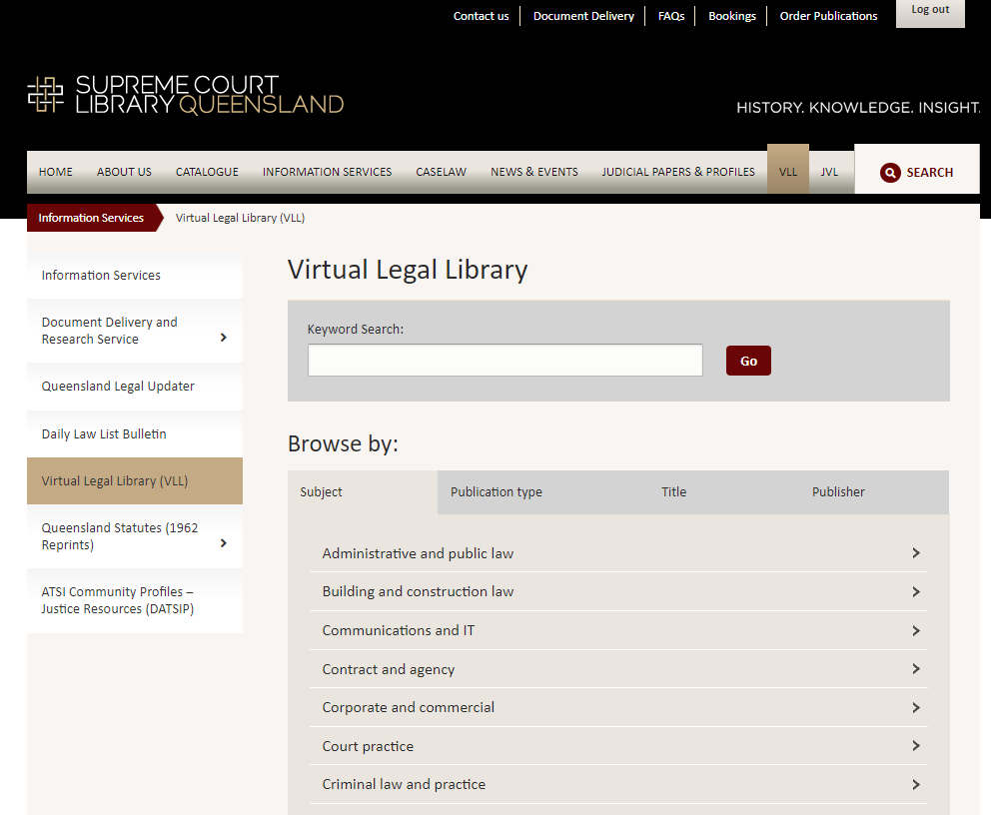
Our website
Notes:
VLL platform
Log in to VLL by either clicking on my account and using your username and password or through Information Services > VLL > Log in
Do a keyword search using broad terms to find resources - *note this only searches within the title not in the full text

Slide 17
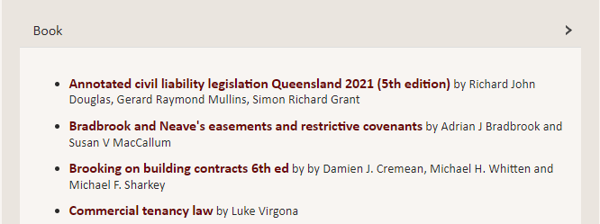
Our website
Notes:
When browsing you can click on the title to view the resource

Slide 18
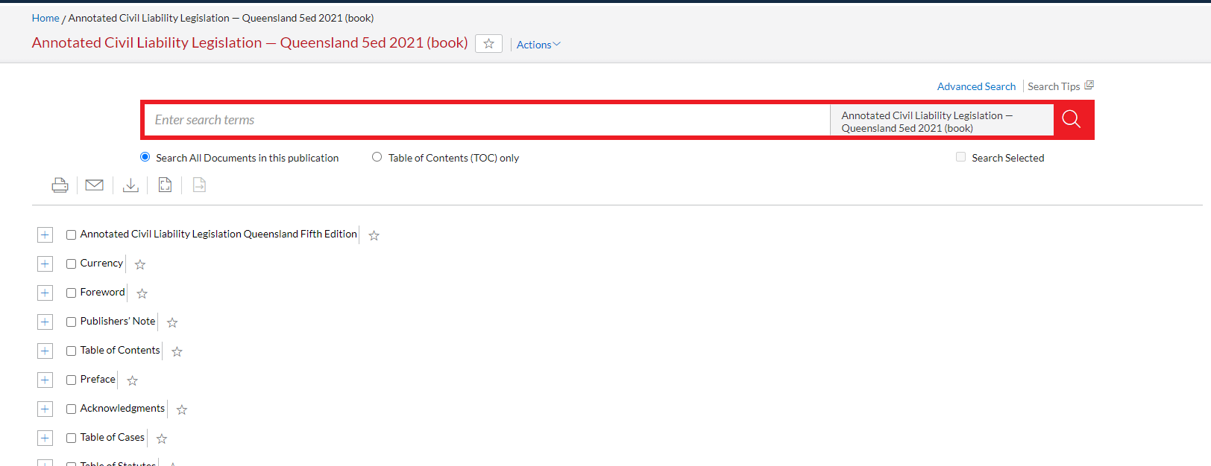
Our website
Notes:
There are two different types of resources:
- Some like this commentary will take you to within the platform it is located and you will be able to search within the resource or browse from there

Slide 19
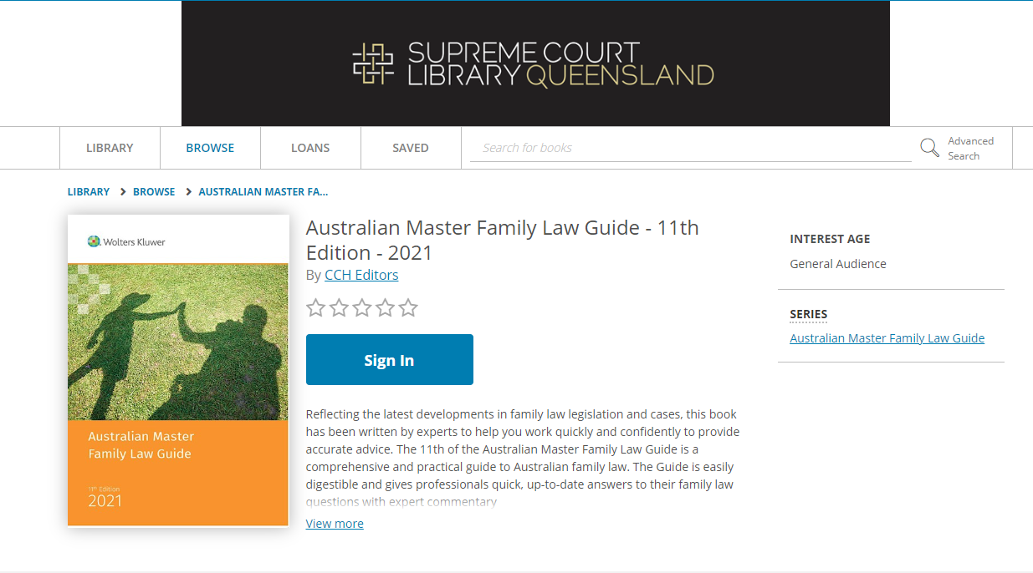
Our website
Notes:
The other type of resource we have are e-books hosted on the eLending platform
To read these you will need to click ‘Sign in’

Slide 20
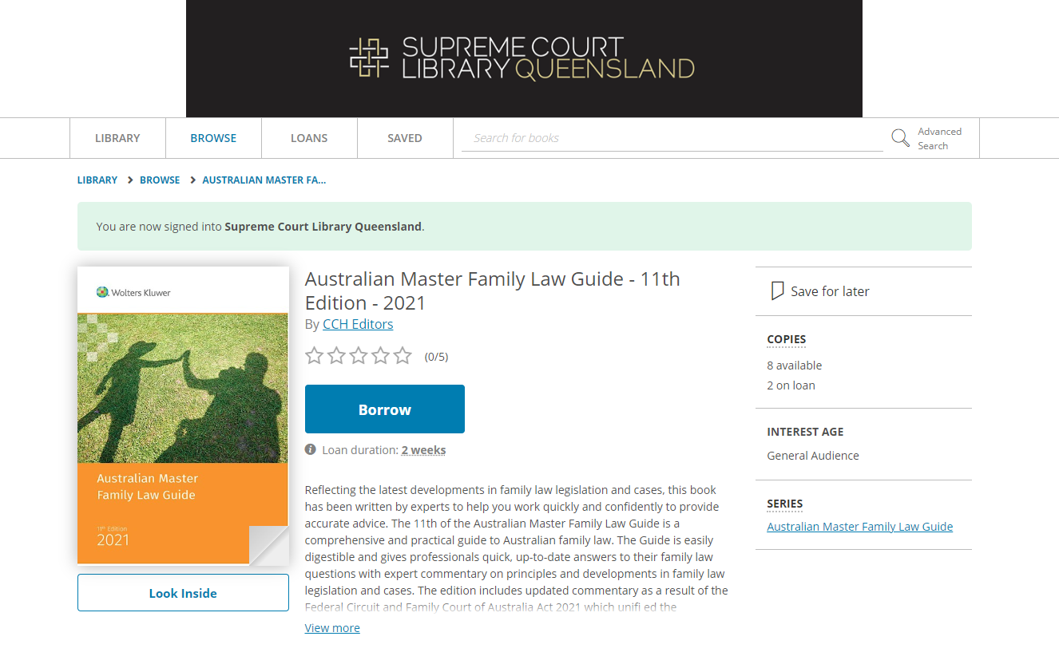
Notes:
‘Look inside’ to preview or ‘Borrow’ to read the full book
Note how many copies are available and on loan if you are unable to access it may be because all the copies are being read by other users – if you do finish with a book it is a good idea to return it to make sure everyone is able to access the book when they need it

Slide 21
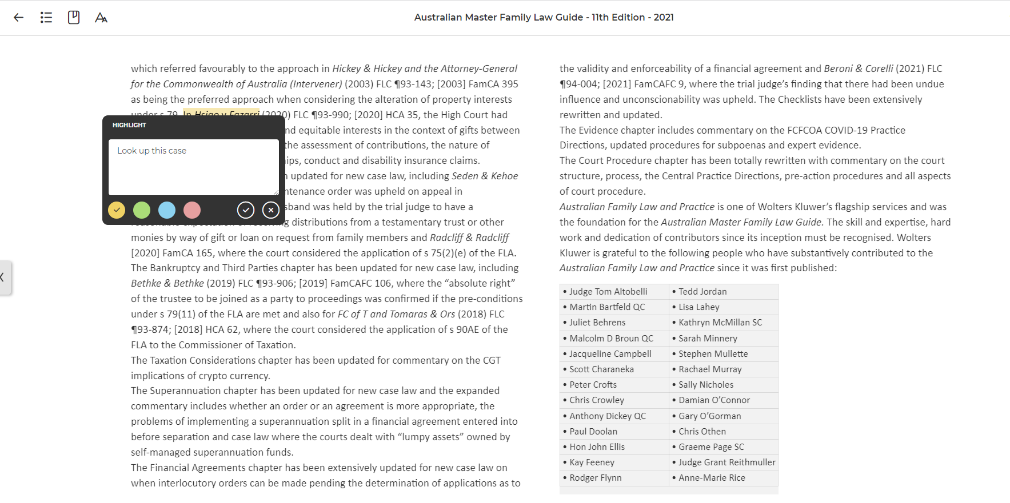
Notes:
eLending platform allows you to annotate and make notes on sections – you may want to download these sections once you have created them as they are unique to your session (i.e. don’t stay)

Slide 22
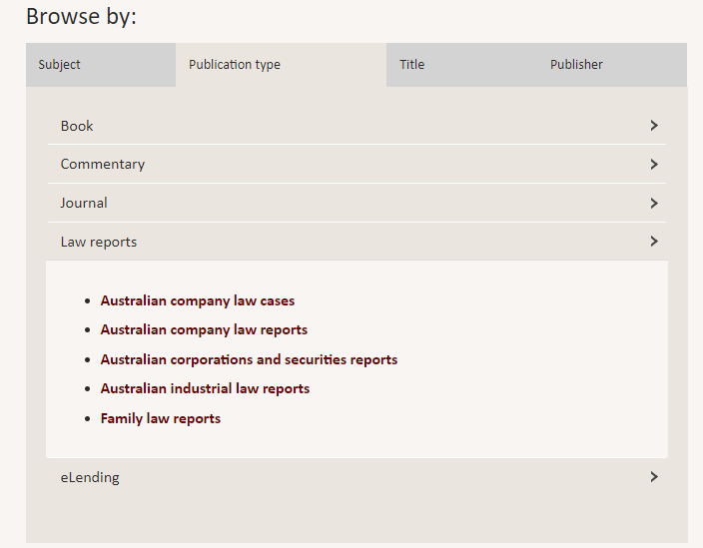
Notes:
Also a selection of law reports available – search or browse these through the link – will be available through the relevant platform

Slide 23
Queensland CaseLaw

Slide 24
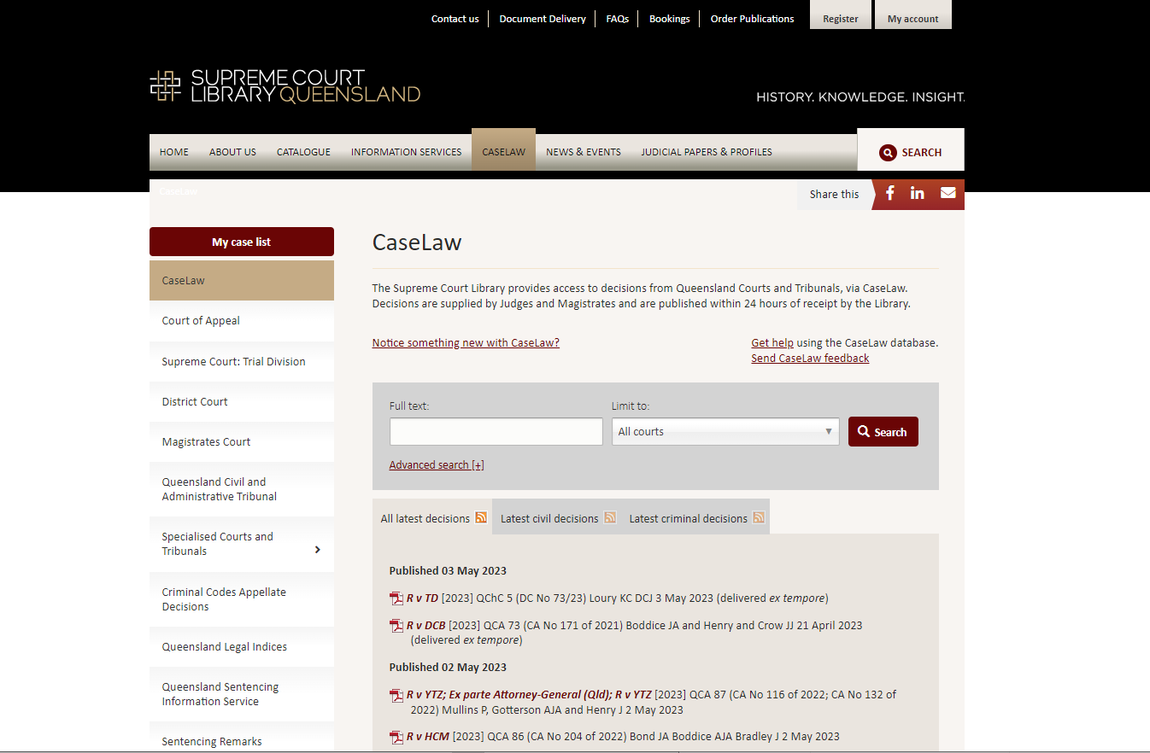
Our website
Notes:
CaseLaw will search across all the courts and tribunals – but not sentencing remarks
Do a keyword search in the full text box or click on the advanced search link for more options

Slide 25
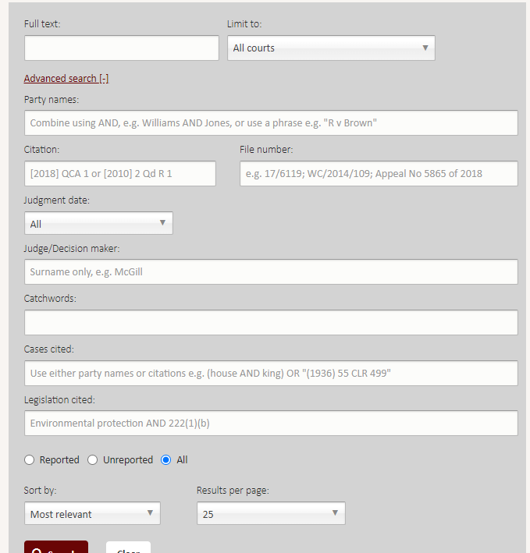
Notes:
Search across multiple fields

Slide 26
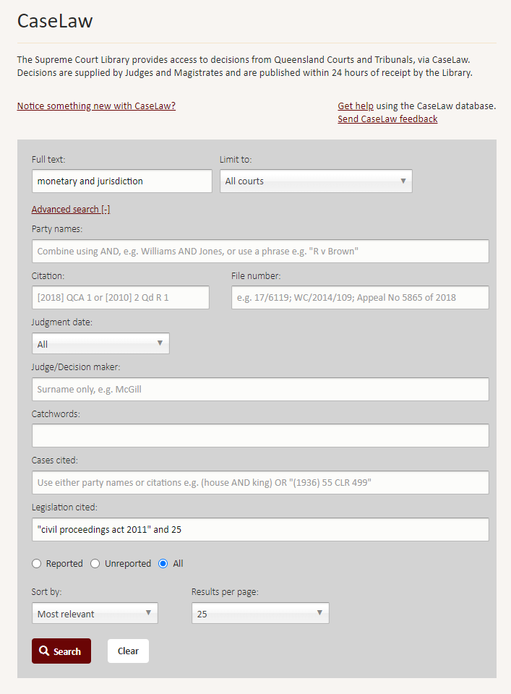

Slide 27
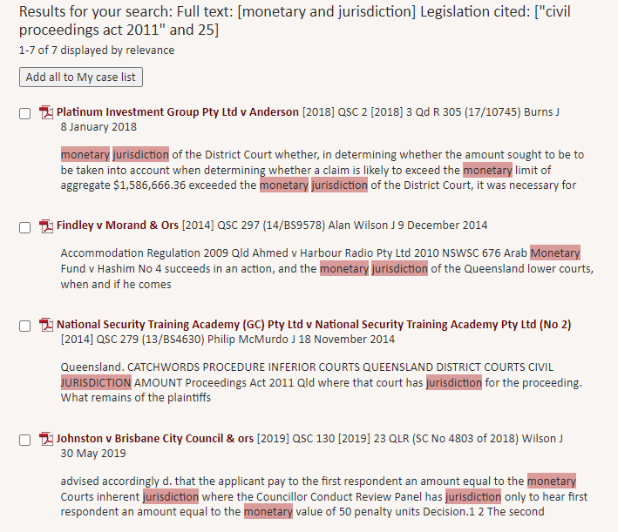
Notes:
Search results will highlight your search terms in the text

Slide 28
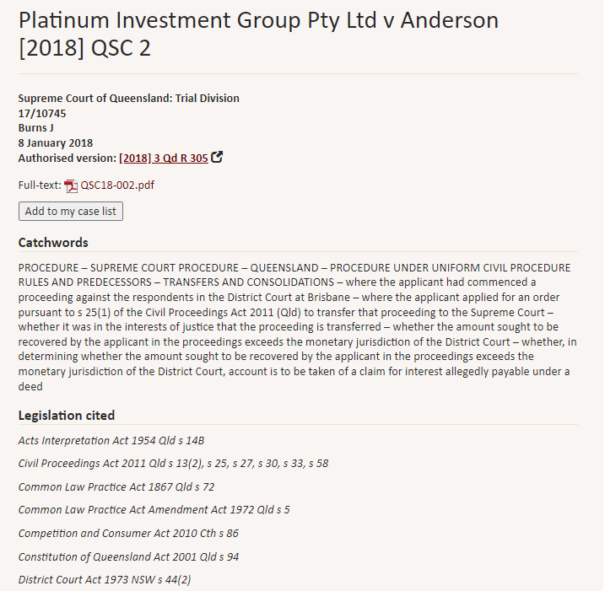
Notes:
View the authorised version – online via Queensland Judgments

Slide 29
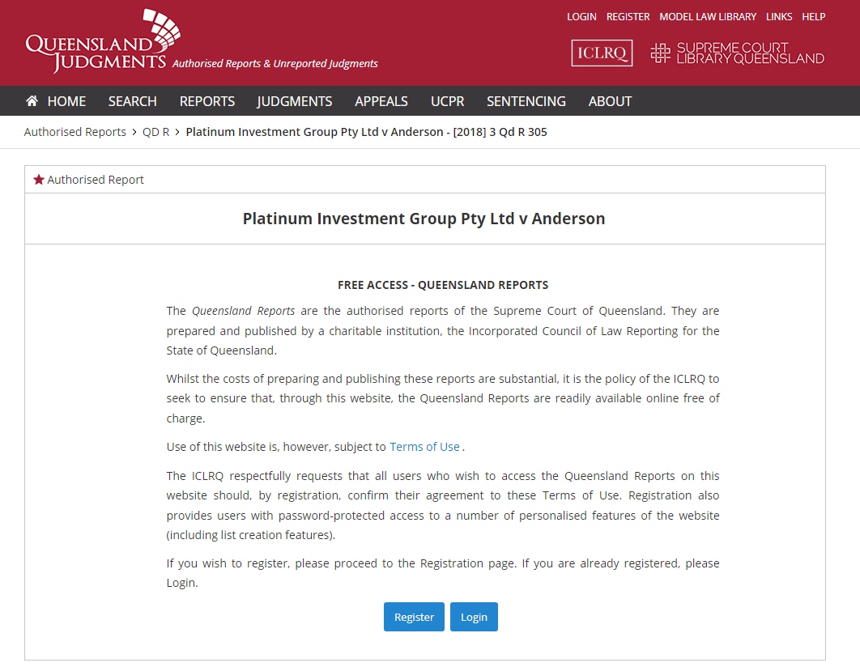
Notes:
You will need to register by providing your email address and creating a password to view the case

Slide 30
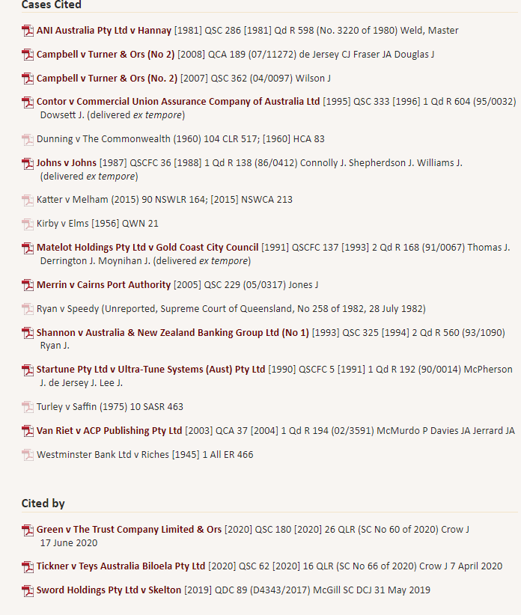
Notes:
When you’re on the record for the case you will also be able to see the Queensland decisions citing that decision

Slide 31
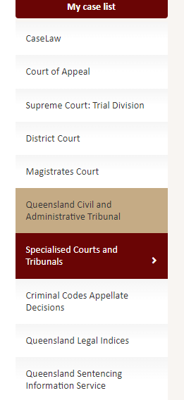
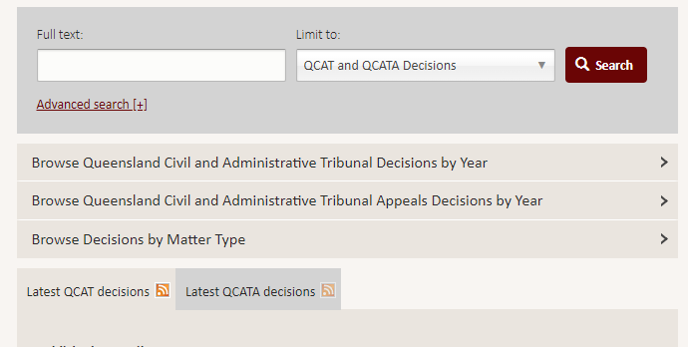
Notes:
For some of the specialised courts it’s worth searching from within their specific page – particularly for QCAT as you can browse and search by ‘Matter type’

Slide 32
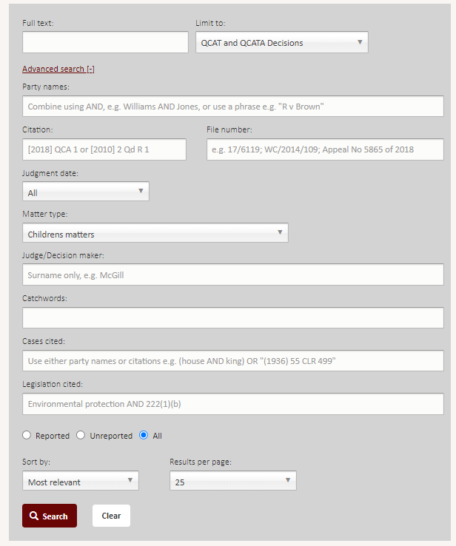
Notes:
There is also an advanced search field that allows you to limit by matter type

Slide 33
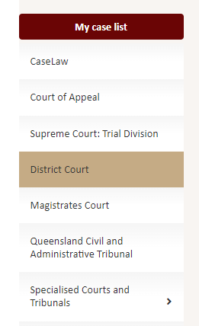
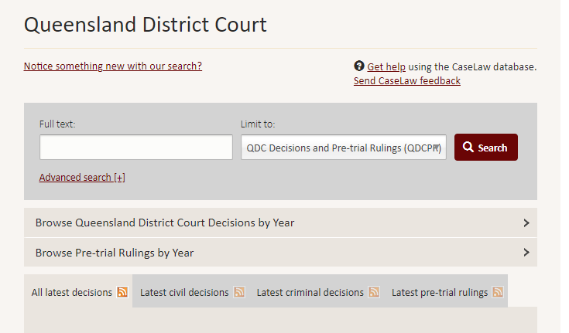
Notes:
QDC – can also find pre-trial rulings

Slide 34
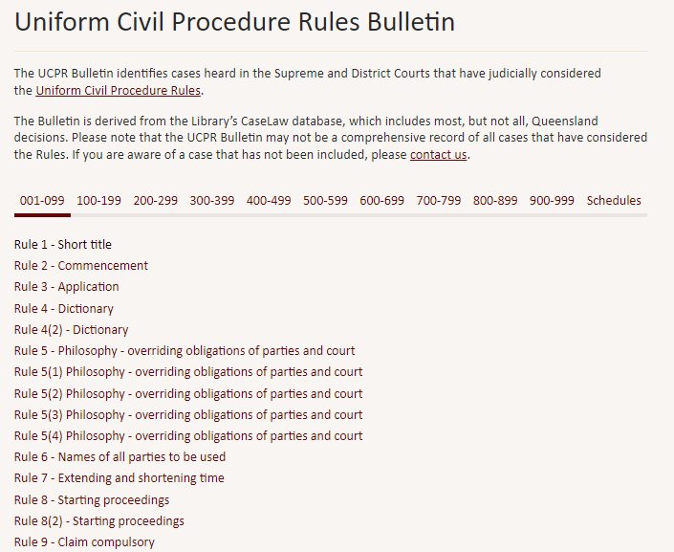
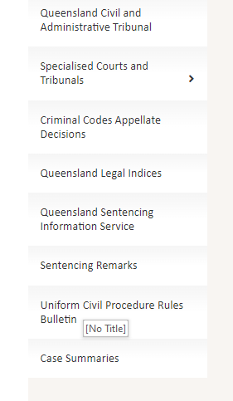
Notes:
UCPR Bulletin – browse for decisions referring to particular rules

Slide 35
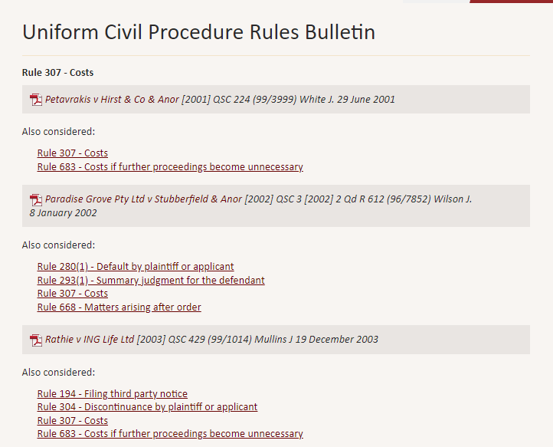
Notes:
Will also list related rules

Slide 36
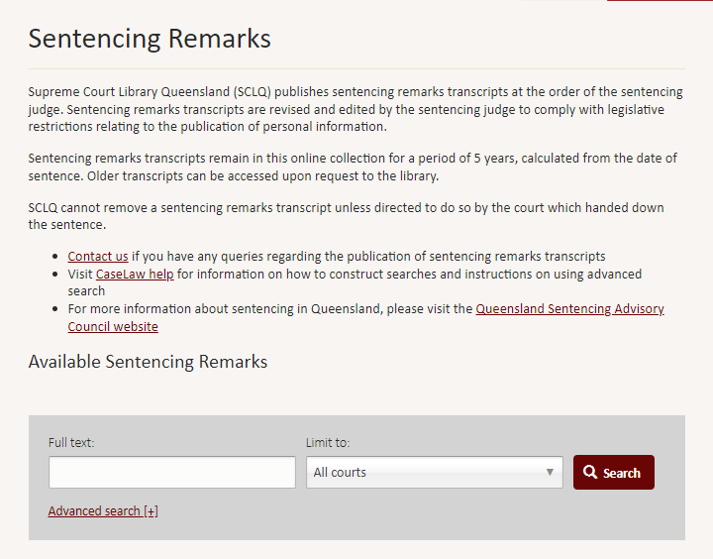
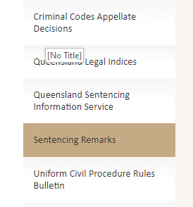
Notes:
Some sentencing remarks are made publicly available online – will need to go to the Sentencing Remarks tab to view these

Slide 37
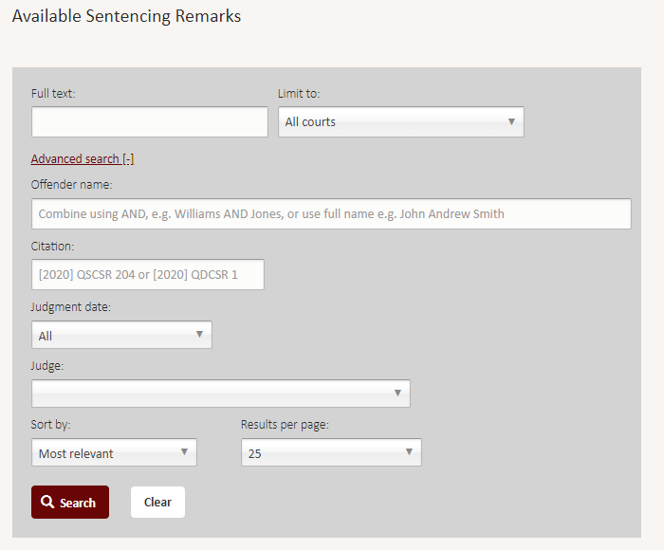
Notes:
Use advanced search to search for remarks by offender name, citation, date etc
Remarks only available publicly for five years

Slide 38
Queensland Sentencing Information Service (QSIS)

Slide 39
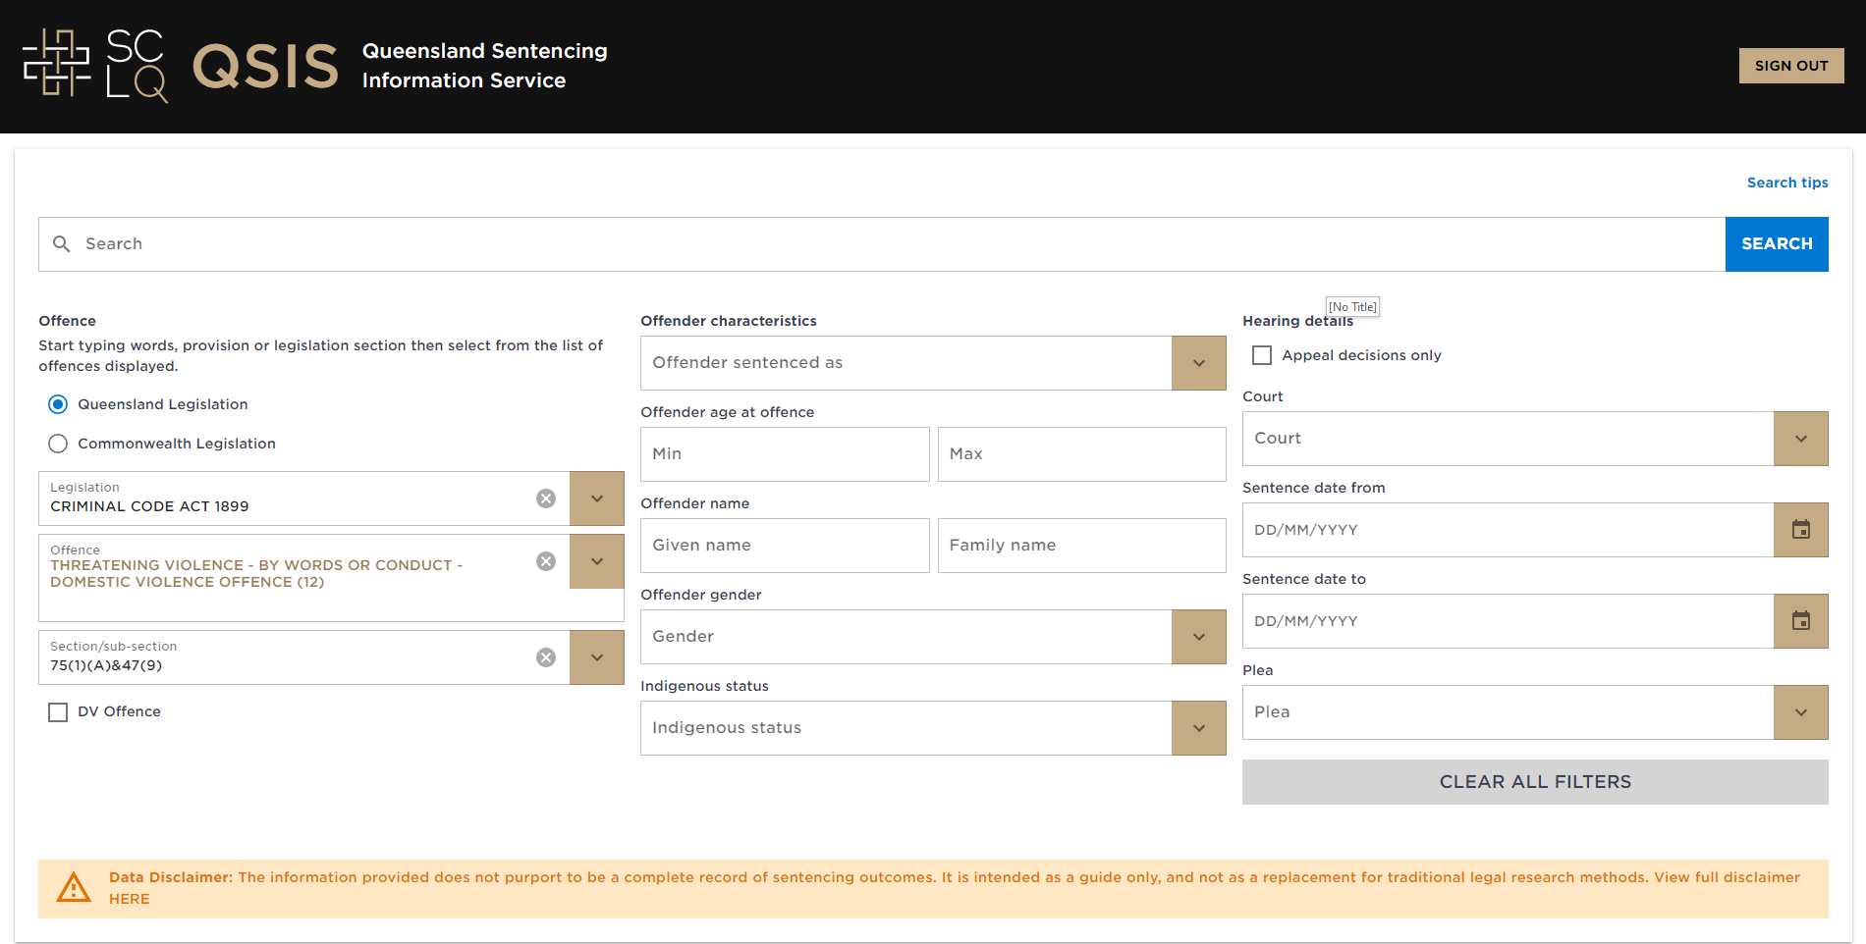

Slide 40
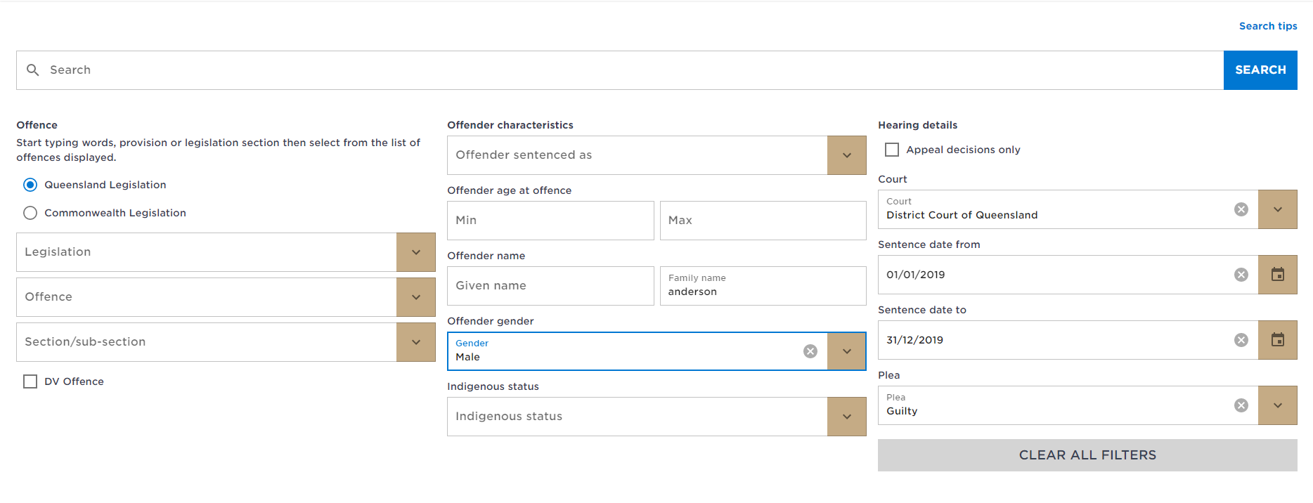
Notes:
Searching for specific sentencing remarks

Slide 41
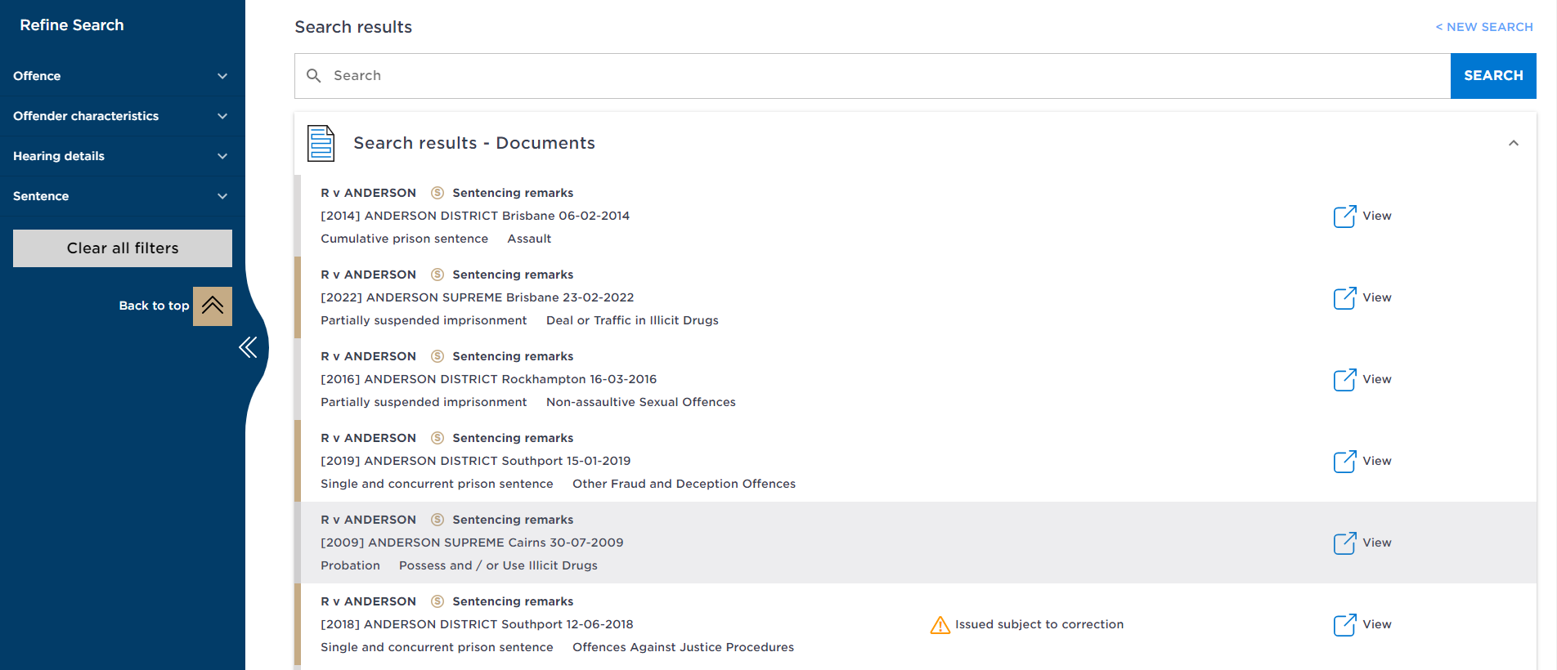
Notes:
Any additional notices regarding corrections will be made clear
Click view – not the title of the case to see the transcript
Use the filters on the left to further refine

Slide 42
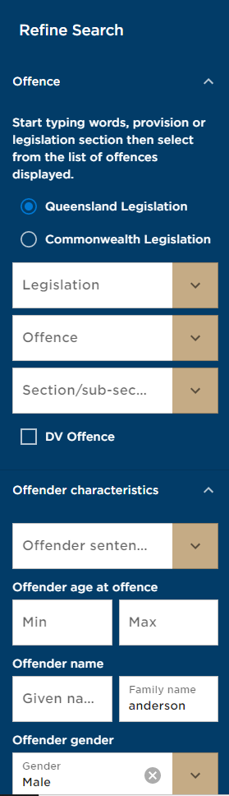
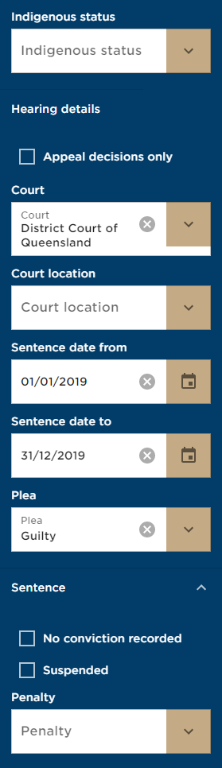
Notes:
Use filters including offence, offender characteristics, sentence and penalty

Slide 43
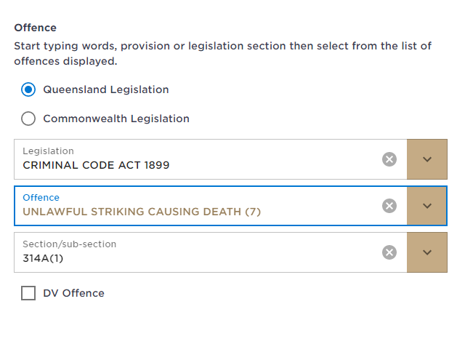
Notes:
Searching for comparable sentences
Type in the offence

Slide 44
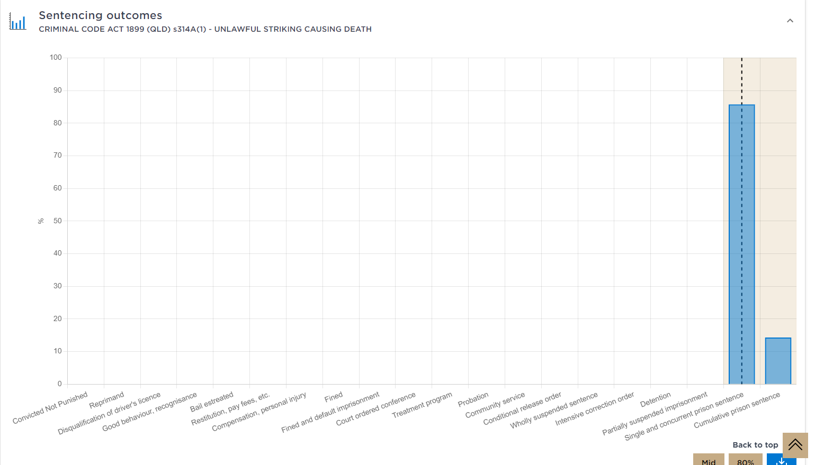
Notes:
If you would like to drill down further into a particular sentence, click on the bar graph

Slide 45
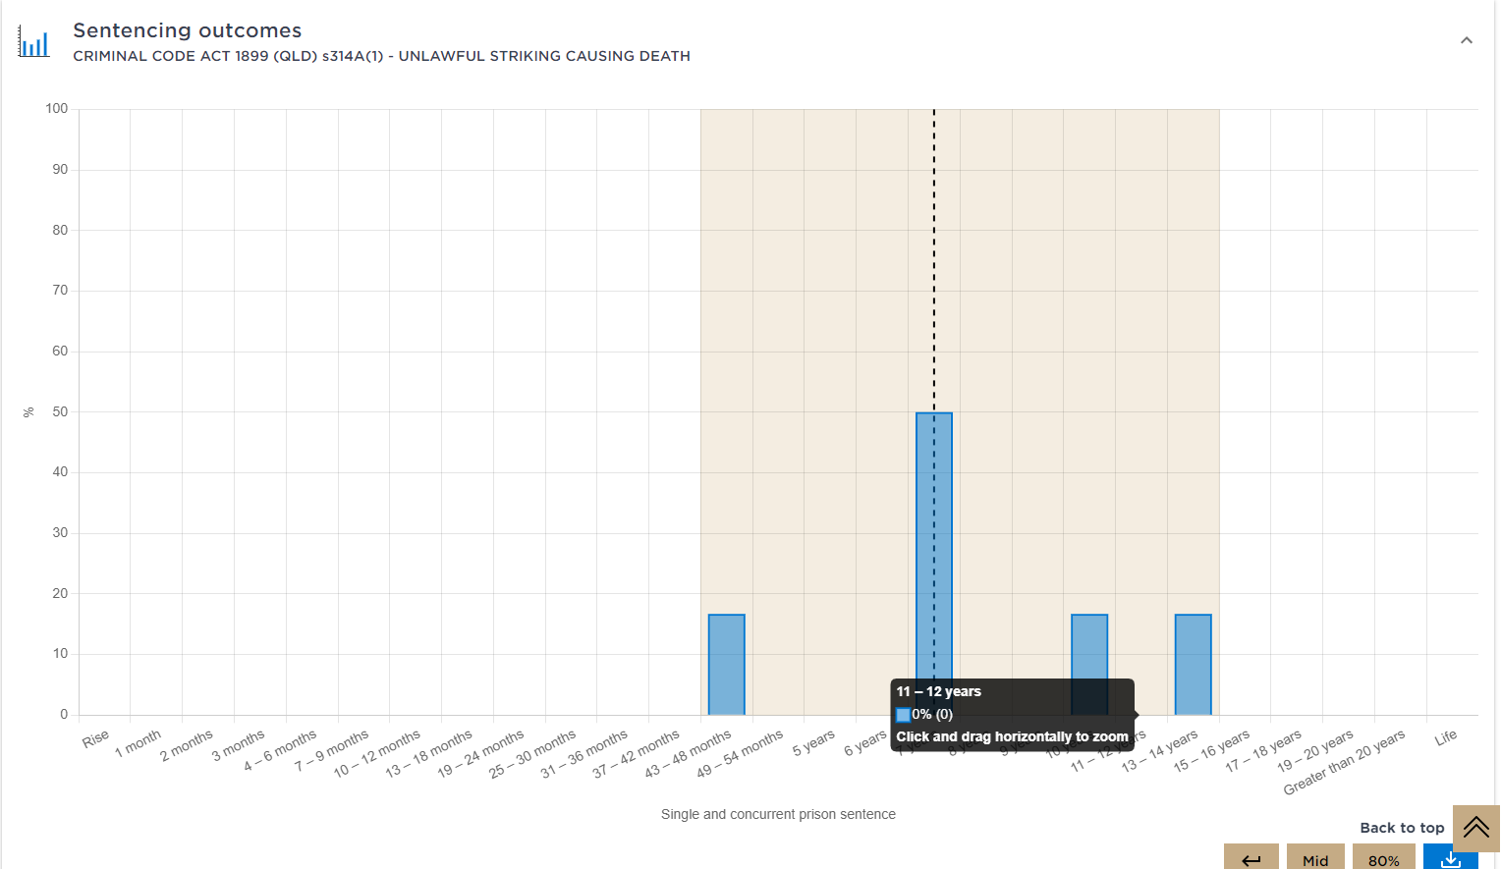
Notes:
View the range of years of sentence and where the majority of offenders fell within sentence

Slide 46
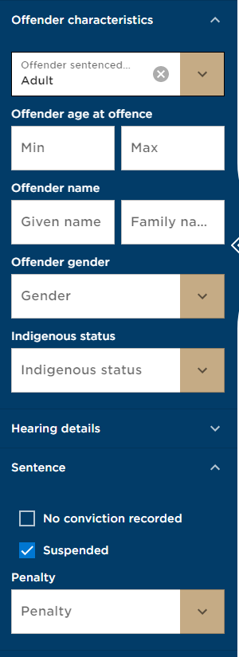
Notes:
At this point you can also use filters to narrow results

Slide 47
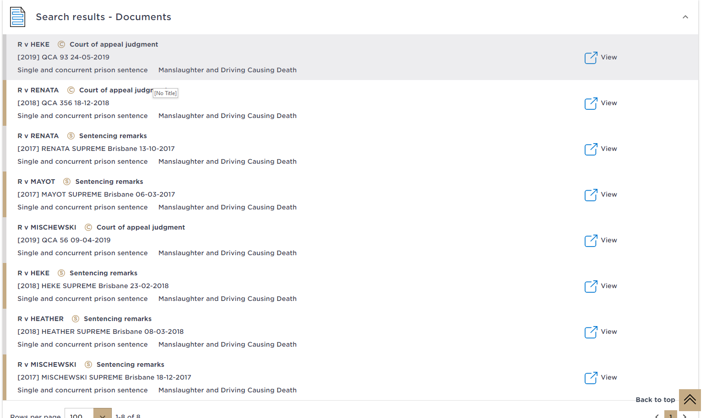
Notes:
View a list of the sentencing transcripts at the bottom

Slide 48
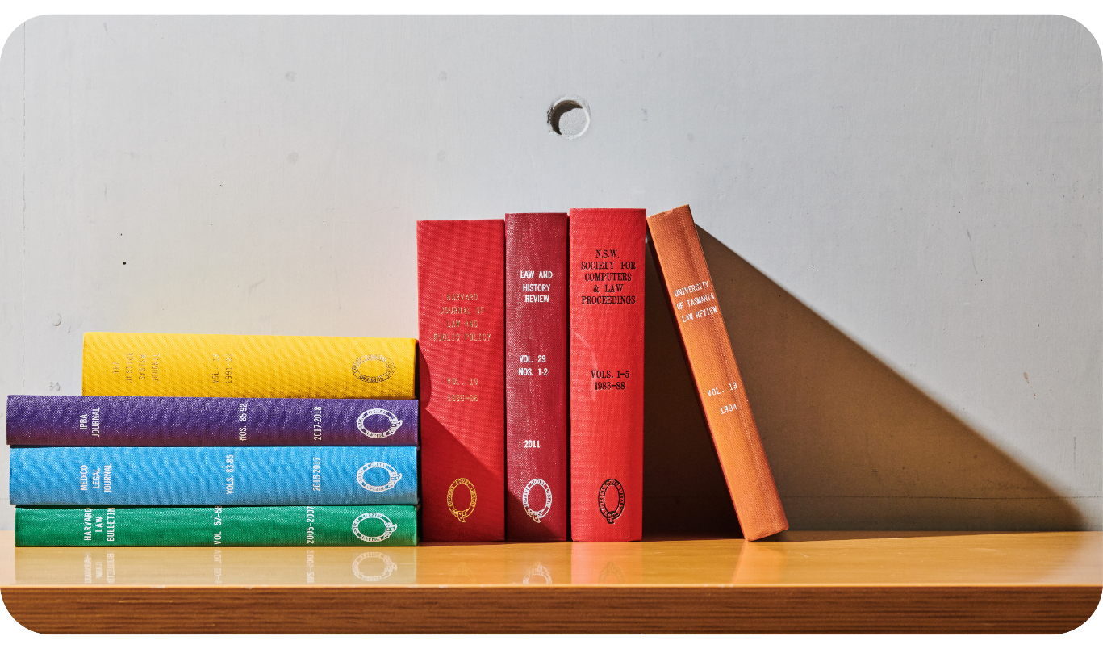
Contact us
informationservices@sclqld.org.au
sclqld.org.au

