Slide 1

Rural and Agribusiness Law: The Latest Updates and Challenges
Leah Mangano
Principal

Slide 2
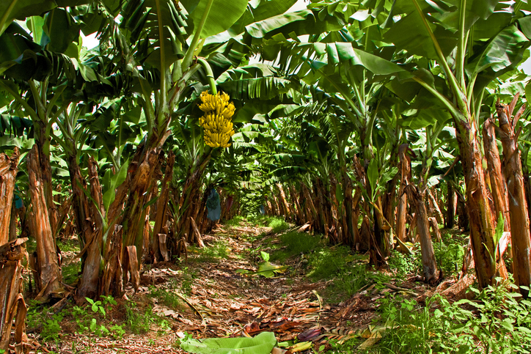

Slide 3
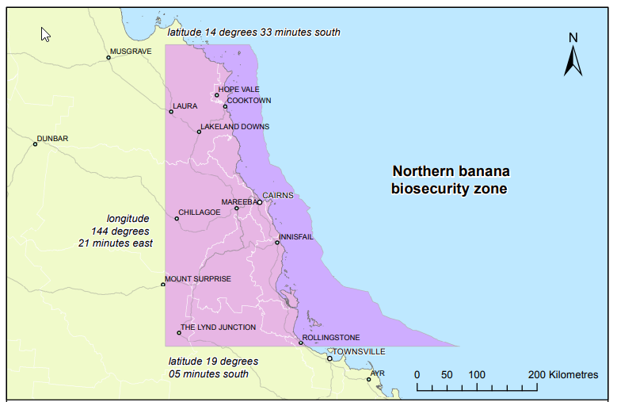

Lakeland
Mareeba
Innisfail
Tully
Kennedy

Slide 4
Sellers/
Buyers
Bank
Valuations
Landlords/
Tenants
Options for diversity?
Succession Planning
Liability?

Slide 5
Queensland Government Description of Panama TR4
Panama TR4 is one of the greatest threats to worldwide banana production. In some countries, it has had a devastating impact on industries and livelihoods.
If not managed it has the potential to do the same in North Queensland.

Slide 6
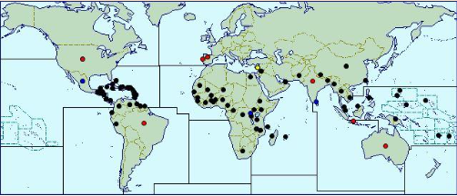
Present Widespread Localised

Slide 7
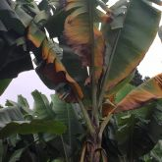
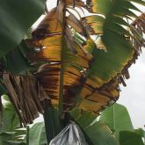
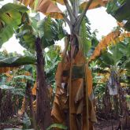
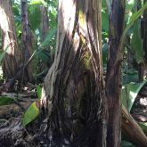
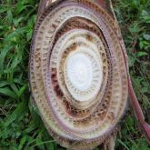

Advanced stages of Panama TR4
Do not cut open suspect plants!

Slide 8


Australian Bananas Ambassador
Billy Slater

Slide 9




Panama vs Healthy
Cross-section of a banana tree infected with Panama
Cross-section of a healthy banana tree

Slide 10
Timeline
Farm 1
15 March 2015
Farm 2
26 July 2017
Farm 3
24 January 2018
Farm 4
26 February 2020
Farm 5
10 September 2020
Farm 6
23 June 2022
Farm 7
24 March 2023
?
?

Slide 11
A general biosecurity obligation
The person has an obligation to take all reasonable and practical measures to prevent or minimise the biosecurity risk.
Biosecurity Act 2014

Slide 12
Also - A general biosecurity obligation
To prevent or minimise adverse effects on a biosecurity consideration of the person’s dealing with the biosecurity matter or carrier or carrying out the activity; and
To minimise the likelihood of causing a biosecurity event, or to limit the consequences of a biosecurity event caused, by dealing with the biosecurity matter or carrier or carrying out the activity; and
Not to do or omit to do something if the person knows or ought reasonably to know that doing or omitting to do the thing may exacerbate the adverse effects, or potential adverse effects, of the biosecurity matter, carrier or activity on a biosecurity consideration.
Biosecurity Act 2014

Slide 13
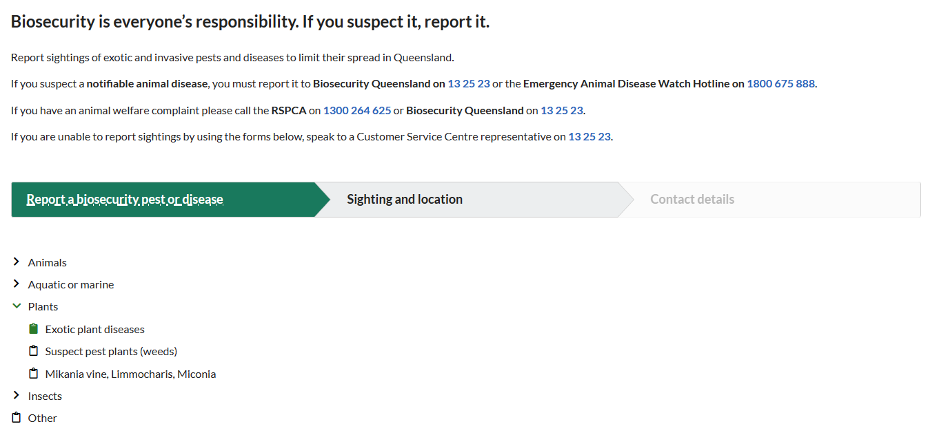
Report to Biosecurity

Slide 14
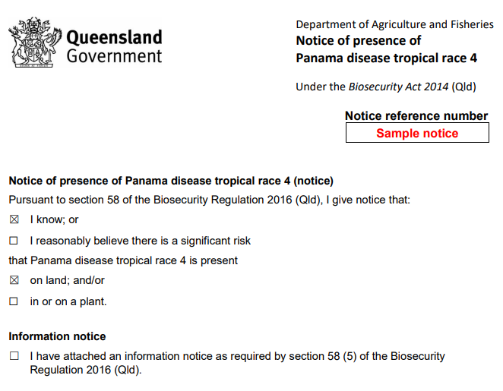

NOTICE OF PRESENCE OF PANAMA

Slide 15
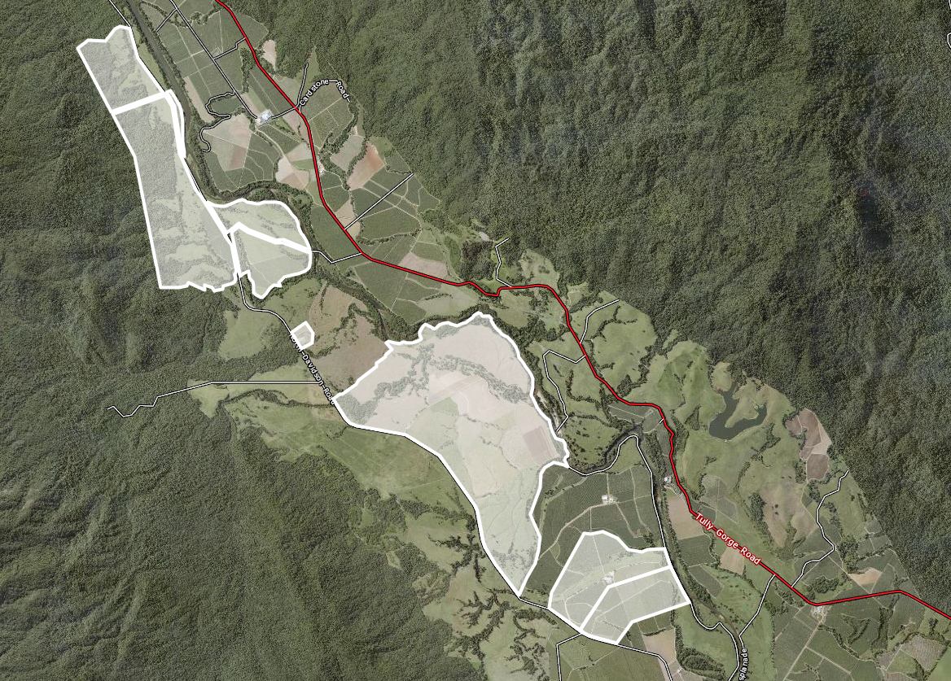

Panama = 1 Plant
Notices = 6 Lots

Slide 16
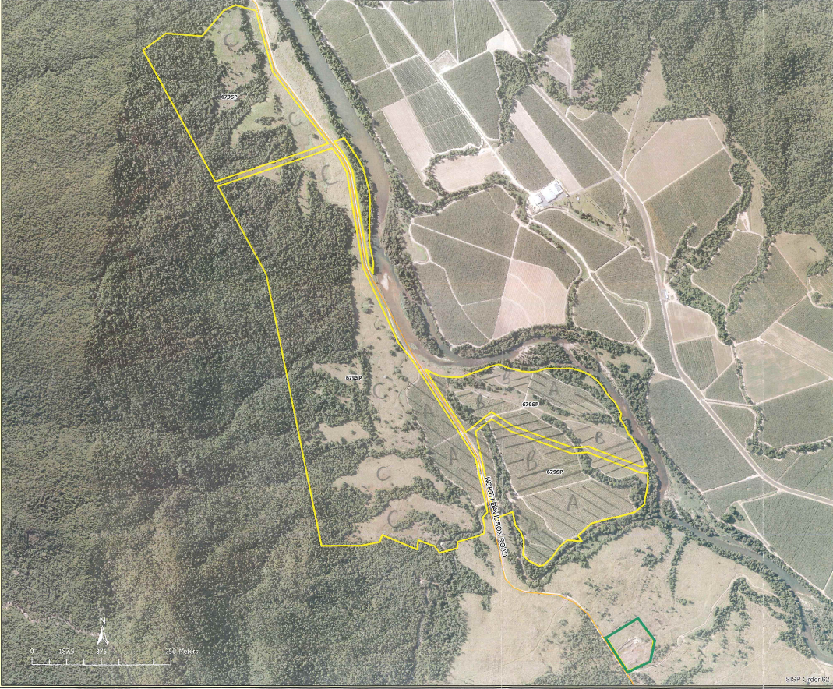
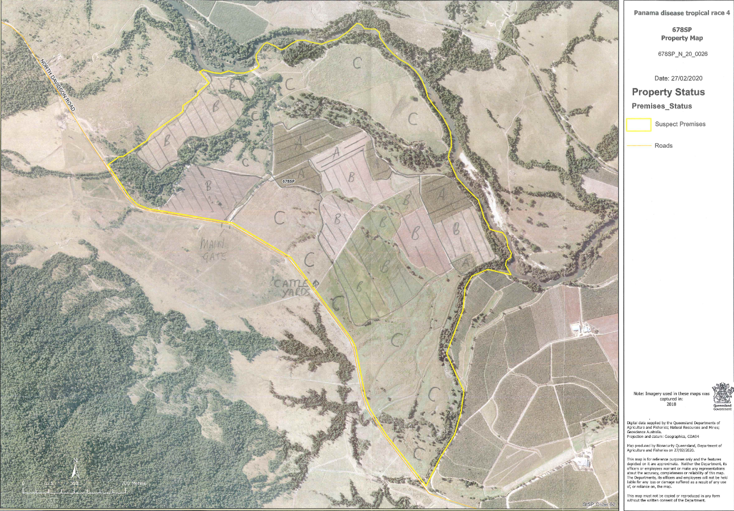
Traceability

Slide 17
Risk Based Decisions
The aim of risk-based decision making is to ensure that the steps to prevent or minimise the risk.
The steps you take may depend on:
the likelihood of the risk occurring (e.g. more action for a higher likelihood)
how serious the adverse impact could be (e.g. human deaths or extensive productivity loss)
what you know, or should reasonably be expected to know about the risk (e.g. how dangerous it is and how it is spread)
how to minimise the risk, including equipment and work practices
how effective a particular action would be in minimising the risk
feasibility and expense (e.g. is the cost proportionate to the risk)

Slide 18
The Precautionary Principle
“including in risk-based decision-making under this Act the principle that lack of full scientific certainty should not be used as a reason to postpone taking action to prevent a biosecurity event or to postpone a response to a biosecurity risk”
Biosecurity Act 2014

Slide 19
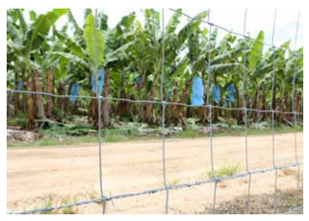
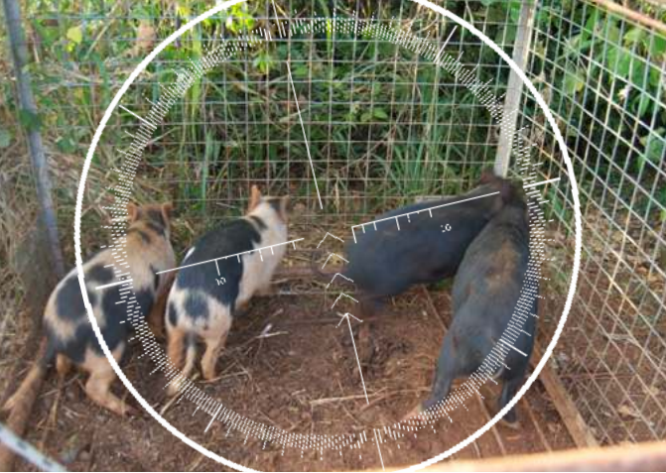
Minimise Risk

Slide 20
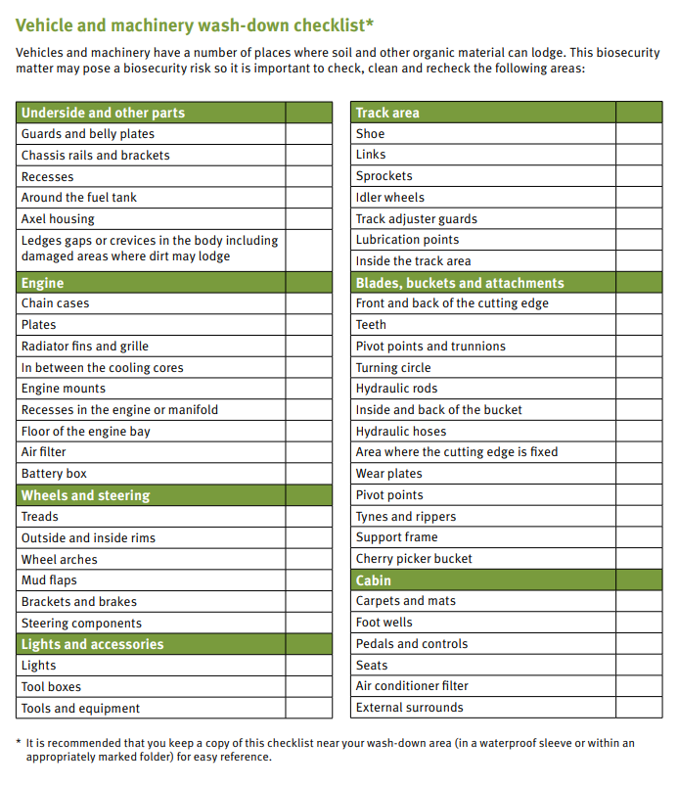
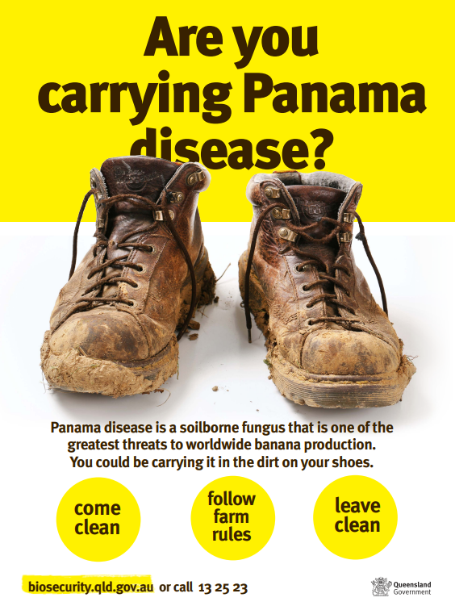

Slide 21
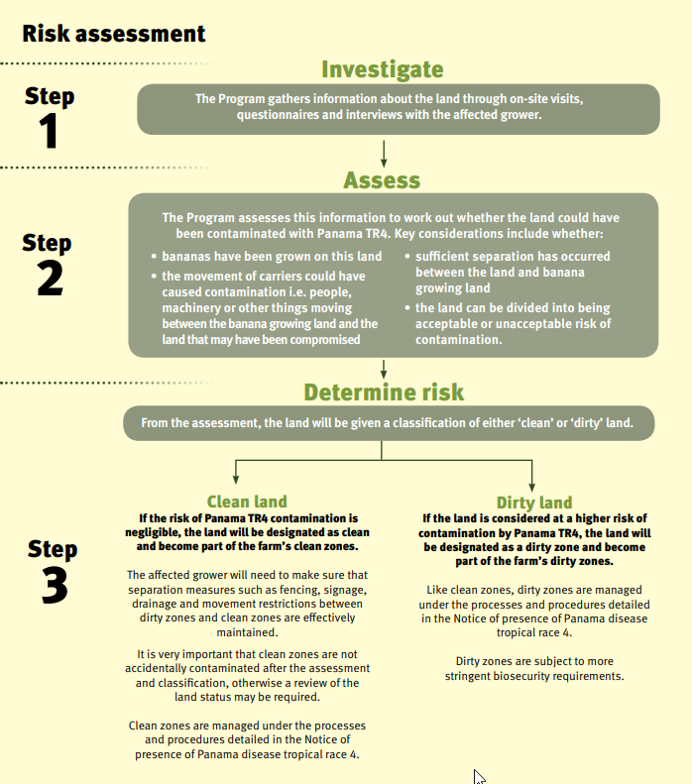
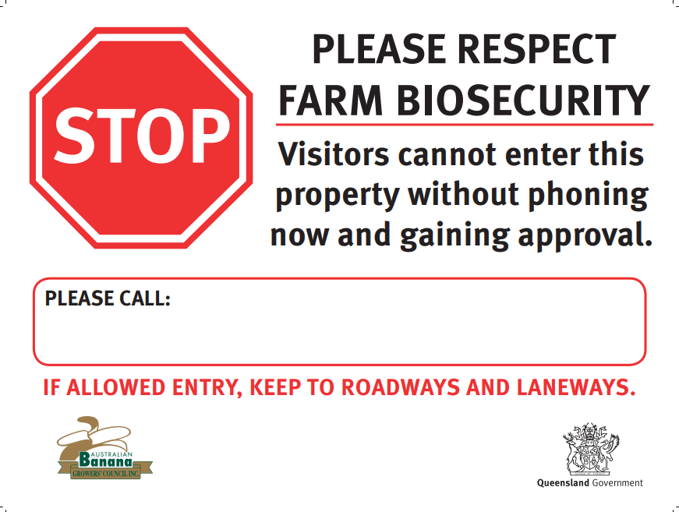

Slide 22
Defence of Due Diligence
In a proceeding for an offence against the general biosecurity obligation offence provision, it is a defence for a person to prove that the person took all reasonable precautions and exercised proper diligence to prevent the commission of the offence by the person or by another person under the person’s control.
Biosecurity Act 2014

Slide 23
Disclosure and Due Diligence
Ongoing disclosure to banks and financiers
Sale and Purchase Contract:
  Due Diligence Special Conditions
  Special condition recommended by QLS: requiring the purchaser to sign the ‘Permission to Release Property Information’ form (which could be annexed to the contract) contemporaneously with signing the contract
Leases
  Biosecurity clause
  Onus on both landlord and tenant

Slide 24
Principals: Ross Mangano and Leah Mangano
1 Still Street, Tully QLD 4854
Ph: 07 4068 3177
Fax: 07 4068 3180
Email: oﬃce@rossmanganosolicitors.com.au
Areas of Practice:
Property Law
Agribusiness
Commercial Law
Wills and Estate Administration
Court Matters

