Slide 1

Federal Court in the Tropics
The Hon Justice Derrington

Slide 2
National Practice Areas (NPAs)
  Administrative and Constitutional Law and Human Rights;
  Admiralty and Maritime;
  Commercial and Corporations;
  Employment and Industrial Relations;
  Federal Crime and Related Proceedings;
  Intellectual Property;
  Native Title;
  Taxation;
  Other Federal Jurisdiction.

Slide 3
Sub-areas of the Commercial and Corporations NPA
  Commercial Contracts, Banking, Finance and Insurance;
  Corporations and Corporate Insolvency;
  General and Personal Insolvency;
  Regulator and Consumer Protection;
  Economic Regulator, Competition and Access;
  Commercial Arbitration.

Slide 4
Sub-areas of the Intellectual Property NPA
  Patents and Associated Statutes;
  Trade Marks;
  Copyright and Industrial Design.

Slide 5
Sub-areas of “Other Federal Jurisdiction” NPA
Negligence (particularly in relation to off-shore or environmental matters);
Civil Aviation;
Federal election related disputes;
Defamation.

Slide 6
Involuntary and voluntary use of the Federal Court
Involuntary:
  Your client is a respondent / defendant to an action commenced in the Federal Court;
  The matter in question is within the Court’s exclusive jurisdiction.
Voluntary:
  A choice to use the Federal Court for a matter that may also be litigated in the Supreme Court.

Slide 7
The Federal Court’s Jurisdiction
“The very mention of ‘federal jurisdiction’ is enough to strike terror in the hearts and minds of Australian lawyers who do not fully understand its arcane mysteries. The expression conjures up images of constitutional train-wrecks, of which Momcilovic v The Queen is a spectacular example.”
Sir Anthony Mason

Slide 8
Section 39B(1A)(c) of the Judiciary Act
39B Original jurisdiction of Federal Court of Australia
Scope of original jurisdiction
...
(1A) The original jurisdiction of the Federal Court of Australia also includes jurisdiction in any matter:
(a) in which the Commonwealth is seeking an injunction or a declaration; or
(b) arising under the Constitution, or involving its interpretation; or
(c) arising under any laws made by the Parliament, other than a matter in respect of which a criminal prosecution is instituted or any other criminal matter.
(emphasis added)

Slide 9
A matter … arising under any laws made by the Parliament
Any action involving the application of a federal law, whether as a claim or defence;
Any action where a right or duty in question owes its existence a federal law;
  Misleading or deceptive conduct, or other claims under the Australian Consumer Law or cognate legislation;
Any action arising from a controversy in respect of which a right under a federal law is raised.

Slide 10
LNC Industries Ltd v BMW (Australia) Ltd (1983) 151 CLR 575, 581
… A claim for damages for breach or for specific performance of a contract, or a claim for relief for breach of trust, is a claim for relief of a kind which is available under State law, but if the contract or trust is in respect of a right or property which is the creation of federal law, the claim arises under federal law. The subject matter of the contract or trust in such a case exists as a result of the federal law.

Slide 11
Desktop litigation
Save in relation to final hearings that require cross-examination, nearly all parts of Federal Court litigation can be conducted from a desktop computer, including:
Commencing the action;
Filing documents;
Attending case management hearings;
Attending interlocutory hearings.

Slide 12
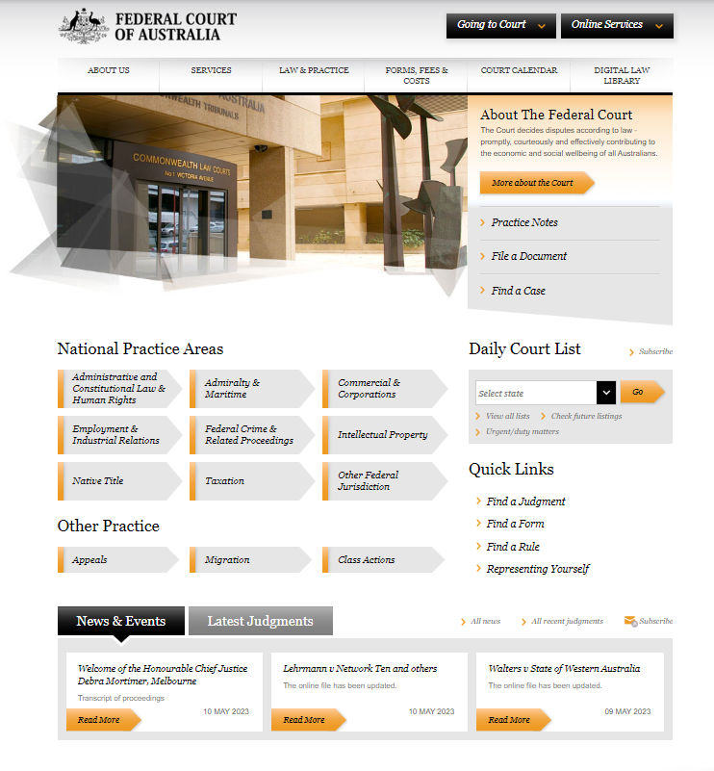
Federal Court website: www.fedcourt.gov.au

Slide 13
The Commonwealth Courts Portal
• Lodge court documents, including initiating and supporting documents, on new or existing files;
• Receive stamped, “service ready” documents;
• Monitor the progress of lodgements;
• View the history of lodgements;
• View your files with the Court;
• Filter files so as to show only what you are working on;

Slide 14
The Commonwealth Courts Portal
• View recent activity on files, including documents lodged by the parties;
• Set up notifications via email of activity on your files;
• View court diaries, events, orders, judgments and documents lodged in relation to specific files;
• Share access to the files with all persons involved in your litigation, including solicitors, barristers and others.

Slide 15
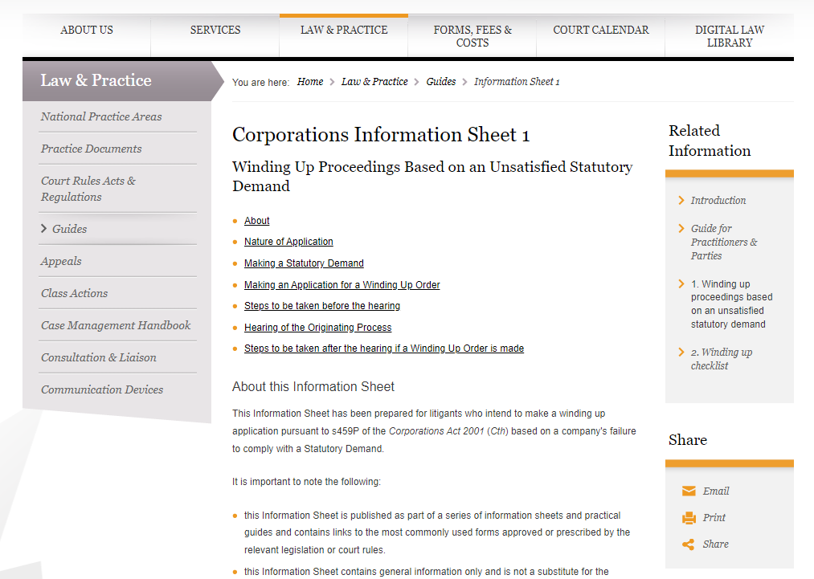
Winding up applications

Slide 16
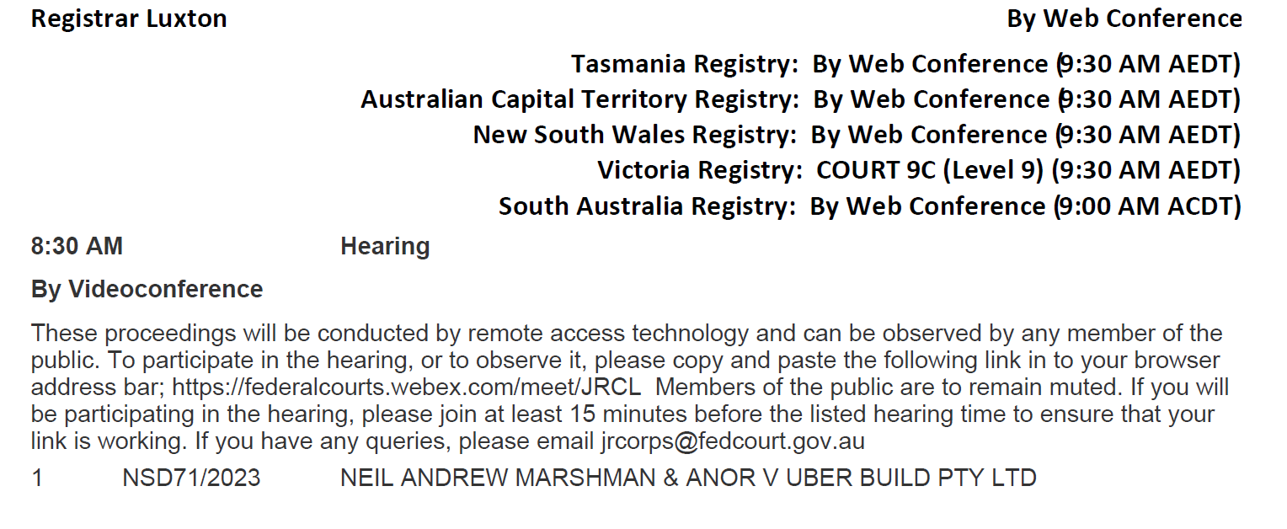
From the Daily Court List

Slide 17
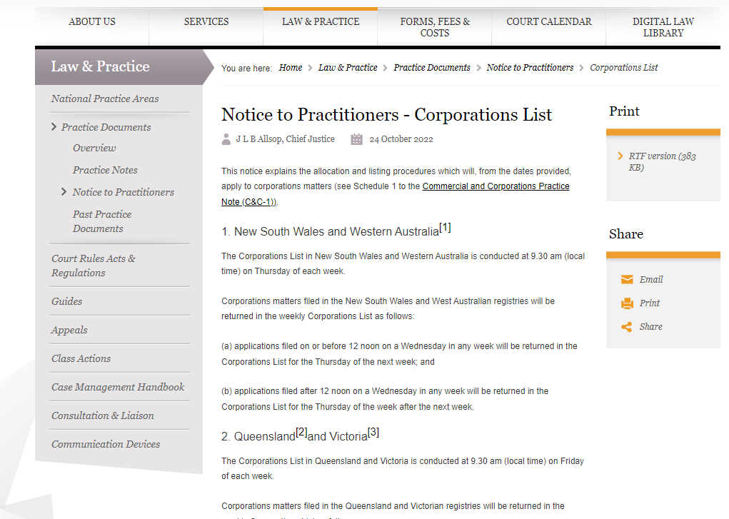
Corporations List information

Slide 18
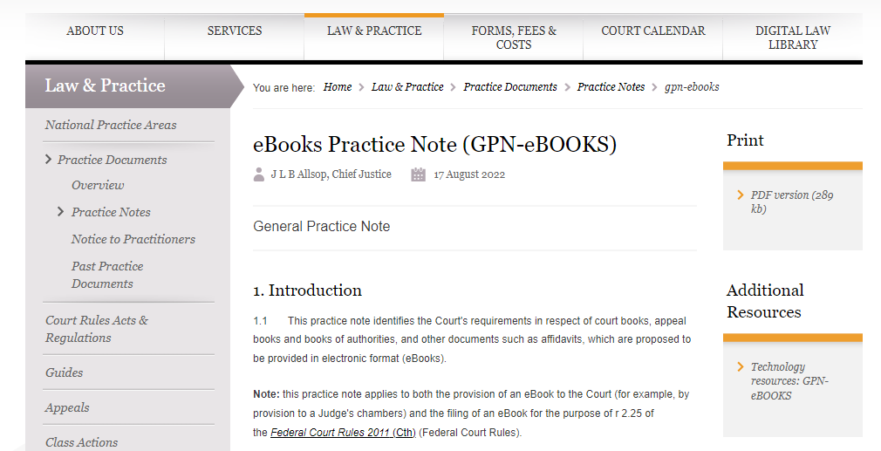

Slide 19
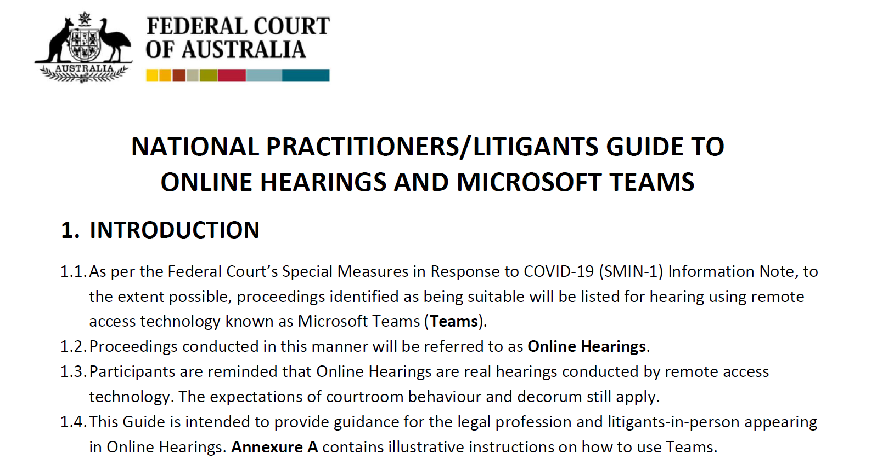

Slide 20
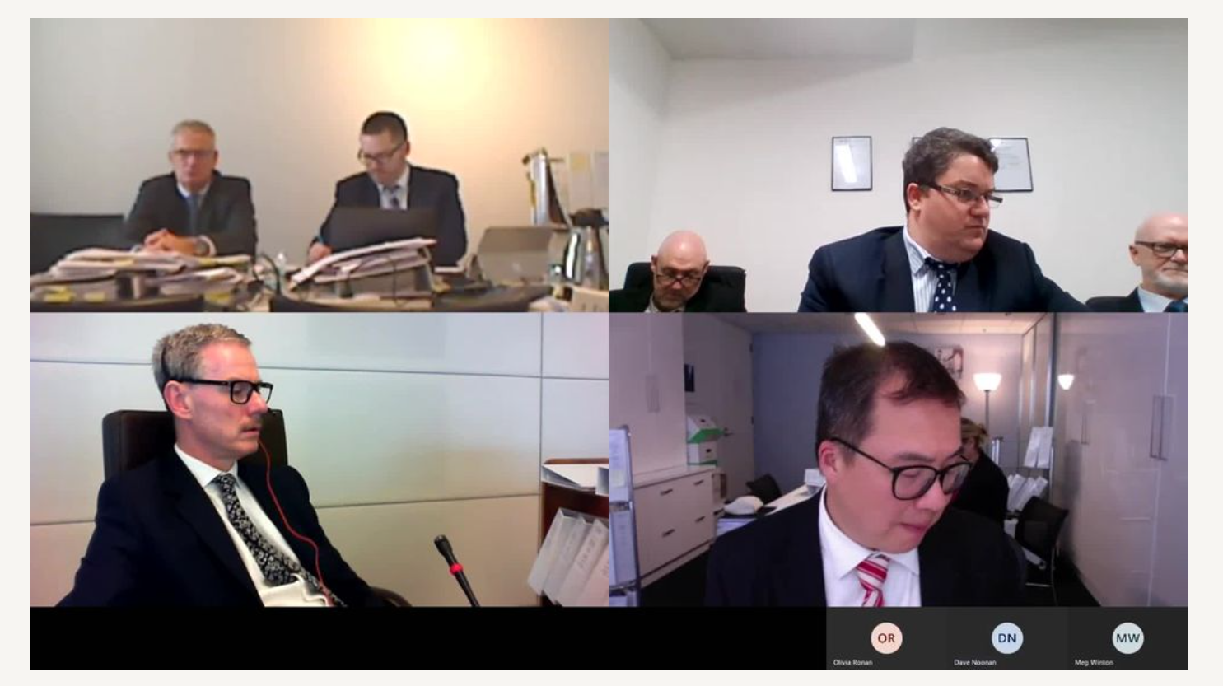
Example of an online hearing taking place

Slide 21
NATIONAL PRACTITIONERS/LITIGANTS GUIDE TO ONLINE HEARINGS AND MICROSOFT TEAMS
4.2. WHAT IS EXPECTED OF PARTICIPANTS
4.2.1. The same formal etiquette and protocol of a physical Court is expected in the Online Court.
4.2.2. The matter will be called and the Court will ask for appearances.
4.2.3. Judges are to be addressed as ‘Your Honour’, and registrars are to be addressed as ‘Registrar’.
4.2.4. Where a judge has elected to robe, counsel must also robe.
4.2.5. The Court may elect to dispense with any of the usual formalities, and the parties are expected to act accordingly.
4.2.6. Participants are to join an Online Hearing from a quiet, secure location.

Slide 22
NATIONAL PRACTITIONERS/LITIGANTS GUIDE TO ONLINE HEARINGS AND MICROSOFT TEAMS
4.2. WHAT IS EXPECTED OF PARTICIPANTS (continued)
4.2.7. Participants are expected to ensure that there is sufficient internet coverage in their location and all devices are fully charged.
4.2.8. Microphones and cameras are to be tested and working prior to joining an Online Hearing. This can be managed through the Teams Device Settings.
4.2.9. Other than practitioners/litigants-in-person appearing, all other participants are to keep their microphones muted and cameras turned off.

Slide 23
The End

